Slide 1
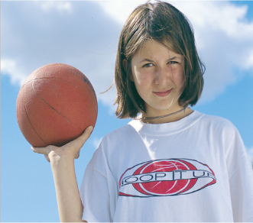
Unit 8 Lesson 44
Georgia Plays Basketball
WWW.PPT818.COM

Slide 2
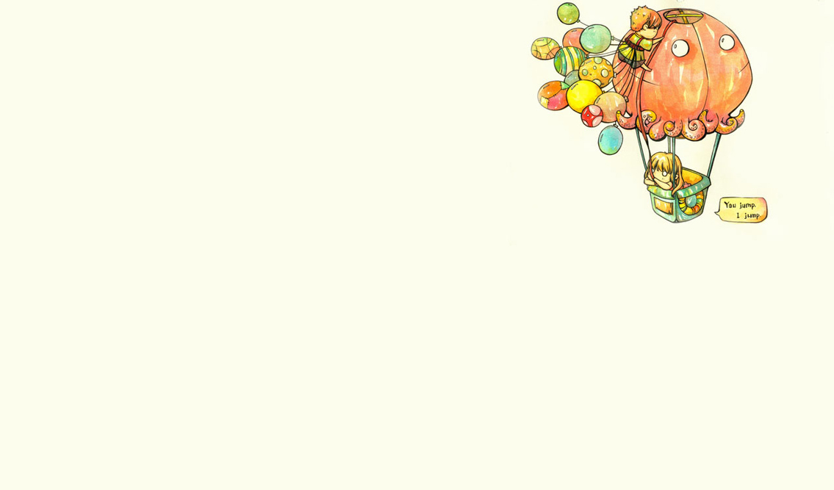
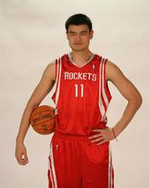
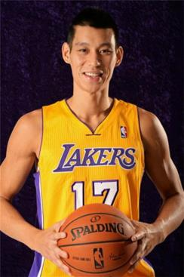
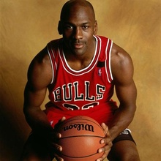
Think about it!
1. Do you enjoy playing basketball?
2. Can you think of any famous basketball players ?

Slide 3
Learning aims
1. 掌握单词: nobody, return, continue.
2. 重点短语: return to sp, continue doing sth, continue to do sth.
3. 能用英语简单介绍什么使得自己独特。

Slide 4
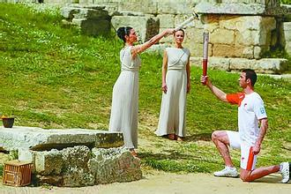
Greece希腊
Greek 希腊人，希腊（人）的

Slide 5
It’s a song named nobody

Slide 6
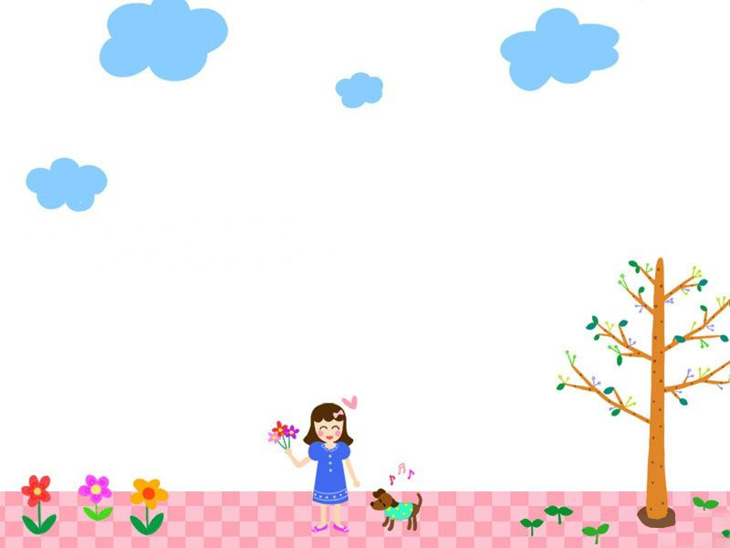
New Words
Georgia 乔治亚（人名）
return v.＆ n.返回；回应
junior adj. ＆n.初级（的）；儿童（的）
continue v.继续；延续

Slide 7
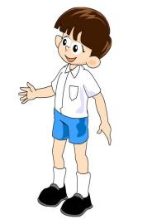
Read carefully and answer the questions:
1. What makes Georgia unique?
2. What’s her main talent?
3. What’s her sister?
4. How is Georgia’s basketball team?
5. What’s her ambition?
Nobody else in her school comes from Greece.
Basketball is her main talent.
She is a basketball player in Canada.
Her team is great.
She wants to play basketball in the Olympics.

Slide 8
Language points
My sister returned to Greece to play for the Greek National Basketball Team.
return相当于come/go back, “回；返回”。表示返回某地要用return to + 地方。
e.g. He has returned to Paris from London.
return还可表示 “归还；放回；送回” ，相当于give back ,用法为：return sb. sth. = return sth. to sb.
e.g. She returned me the book. = She returned the book to me.

Slide 9
Language points
I want to continue taking P.E.
continue doing sth.做一件事中断后再继 续做这件事
continue to do sth.做完一件再做别的
e.g.
1) After finishing my homework ,I continue to help my mother with housework. 2) After taking a rest, the students came back to continue studying.

Slide 10
Fill in the blanks with the correct forms of the given words.
Last year he _______(return) to China to play for the Chinese team.
Jack wants to continue ________(study) Chinese when he returns to Canada.
returned
studying

Slide 11
What makes him unique?
Jackie Chan
Hong Kong
a well-known actor
a great director
Kung Fu star
win so many prizes

Slide 12
What makes you unique?

Slide 13
Homework: Write something about yourself.
Introduce yourself. Write about your family, friends, hobbies and anything else you think is important.

Slide 14
Thanks for listening
Goodbye !

