Slide 1
Module4 Healthy food
Unit 1 We’ve got lots of apples.
WWW.PPT818.COM

Slide 2
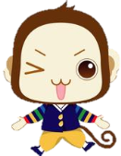
学习目标
一、通过图片展示，能够对食物进行正确的分类。
二、能够听懂有关食物和饮料的对话。
三、通过小组活动，制作购物单并用“have/has got…”句型谈论要购买什么食物。

Slide 3
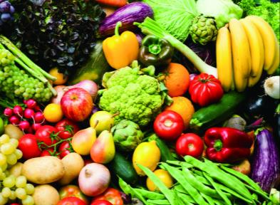
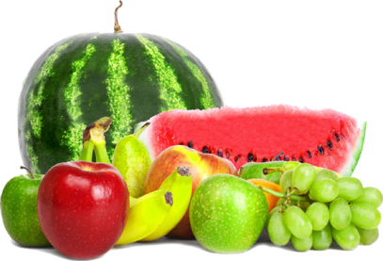
Ask and answer
What’s your favourite food?
vegetables
fruit

Slide 4



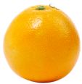


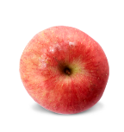
Let’s learn
banana
pear
orange
fruit
strawberry
lemon
apple

Slide 5
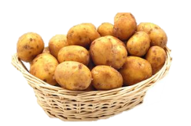
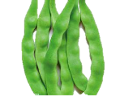
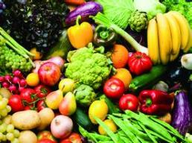
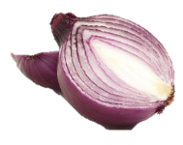
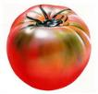
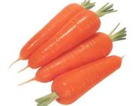
beans
potatoes
vegetables
onion
tomato
corrats

Slide 6
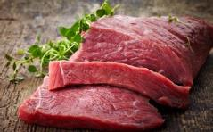
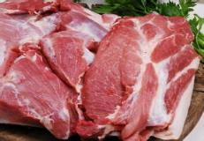
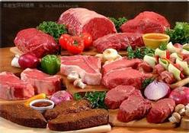
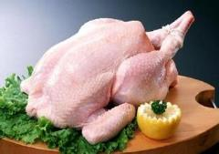
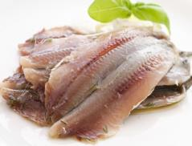
beef
pork
meat
chicken
fish

Slide 7

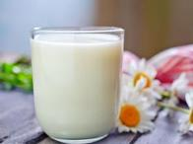
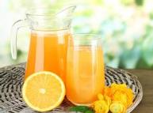
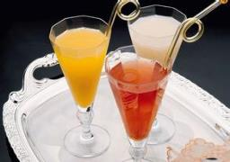

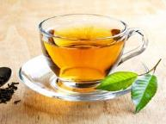

water
juice
milk
drink
coffee
tea
cola

Slide 8
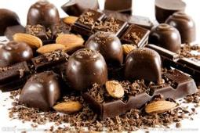
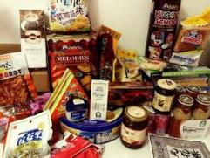
candy
chocolate

Slide 9
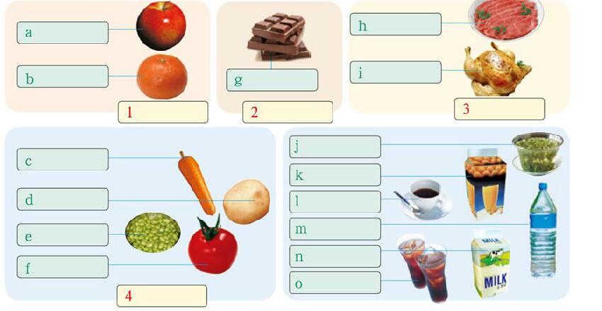
1 Label the food in the pictures.
apple
beef
orange
chicken
chocolate
tea
carrot
juice
potato
coffee
water
beans
milk
tomato
cola

Slide 10
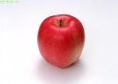


Put apple, bean, beef, carrot, chicken, chocolate, coffee, cola,
juice, milk, orange, potato, tea, tomato, water in different boxes.
food
drink
fruit
vegetables
meat
candy
tea
juice
carrot
apple
beef
chocolate
coffee
potato
water
orange
chicken
beans
milk
tomato
cola

Slide 11
4 Listen and check (√)the food and drink Betty and her mother have got.
apples juice
beans milk
beef oranges
carrots potatoes
chicken tea
coffee tomatoes
cola water

Slide 12
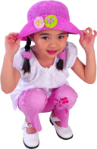


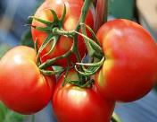
Ask and answer
What has Betty got?
Betty has got…, but she hasn’t got… .

Slide 13
Answer the questions
What does Tony want to buy?
2. What is bad for Tony’s health?
3. What have they got for Tony’s mum?
Chocolate, apples and cola.
His dad thinks too much chocolate and cola are
bad for his health.
They have got some coffee for her.

Slide 14
Read and complete the table.
 | Things Tony’s family has got at home | Things Tony’s family hasn’t got at home
Food
Drink
apples, chocolate
meat, chicken, oranges
orange juice, coffee cola, tea
Talk about Tony’s shopping.
—Has Tony got any chicken?
— No, he hasn’t . He has got….

Slide 15
Fill in the blanks
Tony and Tony’s dad go shopping for food and drink. They haven’t got any ______.
They get some ________. They have got some _________ and ______. They haven’t got any _______. They have got some ____________. They have got some _________ for Mum. They haven’t got any _______. ______ is bad for Tony, so they have got some ____.
meat
chicken
chocolate
apples
oranges
orange juice
coffee
cola
Cola
tea

Slide 16
Group work
Tomorrow is Sunday. Your friend Tom is coming to your home for dinner. But there isn’t too much food and drink at home. Your family will go shopping for food and drink. Please make a shopping list and then make a dialogue between you and your father or mother (A-father or mother B-you).
A: …, let’s go shopping for food and drink. Now, we haven’t got any…. Let’s get some….
B: OK. Have we got any…?
A:No,we haven’t. We have got some…
B: Have we got any…?
A: ….

Slide 17
Pronunciation and speaking
7 Listen and repeat.
/s/ drinks
/z/ apples potatoes vegetables
/t/ tea tomato water
/d/ bad food idea
双唇微微张开，舌端靠近上齿龈，舌头自然放松，气流从齿间送出，声带不振动。
发音和/s/相似，但声带振动。
舌端抵上齿龈，憋住气，然后弹开舌头，让气流从口腔中喷出，但声带不振动。
发音和/t/相似，但声带振动。

Slide 18
8. Listen and choose /s/ or /z/.
1 apples
2 beans
3 drinks
4 potatoes
/s/ __________________________
/z/ __________________________

Slide 19
Homework
1. Read the dialogue in Activity 5 fluently.
2. Make a new dialogue about going shopping with your family using the sentence patterns “Have we got any…?/We have got some…”.

