Slide 1
Unit 10
I’d like some noodles.
R 七年级下册
第3课时
WWW.PPT818.COM

Slide 2
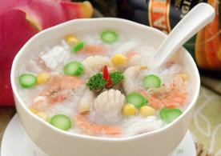
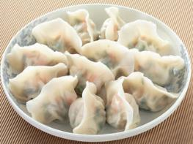
Lead-in
porridge
n. 粥；面糊
dumplings
n. 饺子

Slide 3
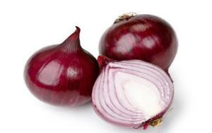
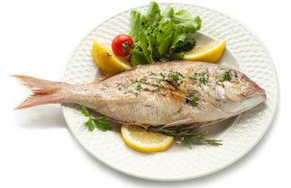
onion
n. 洋葱
fish
n. 鱼；鱼肉

Slide 4
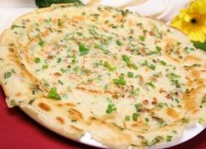
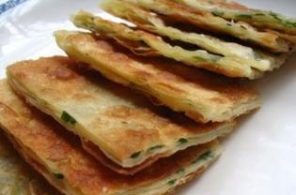
pancake
n. 烙饼；薄饼

Slide 5
green tea
n. 绿茶
orange juice
n. 橙汁；橘汁

Slide 6
What would you like?
I’d like a cup of green tea / a bottle of orange juice…

Slide 7
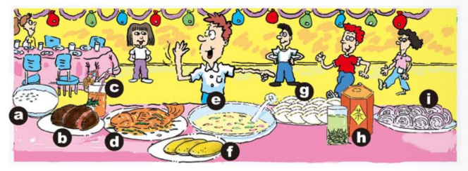
1a
Match the words with the pictures.
1. ____ meat 2. ____ dumplings
3. ____ porridge 4. ____ green tea
b
g
a
h

Slide 8
c
e
5. ___ orange juice 6. ____ soup
7. ___ onions 8. ____ fish
9. ___ pancakes
i
d
f

Slide 9
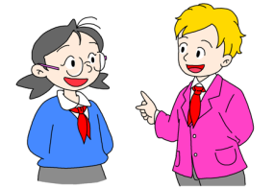
Circle the things you like in 1a. Put an ×
next to the things you don’t like. Then tell
your partner what you like and don’t like.
1b
I like dumplings
fish and orange
juice.
I don’t like onions, green tea or porridge.

Slide 10
I like dumplings and soup. But I don’t like meat.
Really? I like fish, porridge and pancakes. But I don’t like onions.

Slide 11
1c
Listen and complete the food order form.
ORDER FORM
Address: 15th North Street
Telephone number: ___________
Order:
398-2845

Slide 12
Dishes: _______, fish, _________
Dumplings: 12 beef and ____________________
Soup: one _____________
Drinks: one large _________ and _____
small ________ juices.
chicken
cabbage
carrot dumplings
tomato soup
green tea
two
orange

Slide 13
1d
Listen again. Check your answers in 1c.
A: Hello, House of Dumplings.
B: Hello! I want to order some food, please.
A: Sure.
B: I’d like chicken, fish and cabbage, please.
A: Uh-huh.
B: And twelve dumplings.

Slide 14
A: What kind of dumplings would you like?
B: Beef and carrot dumplings, please.
A: OK. What else?
B: Umm … I’d like some soup, too.
A: OK. What kind of soup would you like?
B: Tomato soup.
A: OK. One tomato soup then. Would you like any
drinks?

Slide 15
B: One large green tea and two small orange juices.
A: OK. What’s your address, please?
B: 15 North Street.
A: And what’s your telephone number?
B: 398-2845.
A: 398-2845?
B: Yup.
A: Thank you. That’ll be 65 yuan.

Slide 16
Language points
1. I like dumplings, fish and orange juice.
fish在此处作“鱼肉”讲，为不可数名词，没有复数形式。
当fish意为“鱼，鱼类”时，为可数名词，指“鱼的条数”时复数形式仍为fish；指“鱼的种类”时其复数形式为fishes。
例句：They often eat vegetables and fish.
他们经常吃蔬菜和鱼。

Slide 17
2. I don’t like onions, green tea or porridge.
此处 or 作并列连词，意为“或者，和”，用于否定句或疑问句中，肯定句中用and。
例句：
I don’t like tea or juice. 我不喜欢茶和果汁。
I like milk, coffee and porridge. 我喜欢牛奶，咖啡和粥。

Slide 18
拓展：or 的用法
（1）or 用在选择疑问句中，意为“或；还是”。
例：—Is your brother tall or short? 你弟弟个子高还是矮？
—He is tall. 他个子高。
（2）or 用于否定词后，意为“也不” 。
例：He never smokes or drinks.他从不抽烟，也不喝酒。

Slide 19
（3）or 用于肯定句，表示“或者，还是，或是”。
例：She or I have to do the work.
她或者是我必须来做这项工作。
（4）or 置于祈使句之后时，表示“否则，不然的话”。
例：Take a taxi，or you won’t get there in time.
乘出租车吧，否则你将不会及时到达那里。

Slide 20
Exercise
单项选择。
1. I don’t like onions, green tea ____ porridge.
A. and B. or C. with D. in
2. —Do you like beef noodles ____ mutton dumplings?
—I’d like ____ mutton dumplings.
A. and; some B. and; any
C. or; some D. or; any
B
C

Slide 21
3. —Would you like to go out to play football with me?
— _____, but I should finish my homework first.
A. Yes, I do B. I like
C. Of course not D. I’d love to
4. —Would you like _____ noodles?
—Yes, I like_____.
A. tomatoes; some B. tomatoes; any
C. tomato; any D. tomato; some
D
D

Slide 22
5. He doesn’t know you _____ me.
A. and B. or C. but
6. Would you like _____ beef?
A. some B. any C. a
7. There is not water _____ not air there.
A. and B. or C. but
B
A
B

Slide 23
8. Don’t run in the classroom, ____ you may hurt yourself.
A. and B. or C. but D.so
B
9. Tim would like _________ bowl of porridge.
A. / B. an C. a D. the
C

