Slide 1
Unit 11 They’re lovely
WWW.PPT818.COM

Slide 2
Rhyme time
Cats are cute, cats are fun,
Cats are friends for everyone.
Please, Mum, Please, Mum,
Can I have one ?
OK, son, OK, son,
You can have the little white one.

Slide 3
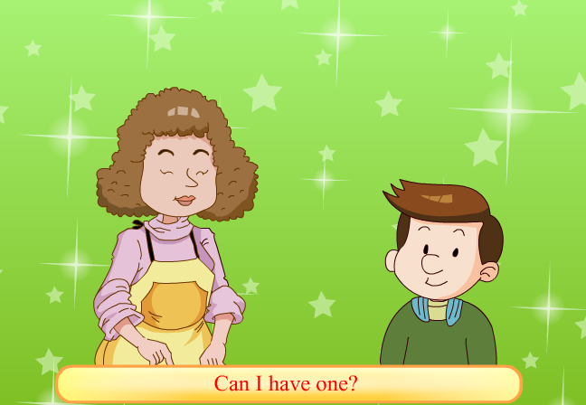

Slide 4
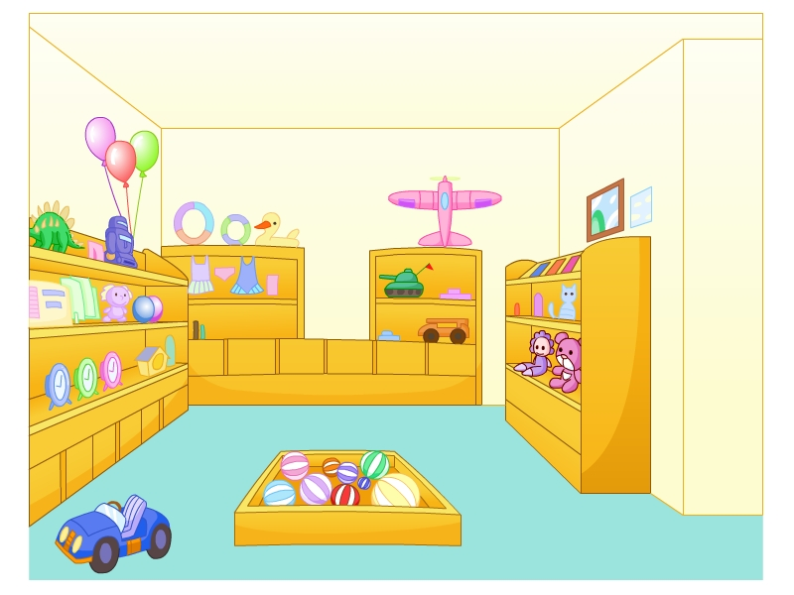
toy
shop

Slide 5
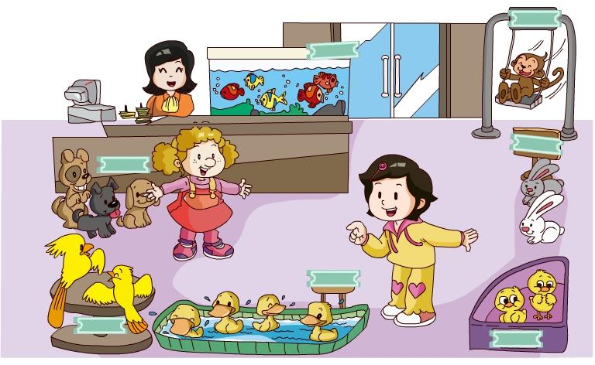
pet shop

Slide 6
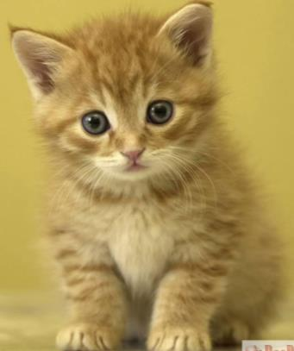
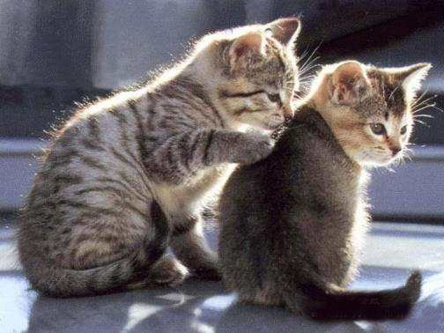
What’s that?
What are those?
a cat
cats

Slide 7
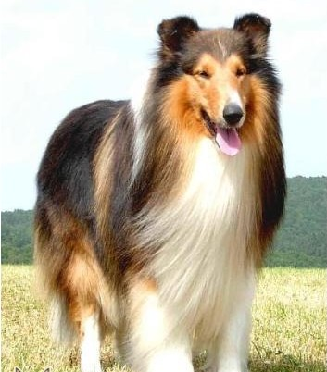
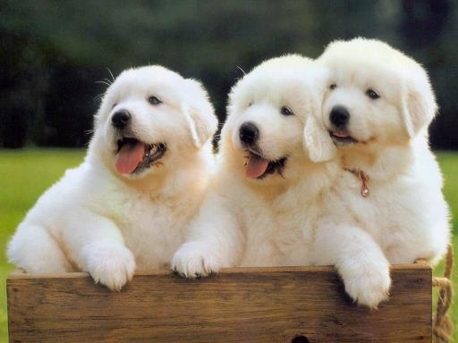
What’s that?
What are those?
a dog
dogs

Slide 8
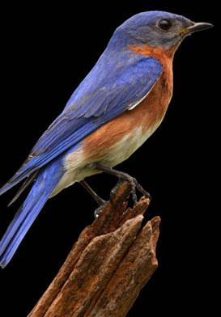
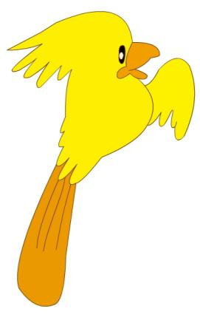
a bird
three birds

Slide 9
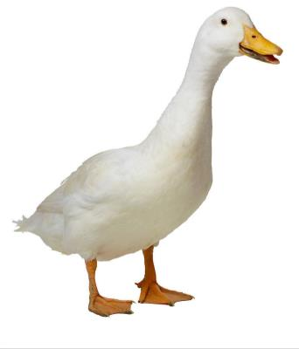
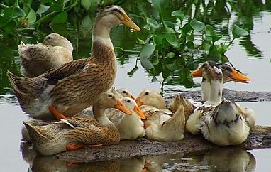
What’s that?
What are those?
a duck
ducks

Slide 10
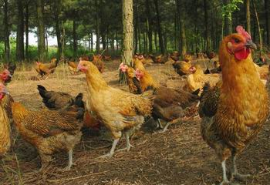
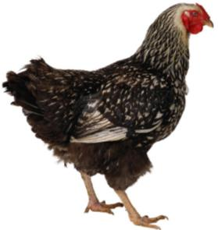
What’s that?
What are those?
a chicken
chickens

Slide 11
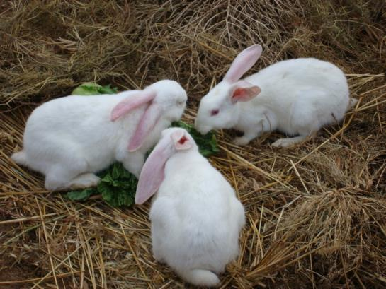
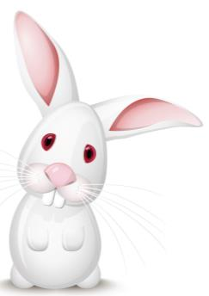
What’s that?
What are those?
a rabbit
rabbits

Slide 12
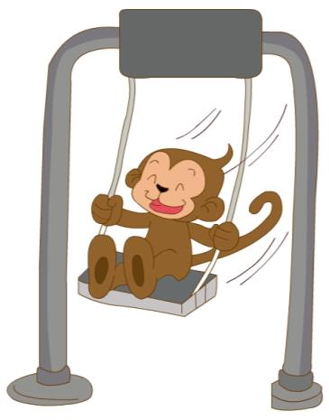
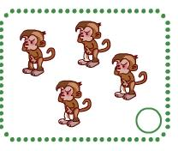
a monkey
four monkeys

Slide 13
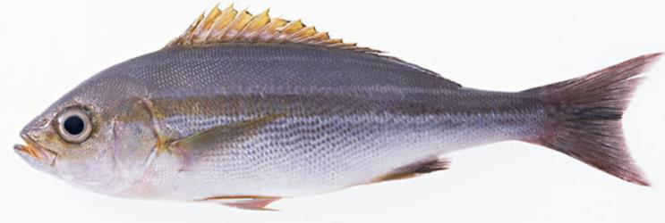
two
a fish

Slide 14
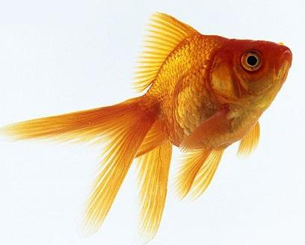
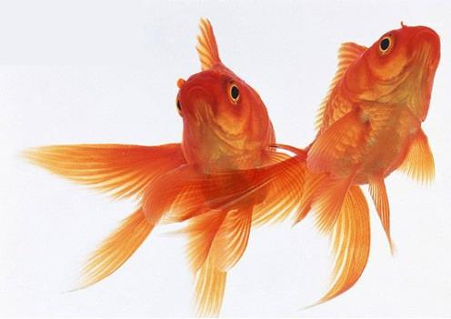
a goldfish
two goldfish

Slide 15
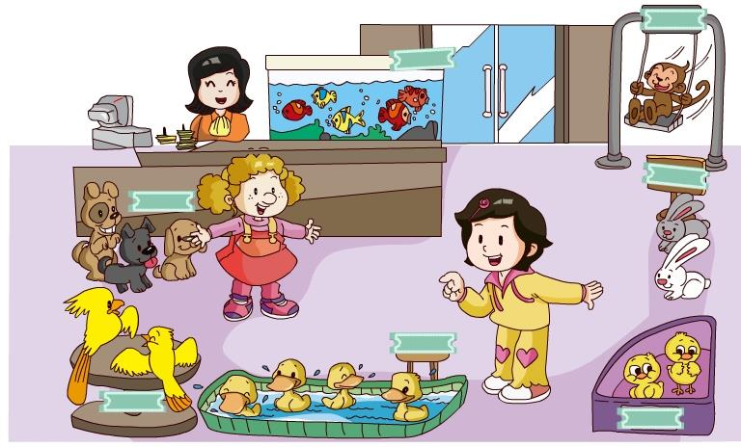
Let’s talk

Slide 16
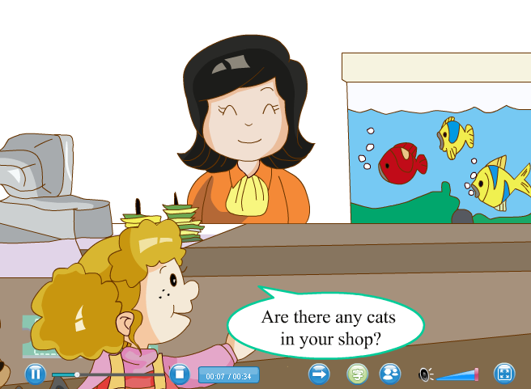

Slide 17
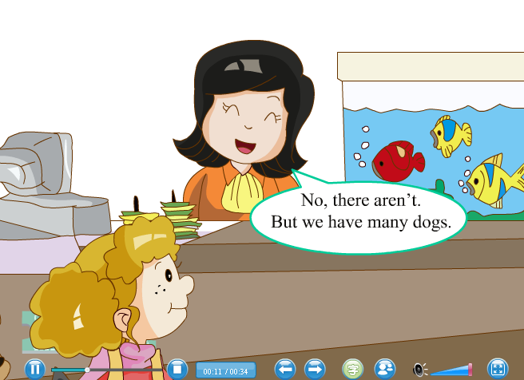

Slide 20
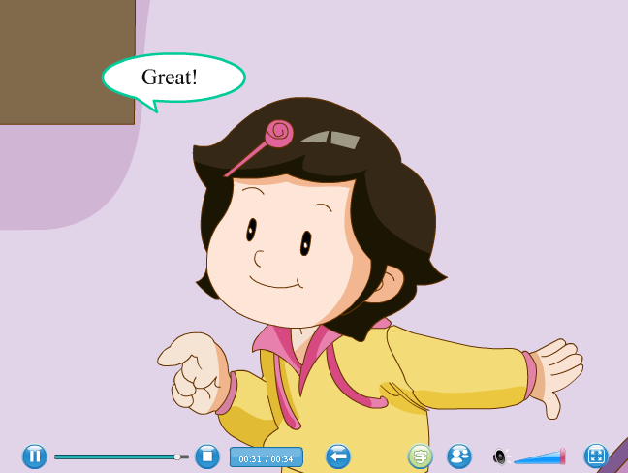

Slide 21
Is there a ……?
有用的句子
Yes , there is. 有
单数
No , there isn’t. 没有
Are there any ……s?
Yes , there are. 有
复数
No , there aren’t. 没有

Slide 22
have/has的用法
I
you
they
we
复数
he
she
it
单数
have
has

Slide 23
Homework 作业
1、完成书本P65 第4小题（做在书本上）。
2、完成书本P64第2小题，在练习本上回答这些问题。
3、读、背U11的课文和单词一次，明天校默U11第1-6个单词。

