Slide 1
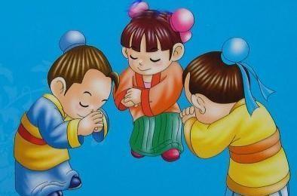
Unit 7
It's the polite thing to do
WWW.PPT818.COM

Slide 2
Look and Say
Do you still remember these signs?
What do they mean?
2023-01-16

Slide 3
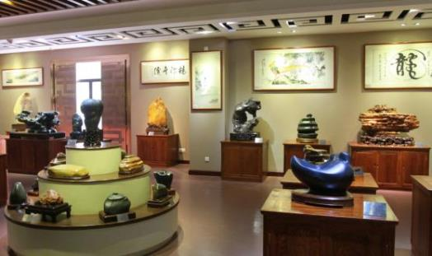
______________ in the museum.
Don't take photos
2023-01-16

Slide 4
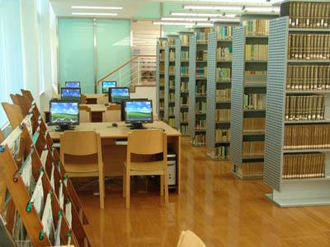
Be quiet
library
_______ in the ______.
2023-01-16

Slide 5
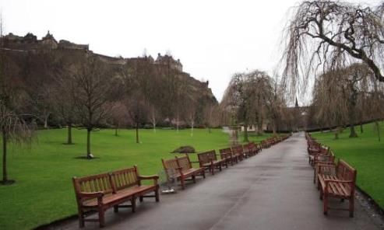
______________ in the _____.
Don't ride a bike
park
2023-01-16

Slide 6
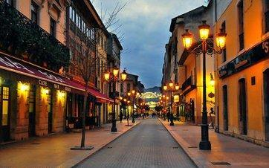
_________ here.
Don't park
2023-01-16

Slide 7
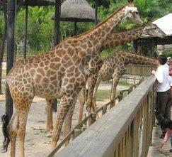
Don't feed the animals
________________ in the ___.
zoo
2023-01-16

Slide 8
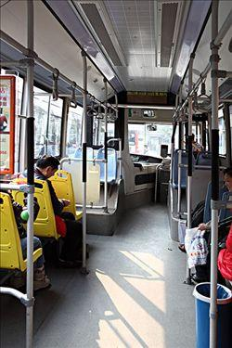
Don't eat and drink
________________ on the ___.
bus
2023-01-16

Slide 9
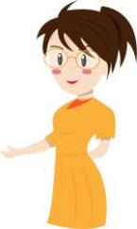
Don’t take photos in the museum.
Be quiet in the library.
Don't feed the animals in the zoo.
Don't eat and drink on the bus.
These are polite things to do.
These are good manners.

Slide 10
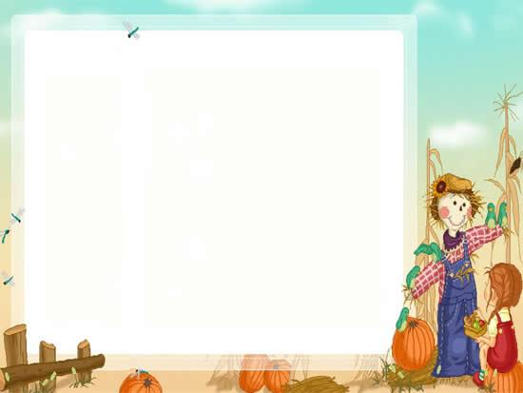
Let’s chant
Good children have good manners
Bad children have bad manners
Polite or impolite
Kind or unkind
Try to be polite
Try to be kind

Slide 11
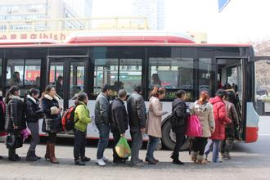
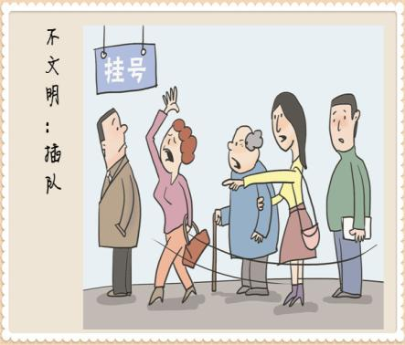
wait in line
push in

Slide 12
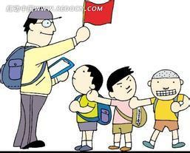
remember
People should always wait for their turn.
If the line is long, don’t push in.
Be patient.
should/don’t+V_{原}

Slide 13
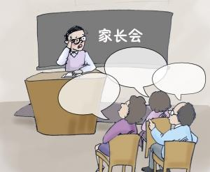
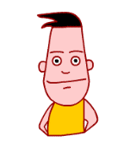
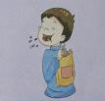
Some parents told me that some children did some impolite things.

Slide 14
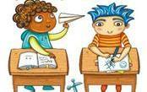
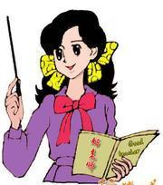
play in class
when the teacher is talking

Slide 15
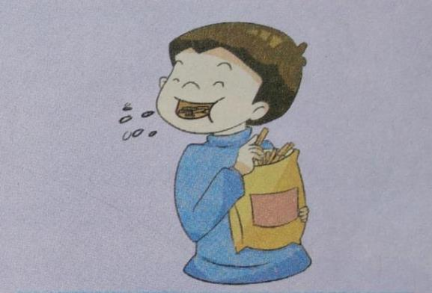
talk with your mouth full

Slide 16
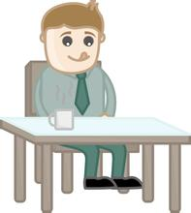
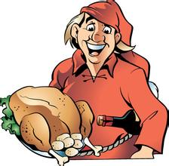
take all the food from the dish

Slide 17
laugh at another pupil

Slide 18
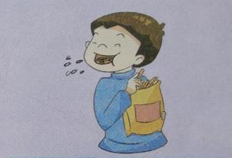
These are the impolite things to do.
Don’t play in class when the teacher is talking.
Don’t talk with your mouth full.
I’m sorry./
OK/All right.
Don’t take all the food from the dish.
Don’t laugh at another pupil.

Slide 19
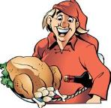
Jack
A: Look, Jack is playing in class when the teacher is talking.
B: Jack, don’t play in class when the teacher is talking.
be quiet
A: You/We should be quiet.
playing in class when the teacher is talking
Jack: I am sorry./OK/All right.
wait until you finish
share with others
be kind
talking with your mouth full
taking all the food from the dish
laughing at another pupil

Slide 20
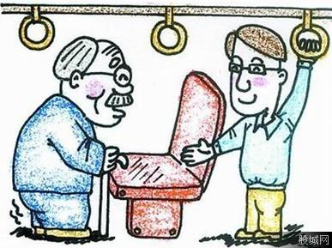
A: What will you do if you see
an old man standing on the bus?
B: If he does not have a seat,
I will give him my seat.

Slide 21
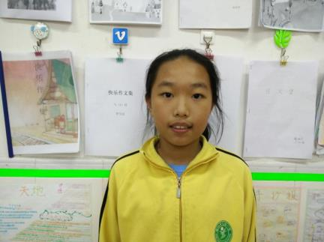
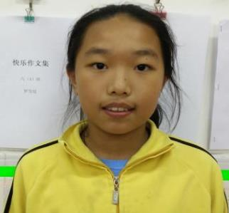
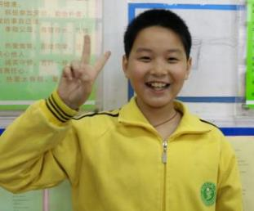
Who was polite? Why?
Yuki was polite. Because she stood up to give her seat to the old man.
How polite!
Yuki
(2) Who was impolite? Why?
Winter was impolite. Because when Yuki gave her seat to the old man, he quickly sat down.
How impolite!
Winter

Slide 22
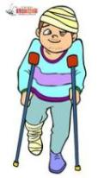
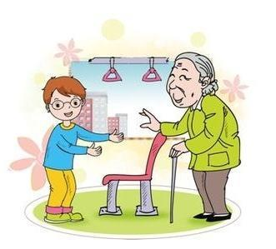
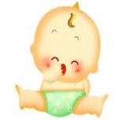
We should give our seat to people in need.
remember
It’s the polite thing to do.
要做有礼貌的事情

Slide 23
Let’s watch the video !
Was Jiamin polite or impolite?

Slide 24
Let’s write polite notice(温馨提示)
Notice in the school
We should save the water.
Be quiet.
Don't step on the grass.
Water is the source of life.
You should turn off the light if you leave.

Slide 25
Polite Notice
Notice in the public places.G1,4,7
Notice about protecting the environmentG2,5,8
Notice about the safetyG3,6,9
Don’t…
Be…
We should… …

Slide 26
Homework:
Read the dialogue three times after the VCD跟光碟读课文三遍。
2. 根据P39词条，用Don’t...和You should…写句子。

