Slide 1
Unit 3 Writing Home
Lesson 17 Danny’s Email
WWW.PPT818.COM

Slide 2
Warming up
Game 你做我猜
1
Come back home
2
Write to
3
Wear new coat
4
Say hi to

Slide 3
Leading in
Questions
How is the weather in Beijing and Canada?
When will Danny come back home?
What clothes is Steven wearing?

Slide 4
Presentation
听录音，做习题。
How is the weather in Beijing?
How does Danny like the people in Beijing?
When is Danny coming back home?
It is sunny.
People in Beijing are kind.
On February 8.

Slide 5
Presentation
完成连线题
Time for Danny to go home
Weather in Beijing
People in Beijing
On February 8
Sunny
Kind

Slide 6
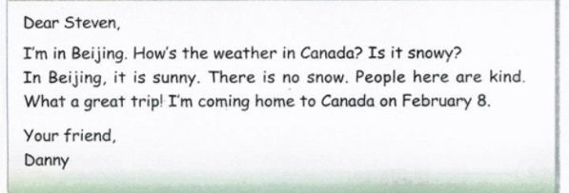
Presentation
了解Danny的电子邮件内容

Slide 7
Presentation
小组内讨论图片的内容
讨论过程中可使用这些词语哦！
Sunny
Weather
Kind
Snow

Slide 8
Presentation
Listen and repeat.

Slide 9
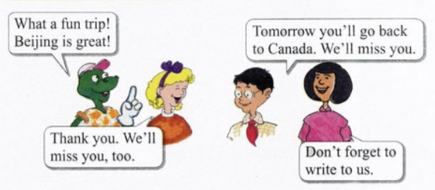
Consolidation and extension
回答问题
How does Danny like his trip?
What a fun trip.

Slide 10
Consolidation and extension
回答问题
When will they go back to Canada?
Tomorrow they will go back to Canada.

Slide 11
Summing up
重点句型:
forget to do…
remember to do…
be happy to do…
say hi to…

Slide 12
Evaluation
互评时间
内容 | 学生A | 学生B | 学生C | 学生D
积极发言
乐于合作
完成情况

Slide 13
Homework
完成Let’s do it!中的练习
用英语讲述今天所见的事情（使用课本句式）
参考答案：√ × √ × ×

Slide 14
Goodbye

