Slide 1
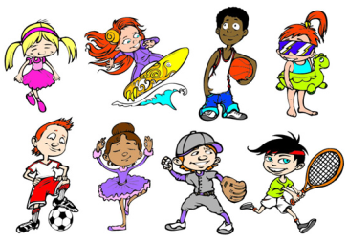
Unit4 What Do You Do on Saturday?
陕旅版
四年级下册
第一课时
WWW.PPT818.COM

Slide 2
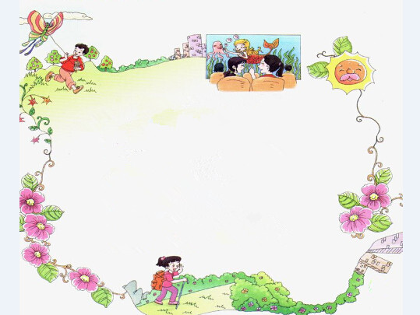

>>Warm-up
Let’s chant
What do you do, what do you do,
What do you do on Saturdays?
I fly, fly my kite.
What do you do, what do you do,
What do you do on Sundays?
I see, see, see films.
What do you do on the weekend?
I climb, climb, climb mountains.

Slide 3
>>Review
Play a game
cloud
snow
glasses
What’s missing?
rain
raincoat
sky
wind

Slide 4
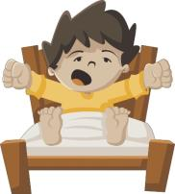
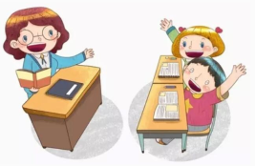
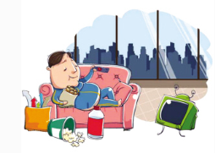
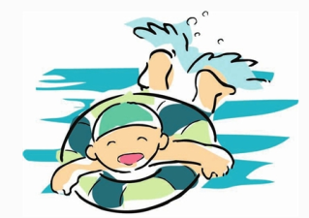
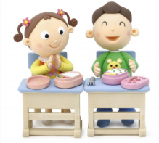
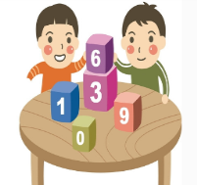
>>Review
I say you do
get up
have a class
watch TV
have lunch
play games
swim

Slide 5
>>Lead-in
Read and tick
What do you like to do after class?
sing
dance
swim
read
play basketball
listen to music
jump rope
draw pictures

Slide 6
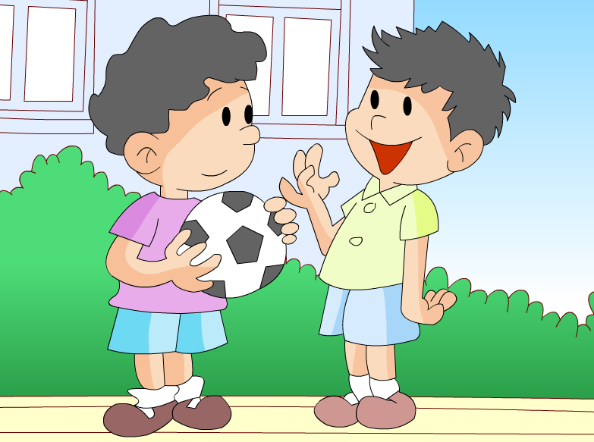

>>Lead-in

Slide 7
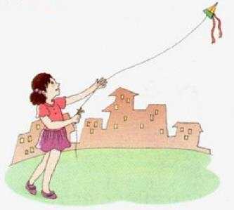

>>Presentation
Let’s learn
fly a kite
I like to fly a kite.

Slide 8
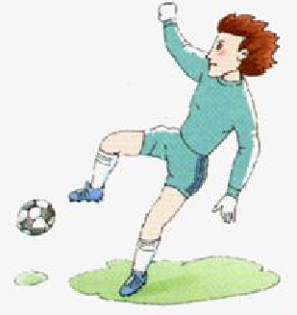
>>Presentation
Let’s learn
play football
He likes to play football.

Slide 9

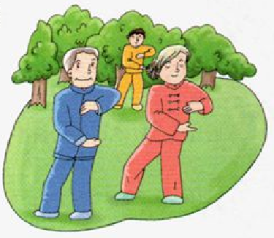
>>Presentation
Let’s learn
What are they doing?
They are doing exercise.
do exercise

Slide 10
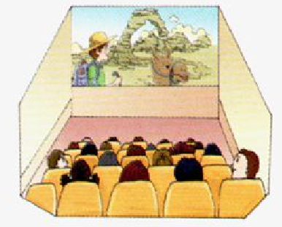
>>Presentation
Let’s learn
Do you like to see a film?
Yes, I do.
see a film

Slide 11
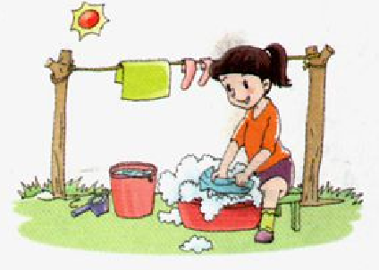
>>Presentation
Let’s learn
What does she doing?
She is doing some washing.
She is washing some clothes.
do some washing

Slide 12
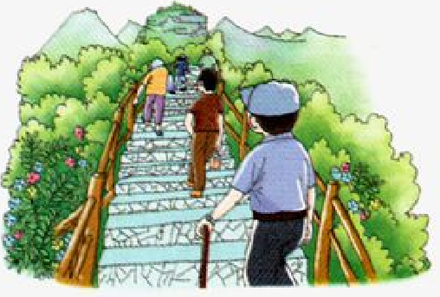
>>Presentation
Let’s learn
What do you often do on the weekend?
I often climb the mountain.
climb the mountain

Slide 13
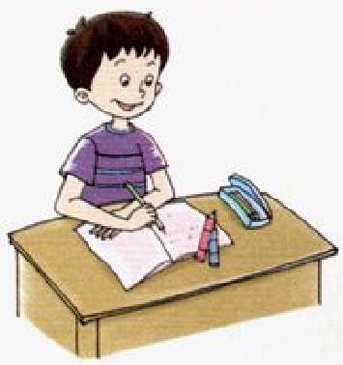
>>Presentation
Let’s learn
What does he doing?
He is doing his homework.
do his homework

Slide 14

>>Practice
Magic fingers
fly a kite play football do exercise see a film do some washing
climb the mountain do his homework

Slide 15

Quick response
play football
fly a kite
do exercise
do some washing
see a film
climb the mountain
do his homework

Slide 16

>>Summary
本课所学的重点单词：
fly a kite play football do exercise
see a film do some washing
climb the mountain do his homework

Slide 17
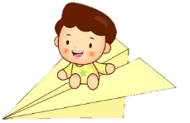

>>Homework
1.听课文录音并跟读，按照正确的语音、语调朗读并表演课文对话。
2.同伴之间互相提问本节课所学的新单词，并默写一遍。
3.预习 Unit4 A Let’s talk。
close

