Slide 1
Unit 6 Christmas
What do you usually do at Christmas?
WWW.PPT818.COM

Slide 2
We Wish You A Merry Christmas.
We wish you a Merry Christmas.
We wish you a Merry Christmas.
We wish you a Merry Christmas,
and a happy new year!
Good tidings to you,
wherever you are.
Good tidings for Christmas,
and a happy new year!

Slide 6
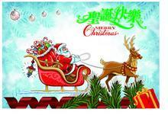
Christmas is coming.

Slide 7
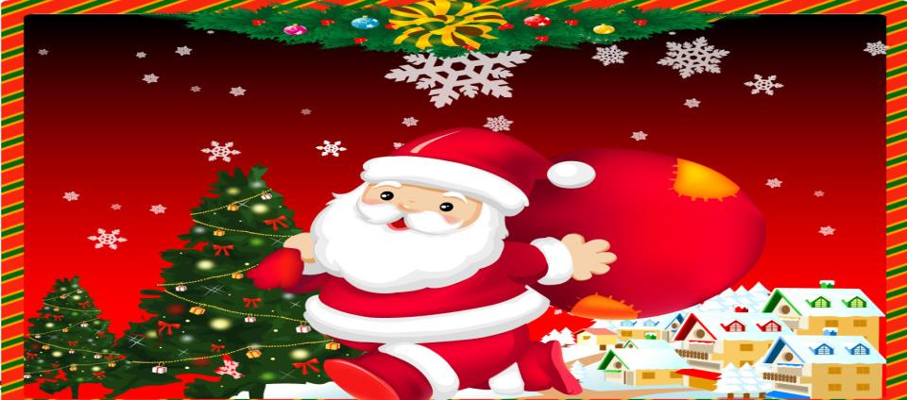
Snata

Slide 8
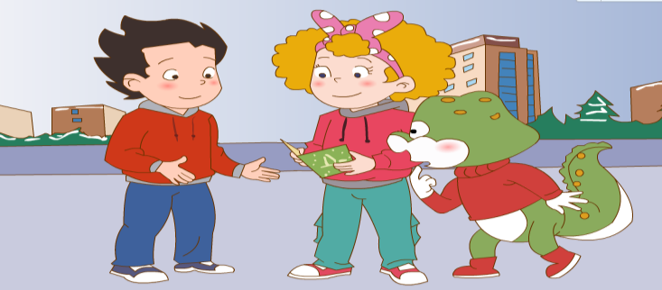
Jenny: Here’s a _______ card from Lucy.
Li Ming: Oh, ________ is coming.
Danny: When is Christmas Day?
Jenny: It’s _________ 25.

Slide 9
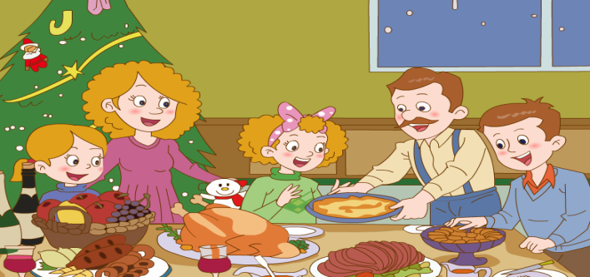
Li Ming: What do you usually do at Christmas?
Jenny: The family get ______. We have a big dinner. We sing Christmas songs.

Slide 10
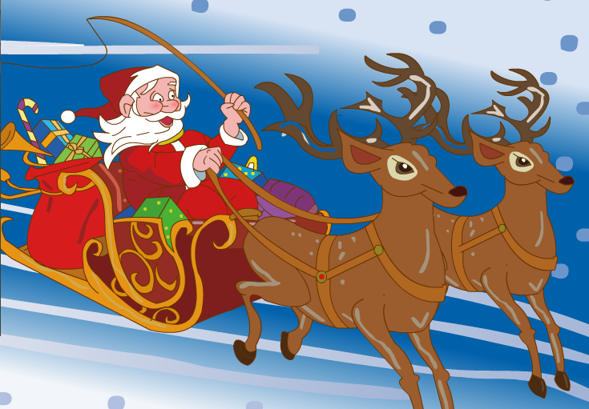
Li Ming: Do you get presents?
Jenny: Yes. We get presents from _____. He _____ toys in his ______.
Li Ming: Sack?
Jenny: Yes. It’s a big _____.

Slide 11
一、Choose the right answer.
1. ( ) What ___ you usually do at Christmas?
A. does B. do
2. ( )-----When is Christmas Day?
-----It’s ____.
A. December 25 B. December 24
3. ( ) We have a ___ dinner.
A. small B. big
4. He ____ toys in his sack.
A. bring B. brings

Slide 12
二、Look and write.
If you are Jenny:
What do you usually do at Christmas?
get together
The family _____________.
have a big dinner
We_______________________________________.
sing Christmas songs
We______________________________________.

Slide 13
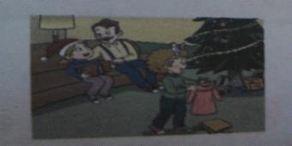
We_______________from Santa.
get presents

Slide 14
Homework:
1. Read the text.
2. 利用今天所学询问身边的朋友在圣诞节
都进行哪些活动。

Slide 15
Thank You

