Slide 1
Unit 3 The Internet
Section Ⅰ Listening and Speaking
WWW.PPT818.COM

Slide 2
主题语境——人与社会之互联网
【语境概说】
本单元的话题内容是“互联网”，属于“人与社会”主题语境下的“科学与技术”。本单元的主要内容包括互联网发展与信息技术创新，网络改变生活和信息安全等。这些内容与学生的生活紧密相关，学习它们有助于进一步丰富学生在互联网科技方面的知识和语言能力、文化意识、思维品质，促进学生学习能力的提高。

Slide 3
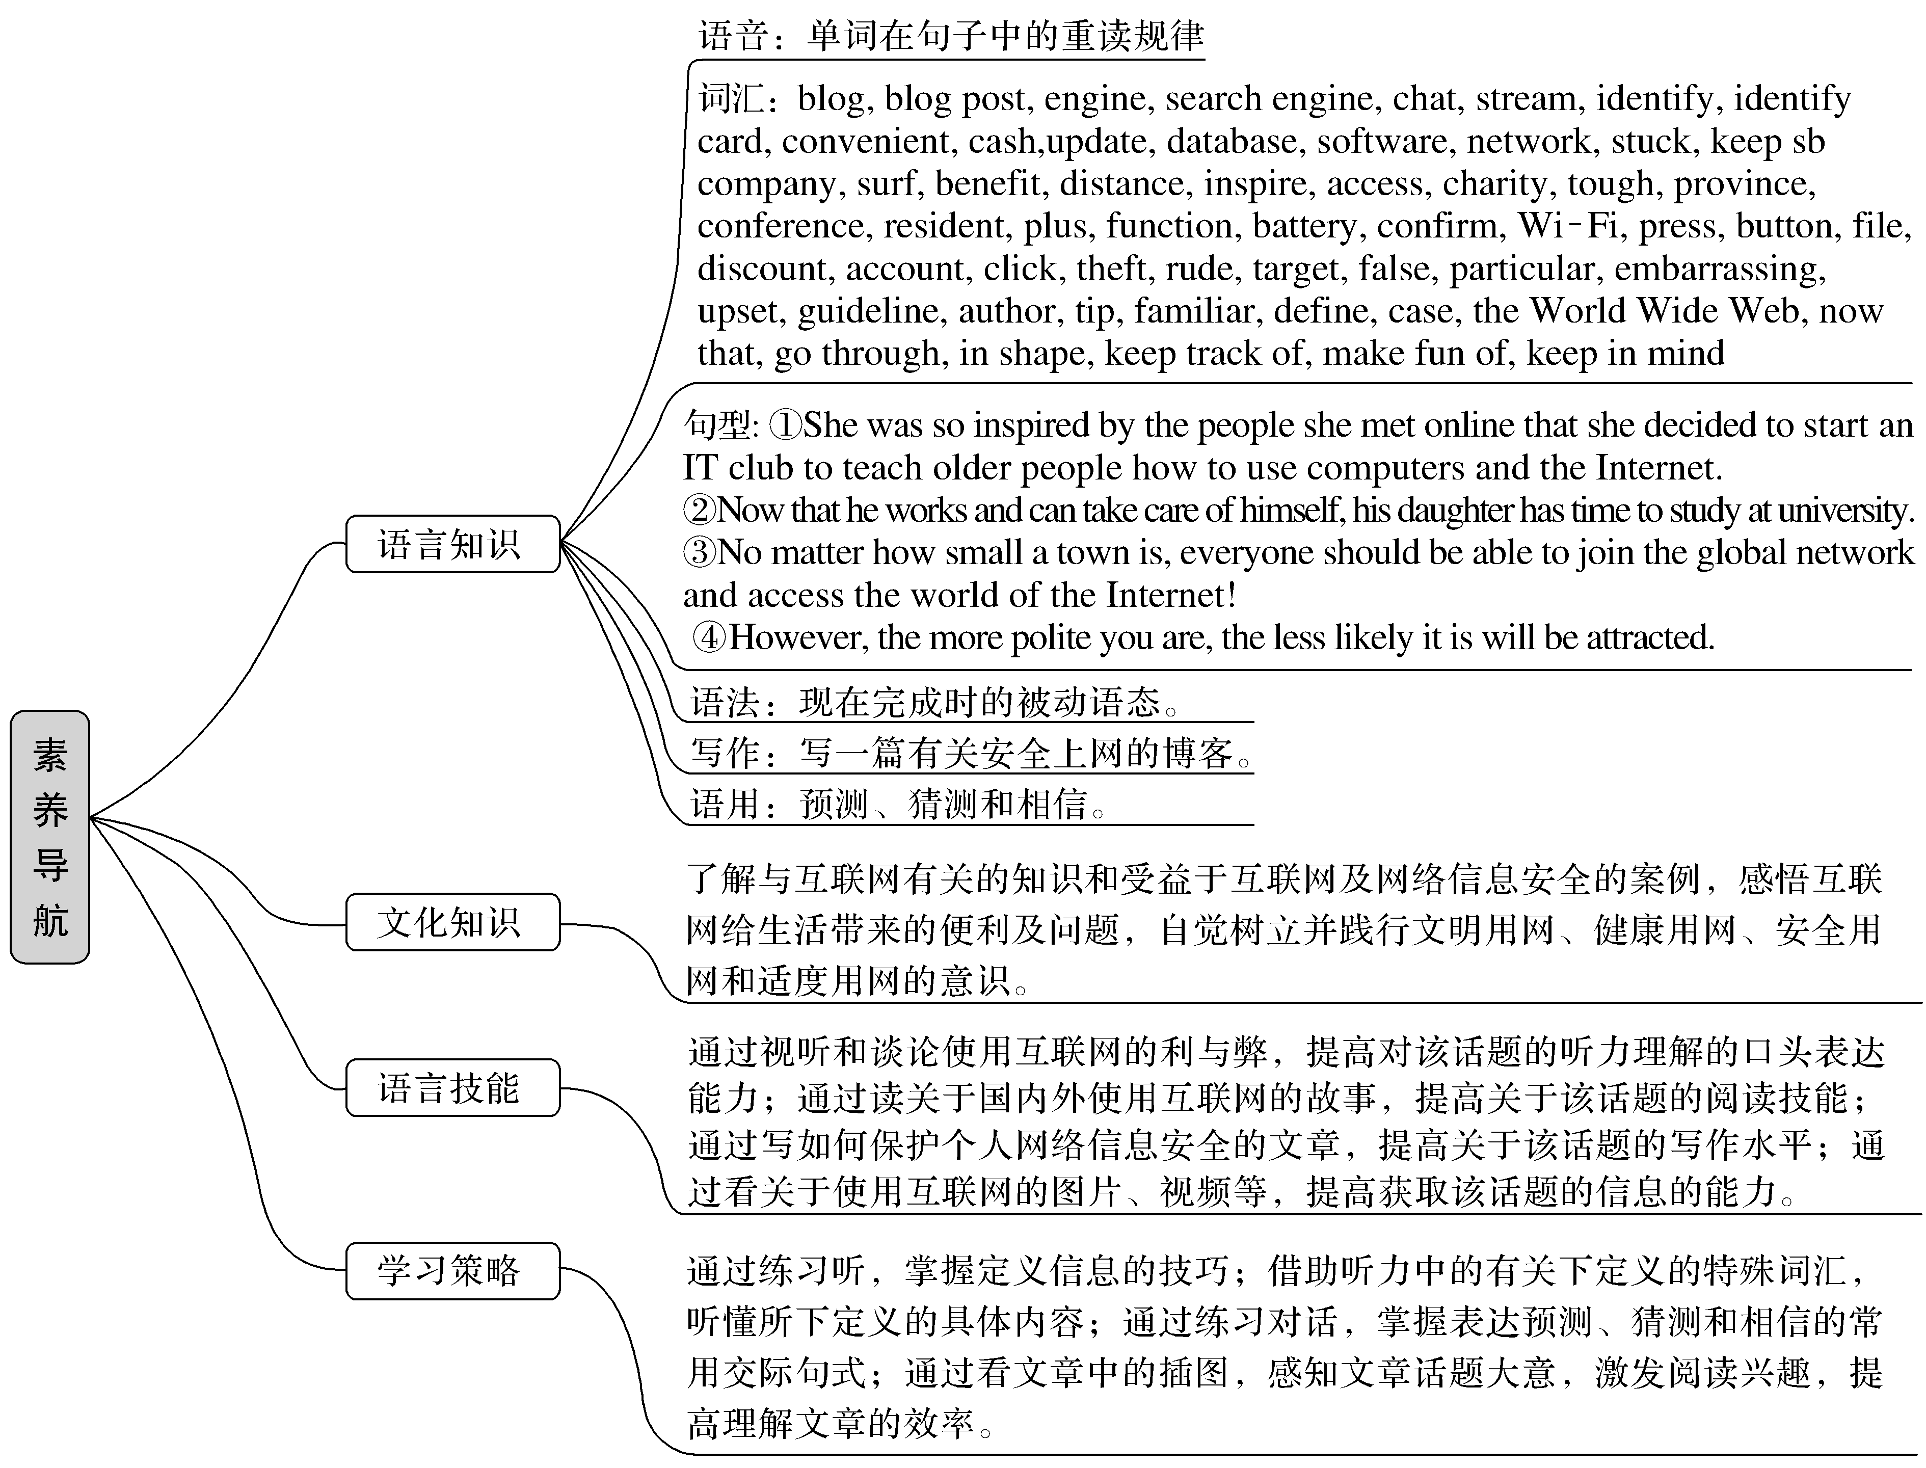

Slide 4
No cyber security, no national security.
没有网络安全，就没有国家安全。
I am convinced that human is able to use Internet properly and scientifically.
我相信，人类能够正确地、科学地使用互联网。
I believe I can use the Internet very well as long as I know how to control myself.
我相信只要我知道如何控制自己，我就能很好地使用互联网。

Slide 5
1.Translate the following words and phrases.
①blog n.____________vi.____________ ②blogger n. _______________
③engine n. ______________________ ④chat vi. ____________
⑤stream v.____________n.____________ ⑥identity n. ____________
⑦blog post _______________ ⑧search engine ____________
⑨identity card ____________
博客
写博客
博客作者；博主
引擎；发动机；火车头
聊天；闲聊
流播；流动
小河；溪流
身份；个性
博文；博客帖子
搜索引擎
身份证

Slide 6
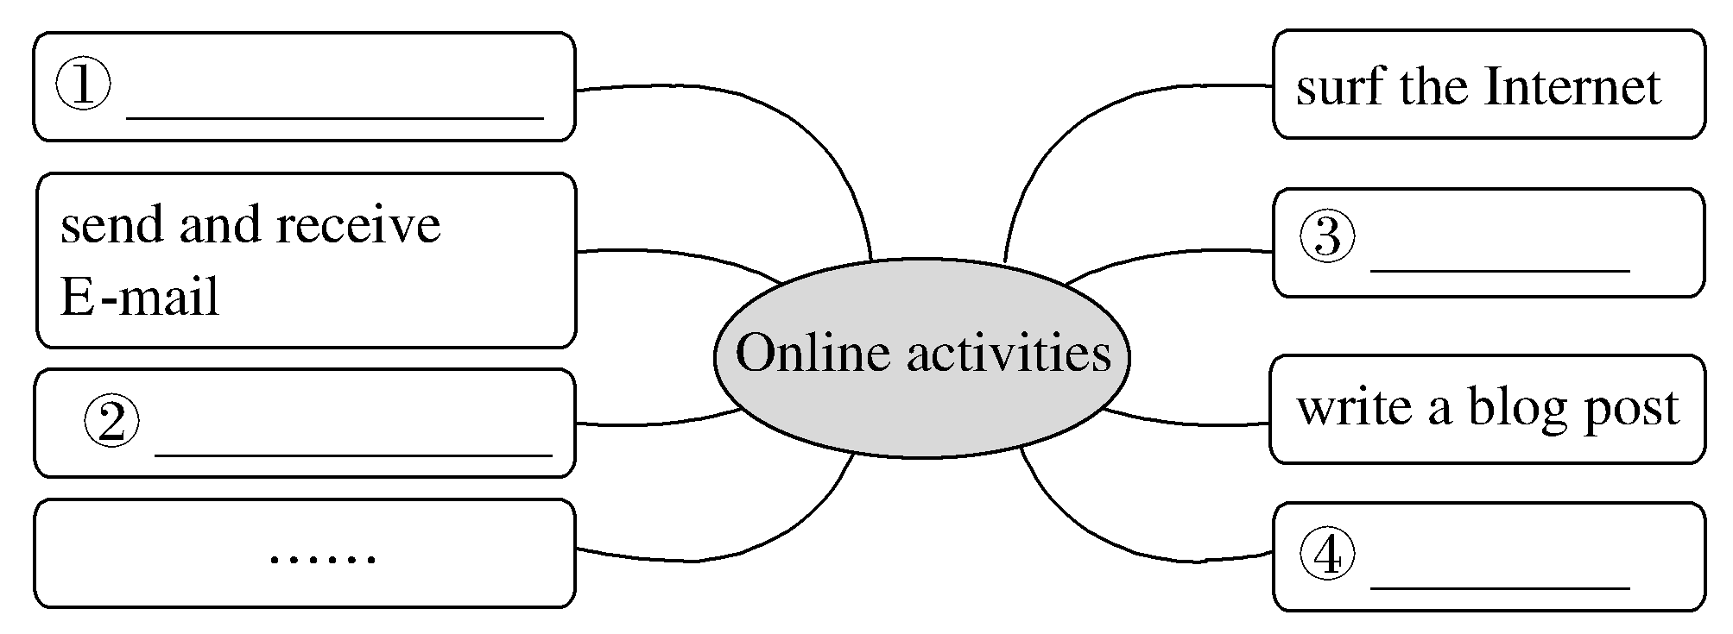
2.Brainstorming：What online activities do you like to do?
①do some shopping ②take online classes ③chat online ④use apps
3.Look at the picture and finish Ex.1 on Page 26.

Slide 7
Finish Ex.2 & Ex.3 on Page 26.

Slide 8
1.Writing—Guess how the words in italics are defined.
A.Use simpler words. B.Use an example. C.Compare to something.
(1)____ The keyboard is a device used to input text into a computer or other device.
(2)____ The shops on the Internet, for example taobao.com, 360buy.com are open for almost 24 hours a day, so we can buy something we want at any time.
(3)____ Cyberspace refers to the virtual computer world, or a global computer network for online communication.
(4)____ Life is just like a box.Inside it are happiness and sorrow, failure and success, hope and despair.
A
B
A
C

Slide 9
2.Finish Ex.4 on Page 27.
3.Pronunciation—Underline the words that are stressed.
①The streets are wide and clean.
②I am so glad to see you again.
③We saw him playing by the river.
④On my way to school，my bike was broken.
⑤He ought to have asked me if I could have given him a few of the tickets.

Slide 10
语言知识积累
在英语听力中，你常会听到一些你不懂的单词，但这些单词有时会在下面的句子中通过一些下定义的词汇来说明它们的意思。常见的下定义的词有：be，that is，it’s like，for example, refer to等。

Slide 11
文化知识习得
网络是一把双刃剑，有利也有弊。正确使用网络工具，文明上网，健康上网，适度上网。作为新时代的网民，要做到把网络当作自己的信息技术课堂，通过网络获得更多的外界信息，更全面更直接的了解和认知社会，从而更好地认识了解社会。

Slide 12
学习策略形成
句子重读的规则
一般来说，在句子中，实词需要重读，虚词不重读。
实词：动词、名词、形容词、副词、数词、疑问词和感叹词等。
虚词：助动词、情态动词、冠词、介词、连词、物主代词、关系代词和关系副词等。
[名师提醒] 人称代词、连词等一般不重读，但在特定情景中，也需要重读。如人称代词作并列主语或宾语时需重读，句首的介词也需要重读，作主语或宾语的指示代词也需要重读。

Slide 13
chat vi.聊天；闲聊
chat online 网上聊天 (教材P₂₆)
[合作探究] 体会chat的用法和意义
James likes chatting with his classmates during breaks between classes.
詹姆士喜欢在课间和同学聊天。
The two friends sat in a corner and chatted about their new school life.
那两位朋友坐在一个角落里谈论他们的新校园生活。
On the net, we can even do shopping, have a chat with others and make friends with them.在网上，我们甚至可以购物、与他人聊天，并与他们交朋友。

Slide 14
[自主发现]
①chat ____________ sb 与某人聊天
②chat ____________ 谈论；闲聊
③have a chat with sb 与某人聊天
with/to
about

Slide 15
[巩固内化] 补全句子
①I shared my favorite books and ______________________________________.
我分享我最喜欢的书，并在课后和她聊天。
②Besides，I often __________________________________________________.
此外，我经常和我的父母谈论我的学习和生活。
chatted with/had a chat with her after class
chat about my study and life with my parents

