Slide 1
初中英语冀教版七年级下
Unit8 Summer Holiday Is Coming！
Have a Good Summer!
WWW.PPT818.COM

Slide 2
课前回顾
I will tell you how _____________. The ________ (第一步) ________________is ________(take) a piece of paper and __________(写下) a list of your habits. Good habits l______ the way____good h_____ and s______. And I’ll c______ those bad habits. We should ______________and__________
to know yourself
first step
towards success
taking
writing down
ead
to
ealth
uccess
hange
develop good habits
improve ourselves

Slide 3
词汇学习
final adj. ______________ adv. _______
final exams____________
finally 最后，终于=_____________
=_________________
2. exam n._________
have/take exams ____________
We are going to take the final exams next Monday.
最后的，最终的
finally
期末考试
at last
in the end
考试
参加考试

Slide 4
【活学活用】
①今天我们期末考试。
We wrote the _________ exam today.
② _________ (final), they got to the top of the mountain.
final
Finally

Slide 5
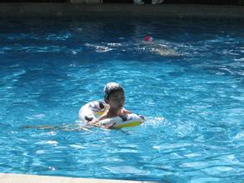
Warm-up
What do you like to do in summer?
Do you like to swim?
When did you learn to swim?

Slide 6
1
Read the lesson and complete Danny’s diary.
Dear Diary,
I am so excited today. We wrote our final ______
and school is ______. The day after tomorrow, I
will go to my uncle’s house. I’ll stay there for one
______. Debby and I will play basketball, ______,
volleyball and ______. We will swim and play in
the ______. It’s going to be a great summer. I’m
looking forward to it so much.
exam
over
month
tennis
football
sun

Slide 7
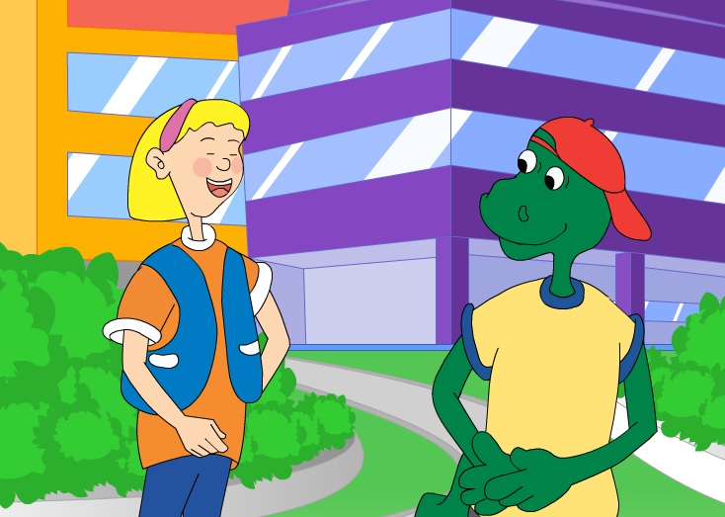
Presentation
Let’s watch the video.

Slide 8
3
Rewrite the sentences using “will” or “be going to”.
She has a new toy car.
→ She is going to have a new toy car tomorrow.
→ She will have a new toy car tomorrow.
2. Jane sings a folk song at the school party.
→__________________________________________
→__________________________________________
Jane is going to sing a folk song at the school party tomorrow.
Jane will sing a folk song at the school party tomorrow.

Slide 9
3
Rewrite the sentences using “will” or “be going to”.
3. Sometimes I walk to school.
→_____________________________________
→_____________________________________
4. They listen to the radio every morning.
→_____________________________________
→_____________________________________
I’m going to walk to school.
I’ll walk to school.
They are going to listen to the radio.
They will listen to the radio.

Slide 10
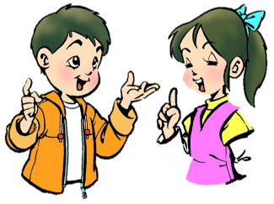
Pair work
Work in pairs. Make a plan for your summer holiday and then talk about it.
What will you do?
Where will you go?

Slide 11
Language points
1. I’m looking forward to it.
我期待着它。
【点拨】(1) look forward to意为“期待，盼望”，后面接名词或者动名词。例如：
I look forward to your good news.
我等待你的好消息。

Slide 12
(2) it 在此处为代词，代替上文所提到过的事物。例如：
I have a new bike. It is from my mother.
我有一辆新自行车。我妈妈给我的。

Slide 13
【用法辨析】one 与it的用法区别
(1)one 意为“一个”，表示泛指，用来代替上文中提到过的同类人和事物。例如：
My bike is broken, I need to buy a new one.
我的自行车坏了，我需要买个新的。
(2)it意为“它”， 用来代替上文中提到过的同一事物。it既可替代单数可数名词，也可替代不可数名词或前面提到的事情或情况。例如：
I lost my pen. I’m looking for it.
我钢笔丢了，我正在找它。

Slide 14
【活学活用】
①Look forward to _________ (hear) from you.
答案：hearing
②Could you record the football game for me? I can watch __________ later.
A. it B. one C. this D. that

Slide 15
2. Jenny and Danny wrote their final exams today.
詹妮和丹尼今天期末考试。
【点拨】final 形容词，意为“最后的，最终的”，其副词形式为finally。
例如：This is the final lesson of this term.
这是这学期的最后一节课。
Finally, we win the game.
最后，我们赢得比赛。

Slide 16
Exercise
Ⅰ. 用所给词的适当形式填空
1. We are _________ (excite) for the school trip.
2. I’m going to _____ (play) basketball this afternoon.
3. Bill ___________________ (buy) a pair of shoes
tomorrow.
4. I’m looking forward to _________ (meet) you again.
5. It’s getting dark. I have to _________ (go) now.
excited
excited
play
play
will buy/is going to buy
will buy/is going to buy
meeting
meeting
go
go

Slide 17
Ⅱ. 完成句子
1. 我打算在星期天去踢足球。
I’m going to _____ _______ on Sunday.
2. 我爷爷在河边有一座小房子。
My grandpa has a small house _____ ___ ____.
3. 我期望一个很棒的聚会。
I’m _________ _________ _________ a great party.
play football
near the river
looking forward to

Slide 18
4. 她打算在上海待一个月。
She is going to _____in Shanghai ___one month.
5. 我确信明天天气晴朗。
I’m _____ the weather ______ ____sunny tomorrow.
stay for
sure
will be

Slide 19
Homework
Listen and read the passage again.
Act out the story with a partner.

