Slide 1
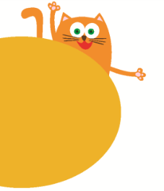
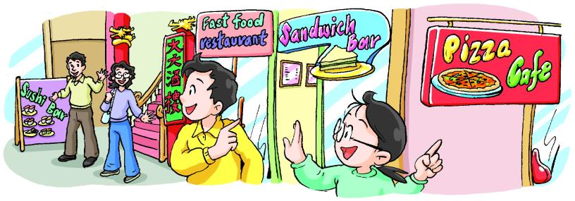
At the shop
8
第一课时
WWW.PPT818.COM

Slide 2
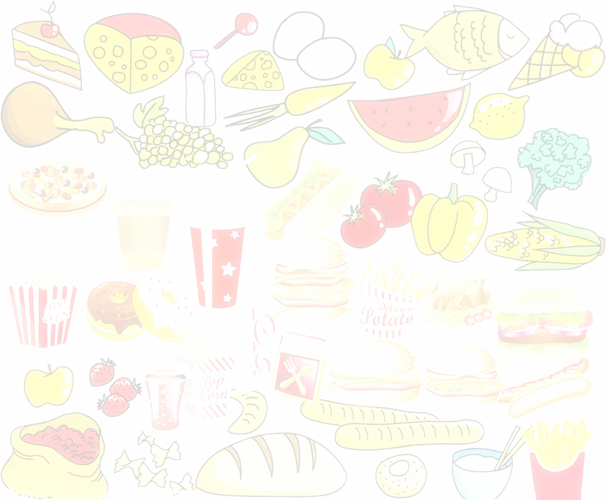


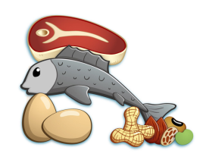


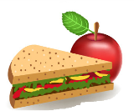

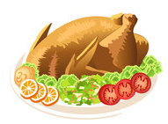









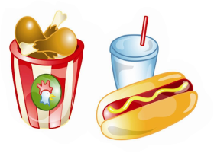

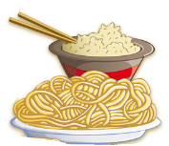




Slide 3
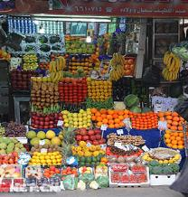
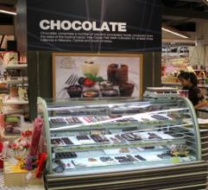
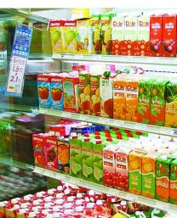
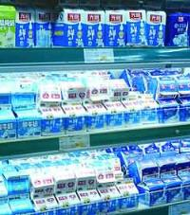
Look and say
We can buy food __________/_________________.
at the shop
in the supermarket

Slide 4

Look and learn
At the shop
shopping trolley

Slide 5
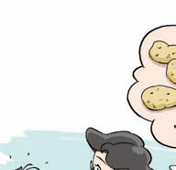
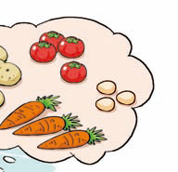
Look and learn
Vegetables:
tomatoes
potatoes
carrots

Slide 6
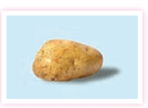

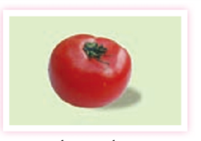
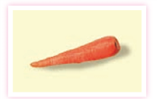
Read, match and say
It is red, soft and juicy.
It is vegetable or fruit.
potato
It is hard. It is long. It is orange. Rabbits like it.
tomato
It is hard. It is brown or yellow.
carrot

Slide 7

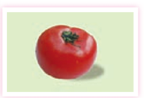

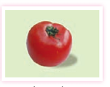
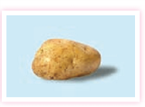
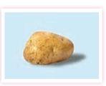



a tomato
tomatoes
a potato
potatoes
a carrot
carrots

Slide 8


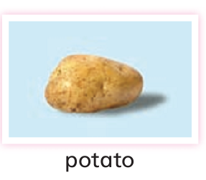
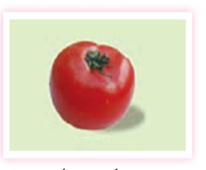
I like carrots. Sweet and healthy.
I like tomatoes. Soft and juicy.
I like potatoes. Nice and yummy.

Slide 9





Think and say
I like carrots. ______ and ______.
I like tomatoes. ______ and ______.
I like potatoes. ______ and ______.

Slide 10
Look and say
tomatoes
eggs
potatoes
carrots
candy
orange juice
S1: What would you like, …?
S2: I’d like some …

Slide 11
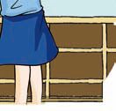
Look and say
How much …?
… yuan, please.
...
...

Slide 12

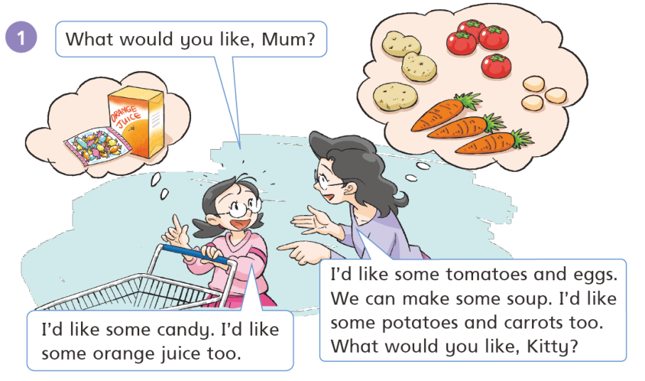

Slide 13
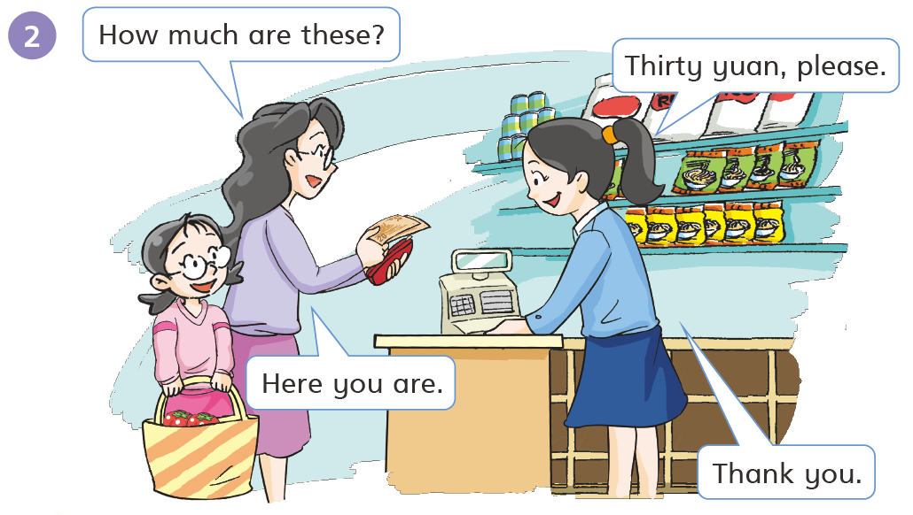

Slide 14

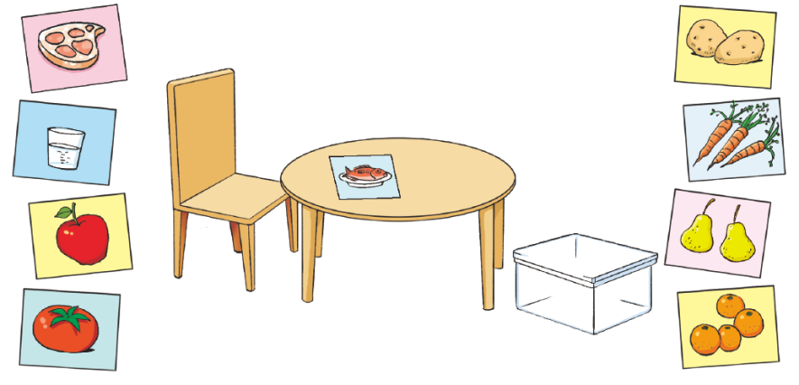


S1: What would you like?
S2: I’d like …

Slide 15
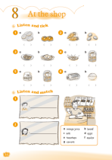
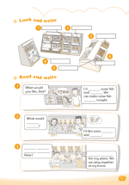


Homework
Read these new words.
potato – potatoes tomato – tomatoes
carrot – carrots
Act out the dialogue on Student’s Book page 42.
Complete Workbook pages 44 and 47.

