Slide 1
Unit 8 It must belong to Carla.
Section B Period 4 3a-Self Check
WWW.PPT818.COM
Notes:
1
1

Slide 2
环游世界 看看诡异地域

Slide 3
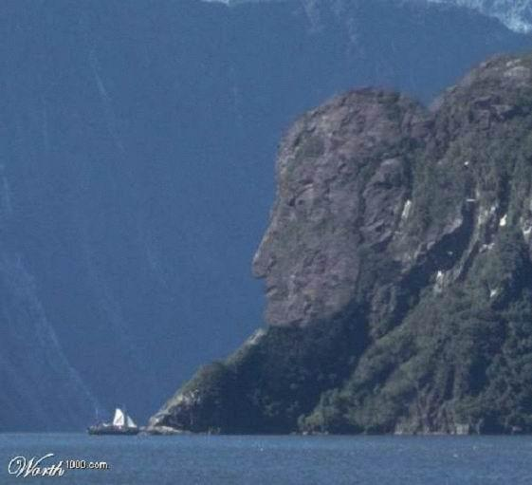
斯堪的纳维亚半岛峡湾： 狮身人面守护者

Slide 4
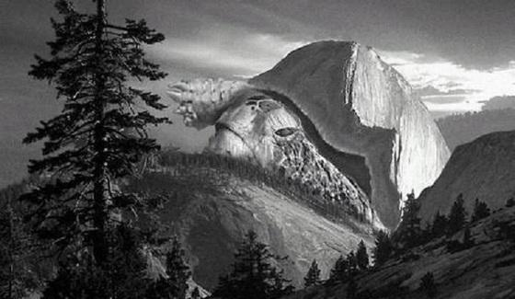
加拿大与美国阿拉斯加交接处：磅礴奔腾的巨大象龟

Slide 5
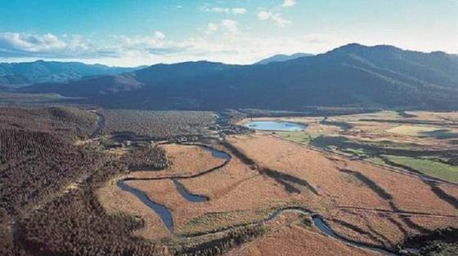
南美秘鲁：富兰克林头像

Slide 6
Read through the article in 3a on page 59 again. What do you think the noise could be? List all your ideas. See who in your group can come up with the most imaginative explanation.
3a
What could the noise be? | Why do you think so?

Slide 7
Look at this newspaper headline and finish the article about the strange happenings.
3b
No More Mystery in the Neighborhood
Last week, in a quiet neighborhood, something strange happened ... We now know what was happening in the neighborhood ... Now the mystery is solved. People in the neighborhood ...

Slide 8
Writing tips
First part: background information about the mystery
Second part: how the mystery was solved
Third part: how the people in the
neighborhood now feel

Slide 9
Self Check
1 Fill in the blanks with must, might or can’t.
1. That bright light _____ be a UFO — there’s no such thing!
2. I’m still waiting for the bus, so I ______ be a bit late for the party.
3. That sweater _______ be Carla’s. She’s the only one who wears such colorful clothes.
can’t
might
must

Slide 10
4. Tony______want to go to the concert. He likes music, but I'm not sure if he likes rock music.
5. The person you saw at the supermarket
_____be Susan. I just talked to her on the phone, and she's at work right now.
might
can’t

Slide 11
Mom: Do you have anything valuable in your
schoolbag ?
Linda: No, just my books, my pink hair band
and some tennis ball.
Mom: So it can’t be stolen.
Linda: Oh, wait! I went to a picnic after the
concert. I remember I have my schoolbag
with me at the picnic.

Slide 12
HOMEWORK
Write a passage.
昨晚天空中有不明飞行物体。对此，你的同学有不同的猜测。请根据下面表格中的信息写一篇80词左右的短文。
Notes:
12
12

Slide 13
人物 | 猜测 | 原因
Alice | a UFO | It flew very fast.
Jack | a kite which can give off light | It didn’t fly high.
Antonio | a plane | Its sound liked a plane sound.

