Slide 1
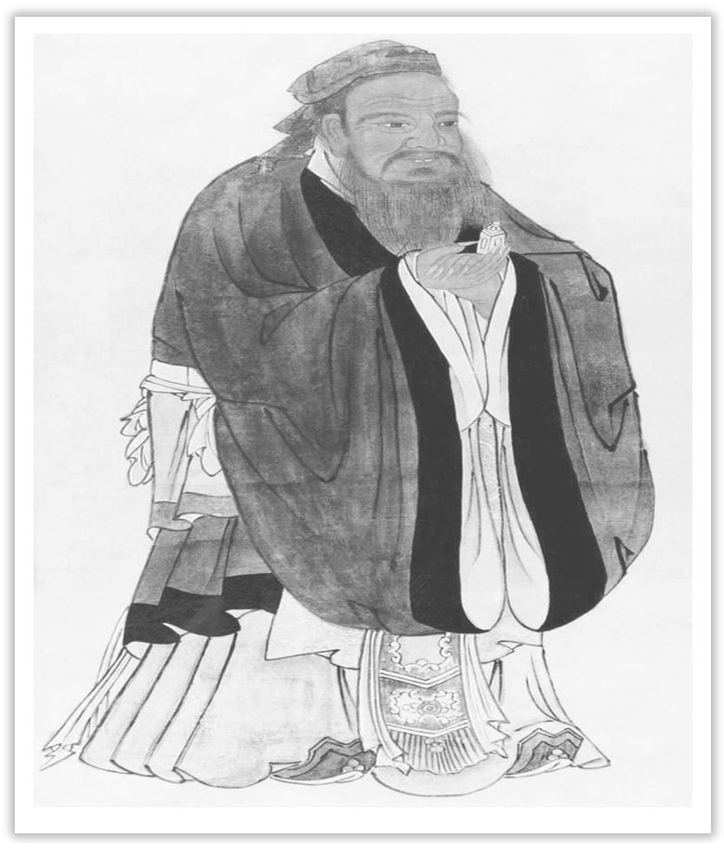
Unit 4 History and Traditions
Section Ⅱ Reading and Thinking(1)
WWW.PPT818.COM

Slide 2
1.Discussing—Match the pictures with the proper introductions.

Slide 3
(1)____ The queen—the head of state，but in name only.The most powerful one is the Prime Minister，who controls everything in the UK.
(2)____ The River Thames—The longest river.
(3)____ London—The capital，where the Olympic Games were held three times.
(4)____ The United Kingdom—It actually includes four countries：England，Scotland，Wales and Northern Ireland.
C
D
B
A

Slide 4
2.Predicting—Look at the map on Page 40 and predict what it is used for.
________________________________________________________________________
The map tells us where the UK lies and how many parts it is made up of.

Slide 5
1.First reading—Read the text and finish the following exercises.
(1)How many names are mentioned in the first paragraph, and what are they?
________________________________________________________________________
(2)Arrange the following events in time order.
①Scotland was joined.
②Ireland was added.
③Wales was joined.
④The United Kingdom of Great Britain and Northern Ireland came into being.
⑤The southern part of Ireland broke away.
________________________________________________________________________
Four; The United Kingdom, Great Britain, Britain, England.
③①②⑤④

Slide 6
(3)In which areas do the four countries work together?
________________________________________________________________________
(4)Why is the history of the United Kingdom interesting?
________________________________________________________________________
________________________________________________________________________
(5)What is the main idea of the last paragraph?
________________________________________________________________________
The same flag, the same currency and military defense.
Because four different groups of people took over at different times through history and had different influences on it.
The charm of the UK is rooted in its history and modern culture.

Slide 7
2.Second reading—Fill in the blanks according to the text.
WHAT’S IN A NAME
Introduction | How to solve the ①____________ caused by the different names | Getting to know a little bit about British history.
puzzle

Slide 8
History | in the ②____________ century | Wales was joined to the kingdom of England.
 | in the ③____________ century | Scotland was joined to ④____________ the kingdom of Great Britain.
 | in the 19th century | The kingdom of Ireland was ⑤____________ to create the United Kingdom of Great Britain and Ireland.
 | in the ⑥____________ century | The southern part of Ireland broke away from the UK，which resulted in the full name：the United Kingdom of Great Britain and Northern Ireland.
16th
create
18th
added
20th

Slide 9
People and traditions | the Romans | built towns and ⑦____________
 | the Anglo-Saxons | introduced the beginnings of the English language，and changed the way people built ⑧____________
 | the Vikings | left behind lots of new ⑨____________，and also the names of many locations across the UK
 | the Normans | had castles built；made changes to the ⑩____________ system
roads
houses
vocabulary
legal

Slide 10
Summary | the capital city London | an ⑪____________ port city；countless historic sites；lots of the museums
 | the UK | a fascinating ⑫____________ of history and modern culture
ancient
mix

Slide 11
3.Third reading
(1)Read the text again and try to summarize main idea in one sentence.
________________________________________________________________________
(2)Why is it important to study the history and culture of a country before visiting it?
________________________________________________________________________
________________________________________________________________________
________________________________________________________________________
The text is about the history and culture of the UK.
The history of a country can reflect its development, and the culture also originates from it.Therefore, learning the history of a country can make your visiting enjoyable and memorable.

Slide 12
1.Group work：You, as a journalist of school English newspaper, are interviewing Li Hua, who has visited the UK.You may start like this：
A：Hello，I’m a journalist of our school English newspaper.What do you think of your visit to the UK?
B：...
A：What does the name“the United Kingdom of Great Britain and Northern Ireland”mean?
B：...

Slide 13
2.Tom, a British, plans to visit China in the coming summer vacation.What do you think he should know about China in advance?
________________________________________________________________________
The answer is open.

Slide 14
阅读技巧点拨
语境猜词的5个小技巧
1.利用下文的解释猜词。阅读中出现的难词有时后面紧跟一个同位语，对前面的词进行解释，这时可利用同位关系对前面或后面的词义或句意进行猜测。
2.利用下文的例子猜词。猜词时，常可参考的关键词有：such as；like；for example；especially等。
3.利用同义词、近义词或反义词来猜词。作者为避免重复，常用一些同义词、近义词来写句子。有时也使用一些反义词加上否定词来表达肯定的观点。
4.当文中出现but, however等表示转折关系，或表示对比关系的while时，可借此逻辑关系来猜词。
5.利用文中的because, so或why等表示因果关系的词来猜词。

Slide 15
语言现象感知
Ⅰ.单词理解
体会句中加黑单词的词性和含义
1.In the 19th century, the kingdom of Ireland was added to create the United Kingdom of Great Britain and Ireland.____________
2.Most people just use the shortened name...____________
3.Almost everywhere you go in the UK, you will be surrounded..._____________
4.London is a great place to start, as it is an ancient port city that has a history dating all the way back to Roman times.____________
v.添加
adj.缩写的
conj.无论哪里
n.时代

Slide 16
5.There are countless historic sites to explore...____________
6.The UK is a fascinating mix of history and modern culture, with both new and old traditions.____________
adj.无数的
n.混合

Slide 17
Ⅱ.词块积累
写出下列词块的含义
1.solve this puzzle_____________
2.the full name____________
3.as well as____________
4.the military defense____________
5.have some differences____________
6.at different times____________
7.across the UK____________
8.make changes to_______________
解决这个难题
全称
也，又，还
军事防御
有一些不同
在不同时代
遍布全英国
对……作出改动

Slide 18
Ⅲ.句式欣赏
1.动名词作主语
Getting to know a little bit about British history will help you solve this puzzle.
2.名词短语作同位语
The first group，the Romans, came in the first century.
3.which引导的非限制性定语从句
People from the UK are called “British”，which means the UK is also often referred to as Britain or Great Britain.

Slide 19
4.that引导定语从句
The four countries that belong to the United Kingdom work together in some areas.
5.way后接定语从句
They introduced the beginnings of the English language，and changed the way people built houses.

