Slide 1
Unit 1
Where did you go on vacation?
Section B (第2课时)
WWW.PPT818.COM

Slide 2
学习目标
Key words & phrases:
activity，decide，try，bird，bicycle，building，
trader，wonder，difference，top… ;
feel like，because of，go to the beach，a lot of，
a little，take the train，too many，what about
Key sentences:
1. I wonder what life was like here in the past.
2. What a difference a day makes!
3. We waited over an hour for the train because there
were too many people.
Reading practice about Jane’s vacation.

Slide 3
New words and phrases
activity n.
decide v.
try v. & n.
paragliding n.
feel like
bird n.
bicycle n.
building n.
活动
决定；选定
尝试；设法；努力
滑翔伞运动
给……的感觉；感受到
鸟
自行车；脚踏车
建筑物；房子

Slide 4
trader n.
wonder v.
difference n.
top n.
wait v. & n.
umbrella n.
商人
想知道；琢磨
差别；差异
顶部；表面
等待；等候
伞；雨伞

Slide 5
wet adj.
because of
below prep. & adv.
enough adj.
hungry adj.
as adv.
湿的；潮湿的；下雨的
因为
在……下面；到……下面
足够的；充足的；充分的
饥饿的
像……一样，如同

Slide 6
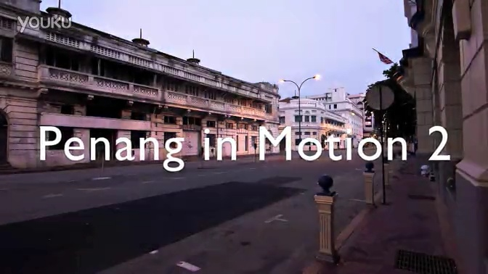
Did you go to any beautiful places on vacation? Let’s enjoy a beautiful place!

Slide 7
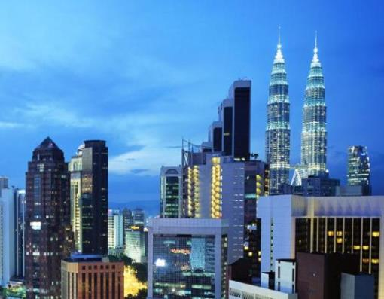
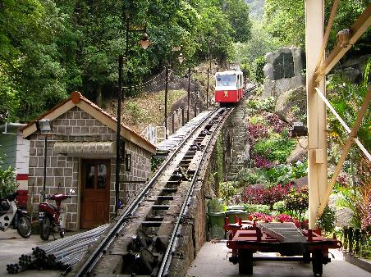
Did you go to Malaysia?
Malaysia n. 马来西亚
Malaysian adj. 马来西亚的
n. 马来西亚人
Penang Hill 槟城山

Slide 8
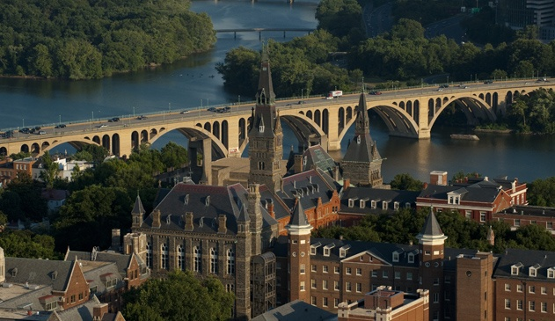
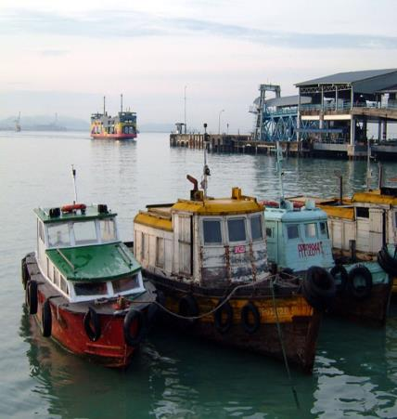
George Town 乔治市
Weld Quay 海墘（滨城）

Slide 9
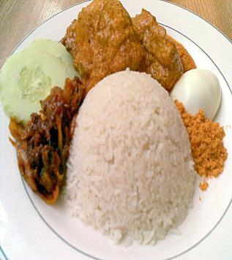
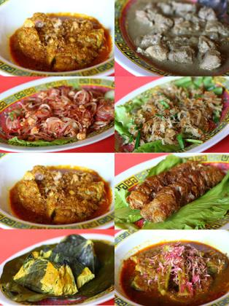
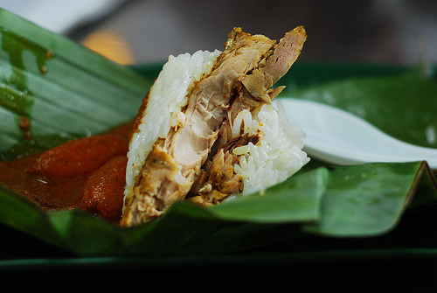
Local food --
Nasi lemak, the
Malaysian breakfast
Nasi Dagang
手扒饭
Nyonya dishes
娘惹菜

Slide 10
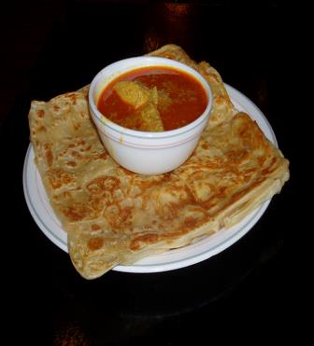
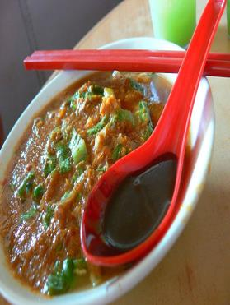
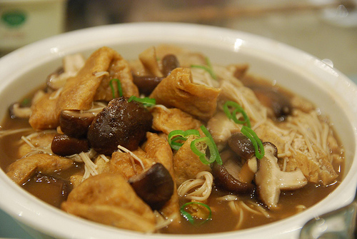
Bah Kut Teh/
Chic Kut Teh
肉骨茶
Roti Canai and
Teh Tarik
煎饼和拉茶
Asam Laksa
阿参拉沙

Slide 11
Read Jane’s diary entries about her vacation and answer the questions.
2b
Did Jane have a good time on Monday? What about on Tuesday?
Jane had a good time on Monday but not on Tuesday.

Slide 12
2c
Read Jane’s diary entries again. Fill in the chart.
Things Jane did or saw | Did she like it? (Yes/No) | Why or why not?
tired paragliding
 |  | They were delicious.
walked around Georgetown
Yes
It was exciting.
ate Malaysian yellow noodles
Yes
She liked the old buildings there and wondered what life was like in the past.
Yes

Slide 13
went to Penang Hill
 |  | It tasted great because she was hungry.
There were many people and they waited over an hour for the train.
It was raining and they didn’t have an umbrella. So they got wet and cold. They couldn’t see anything because of the bad weather. They didn’t have enough money for food.
No
shared/had one bowl of rice and some fish
Yes

Slide 14
Complete the conversation about Jane’s trip to Penang using the
information in the diary entries.
2d
Anna: Hi, Jane. Where did you go on
vacation last week?
Jane: I ______ to Penang in ___________.
Anna: Who ______ you go with?
Jane: I went with my _______.
went
Malaysia
did
family

Slide 15
Anna: What did you do?
Jane: The weather was hot and ________
on Monday, so we went ___________ on
the beach. Then in the afternoon, we
______ bicycles to Georgetown.
sunny
paragliding
rode

Slide 16
Anna: Sounds great!
Jane: Well, but the next day was not as good.
My ______ and I went to Penang Hill,
but the weather ______ really bad and
rainy. We _______ a long time for the
train and we were _______ and cold
because we forgot to bring an ________.
Anna: Oh, no!
Jane: And that’s not all! We also didn’t bring
_______ money, so we only had one bowl
of rice and some fish.
father
was
waited
wet
umbrella
enough

Slide 17
Imagine Jane went to Penang Hill again and had a great day. Fill in the
blanks in her diary entry with the correct forms of the verbs in brackets.
2e
Thursday, July 18th
Today ______ (be) a beautiful day. My father and I ______ (go) to Penang Hill again, but this time we ______ (walk) to the top. We ______ (start) at 9:30 a.m. and ______ (see) lots of special Malaysian flowers along the way.
was
went
walked
started
saw

Slide 18
About one hour later, we _______ (stop) and ______ (drink) some tea. Then we ______ (walk) for another two hours before we ______ (get) to the top. I _______ (be) quite tired, but the city ______ (look) wonderful from the top of the hill!
stopped
drank
walked
got
was
looked

Slide 19
Language points
1. decide v. 决定；选定
① I decide to stay at home today.
今天我决定待在家里。
② Before you make a decision, you must think
it over.
在你作决定之前，你一定要仔细思考。
据例①可知“决定干某事”为decide to do sth。
据例② 可知decide的名词是decision, 而“作决
定”是make a decision, 相当于动词decide。

Slide 20
2. try v.& n. 尝试；设法；努力
I’ll try to improve. (用作动词)
我要设法改进。
Come on and give it a try. (用作名词)
来, 试试看。

Slide 21
try to do sth. & try doing sth.
两者含义不同
前者:“试图或努力去做某事”,
后者:“尝试/试验一下某种方法”。
e.g. try to climb the mountain
设法向山上爬
try climbing the mountain
尝试爬上山去

Slide 22
3. because of 因为
I didn’t go out because of the bad weather.
由于恶劣的天气，我没有出去。
because of & because
e.g. He didn’t come because he had a headache.
= He didn’t come because of his headache.
他没来因为他头痛。
because + 句子
because of + 名词、代词或动名词形式。

Slide 23
4. enough adj. 足够的；充足的；充分的
e.g. There isn’t enough water in our city.
我们城市没有足够的水。
He is old enough to go to school.
他足够大了可以去上学。
enough 作形容词时, 可置于所修饰的名词之前或之后。
enough 作副词时, 一般应放在所修饰的形容词、副词或动词的后面。

Slide 24
Summary
1．Key vocabulary：decide，try，wonder，difference，top，wait，below，enough，hungry，as，feel like，because of，too many
2．Sentences：
①I wonder what life was like here in the past.
②And because of the bad weather，we couldn't see anything below.

Slide 25
Homework
1. Read both of Jane’s diary entries
out loud. Get into pairs and role
play the conversation in 2d.
2. Do the exercises in students’ book.

