Slide 1
Unit 5 On the road
Part Ⅱ Using language——动词-ing形式作定语
WWW.PPT818.COM

Slide 2
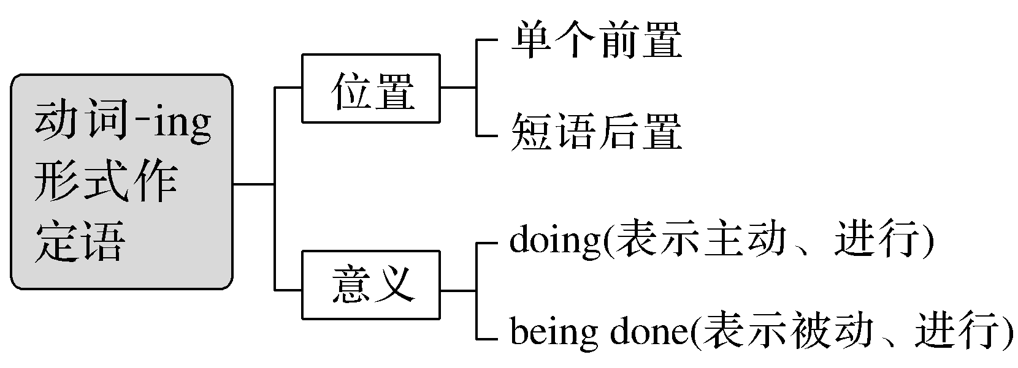
【思维导图】

Slide 3
一、基本特征感悟
动词-ing形式作定语分为前置定语和后置定语。
【感悟用法】
①They talked in a low voice in order not to wake up the sleeping girl.
他们低声说话，以免吵醒那个睡着的女孩。
②The student making the experiment in the lab is our monitor.
在实验室里做实验的学生是我们的班长。
③She found herself in an embarrassing position.她发现自己处于尴尬的地位。
④They built a highway leading into the mountains.他们修建了一条通往山里的公路。

Slide 4
【自我总结】
1.句①为动词-ing形式作定语，它与所修饰的名词具有逻辑上的____________关系。
2.句②④为动词-ing短语作定语，放在该名词____________。
3.句③为形容词化的动词-ing形式单独作定语，放在所修饰的名词_____________。
主谓
后
前

Slide 5
二、主要用法精讲
1.动词-ing形式作定语。名词与非谓语动词之间存有逻辑上的主动关系，并且一般都可以转化为一个进行时的定语从句。
We met a group of pupils(who are) returning from school.
我们碰到了一群从学校回来的孩子。
2.动词-ing形式的被动形式 (being done) 可表示被动的、正在进行的动作。
The river being polluted may do great damage to the environment.
这条被污染的河流可能对环境造成很大的破坏。
名师提醒 过去分词与现在分词作定语时的区别
The girl standing under the tree is very beautiful.(表主动、进行)
站在树下的女孩很漂亮。
Have you read the novel written by Dickens？(表被动、完成)
你读过狄更斯写的这部小说吗？

Slide 6
即学即练
单句语法填空
1.We must improve our ____________(work) method.
2.The building ________________(build) now is our future classroom.
3.Who is the boy ____________(speak) to your sister?
4.Last night，there were millions of people ____________(watch) the opening ceremony live on TV.
5.We can wander among a variety of shops ____________(sell) gifts while enjoying a live music show and nice street entertainment.
6.Today there are more airplanes ____________(carry) more people than ever before in the skies.
working
being built
speaking
watching
selling
carrying

