Slide 1
Unit 5 Topic 1
I’m so happy.
Section C
WWW.PPT818.COM

Slide 2
Review
根据句意和首字母完成下列句子
1. I don’t like Beijing Opera at all because it’s b______.
2. The film was so m_____ that we cried again and again.
3. I have p________ the table for you.
4. He feels s___ because he can’t pass the exam.
5. We are p_____ of our great country.
oring
oving
repared
ad
roud

Slide 3
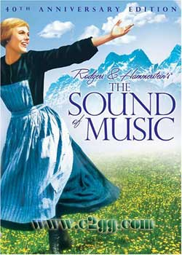
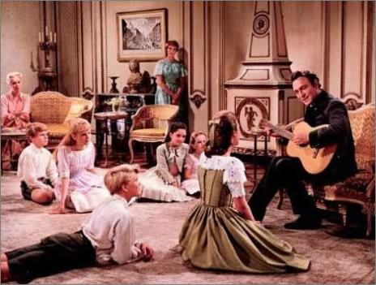
Have you ever seen this film?
the Sound of Music

Slide 4
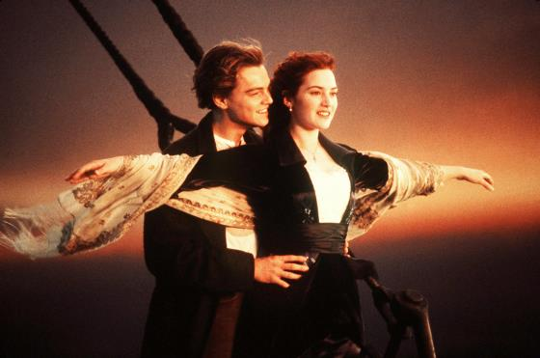
Have you ever seen this film?
Titanic

Slide 5
Review
Translate the phrases:
感到失望
似乎不快乐
看上去很兴奋
味道可口
闻着香
听起来很棒
feel disappointed
seem unhappy
look excited
taste delicious
smell nice
sound great

Slide 6
Review
Translate the phrases:
为某人感到难过/抱歉
乐意做某事
邀请某人去做某事
为某人准备某物
向某人道谢/道歉/告别/问候
feel sorry for
be glad to do sth.
invite sb. to do sth.
prepare sth. for sb.
say thanks/sorry /good bye/hello to sb.

Slide 7
Enjoy this song.
Do Re Mi
Let's start at the very beginning, a very good place to start.
When you read, you begin with ABC. When you sing, you begin with Do, Re, Mi, Do, Re, Mi, Do, Re, Mi. The first three notes just happen to be Do, Re, Mi, Do, Re, Mi. Do, Re, Mi Fa So La Ti.
Doe, a deer, a female deer. Ray, a drop of golden sun. Me, a name I call myself. Far, a long long way to run. Sew, a needle pulling thread. La, a note to follow sew. Tea, a drink with jam and bread. That will bring us back to Do-oh-oh.
Do Re Mi Fa So La Ti Do, So, Do!

Slide 8
What do you think of Do, Re, Mi?
It is/sounds _______/_______/_______.
It can make me happy/cheer me up.
Discussion
beautiful
sweet
lively
充满趣味的；充满生气的
cheer sb. up（使）振作起来

Slide 9
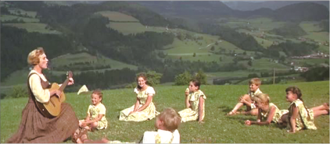
1a
Read and understand
Watching English movies is a good way to practice your English pronunciation, intonation and listening.
1. Look at the picture and guess what the text is about.
2. Read the words in the box and guess the main idea of the text.
Maria children mother
die sad cry father
lonely angry song
play mad happy

Slide 10
Listen to 1a and try to answer the following questions.
Who are the important roles(角色) in the movie?
Why did Maria go to the Von Trapp family?
What happened to the family?
Why did the father often become angry?
How did Maria cheer up the family?
What do you know about The Sound of Music?
What do you think of Maria?

Slide 11
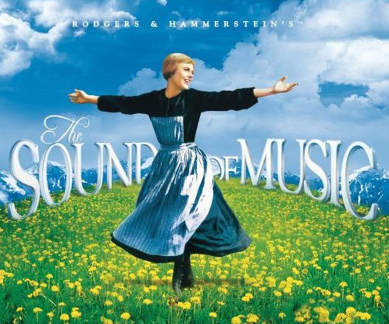
1 b
Read 1a and complete the table
Paragraph 1 | The film is very _________. It is about Maria from _________. She took care of seven ________ of the Von Trapp family.
Paragraph 2 | The Von Trapp family were _______ before Maria came. The children always _______ and _________ . The father felt ________ and often became _________ with the children.
Paragraph 3 | Maria tried to cheer them up with __________ songs and short, __________ plays. The father felt _______ at first, but then he became _________ again when he saw their ____________ faces.
popular
Austria
children
sad
cried
shouted
lonely
angry
lively
funny
mad
smiling
happy

Slide 12
Explanation
1. care for: take care of / look after
2. lonely:孤独的，寂寞的
3. …because of the noisy children =…because
the children were noisy.
4. almost:几乎，差不多
5. cheer sb. up: 使某人振作起来
cheer sb. on: 为某人加油

Slide 13
Retell 1a according to the following key words
popular, Austria, care for, sad, lonely, angry, lively, cheer…up, smiling faces, happy

Slide 14
Exercise
Choose the right words to fill in the blanks.
lively, lonely, alone, almost, cheer…up, cheer…on, exciting
alone
lonely
The old man lives ________ and he often feels very ________.
There’s going to be an ________ basketball game between Class 3 and Class 5. Let’s go and _____ _____ ____.
Every time I’m upset and feel like giving up, my best friend Helen will encourage me and _____ _____ _______.
Ann is a ________ girl and she seems to be happy _________ all the time.
exciting
cheer them
on
cheer me up
lively
almost

Slide 15
1c Read 1a again and discuss the questions in Paris. Then retell the story based on 1b and 1c.
Why did Maria go to the Von Trapp family?
Why were the Von Trapp family sad?
How did Maria cheer up the children?
What do you think of Maria?

Slide 16
Suppose you are Steve. Interview Mr. Brown about The Sound of Music with the help of the questions below and the text.
2a
1. What kind of movie is it?
2. How does the music sound?
3. What is it mainly about?
4. What happens in the movie?
Michael: Hello, Mr. Brown！Did you go to see the movie, The Sound of Music, yesterday?
Mr. Brown: Yes.
Michael: What do you think of it?
…

Slide 17
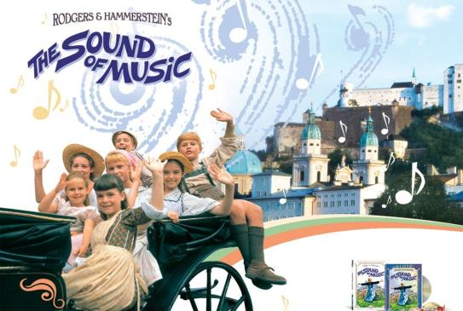
Write down the conversation between Michael and Mr. Brown in your exercise book.
2b
Michael: Hello, Mr. Brown！Did you go to see the movie, The Sound of Music, yesterday?
Mr. Brown: Yes.
Michael: What do you think of it?
…

Slide 18
Talk about your favorite movies.
Project
What’s the name of the movie?
What is it mainly about?
Who are the main roles in it?
How do you like it?

Slide 19
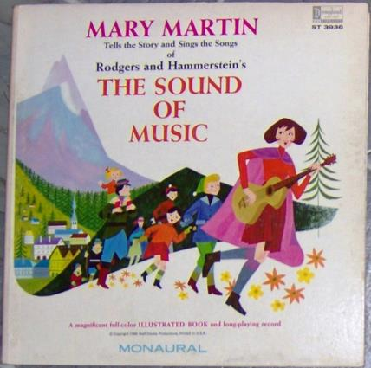
Edelweiss
So Long, Farewell
Climb Every Mountain
Something Good
The Lonely Goat Herb
Sixteen Going on Seventeen
I Have Confidence
The Sound of Music is a movie full of music. You can search the music by the names on the Internet.

Slide 20
Summary
We learn:
Words and phrases:
lively, lonely, almost, cheer up
The sentences of expressing feelings:
The family were very sad.
The father was lonely and often became angry because of the noisy children.
The father was almost mad at first.
We can:
Talk about our favorite movies.
Use linking verbs + adjectives to express our feelings.
Learn English by singing English songs .

Slide 21
Homework
Collect more information about your favorite movies and learn to sing some English songs.
Find some information about Beijing Opera such as its facial painting, stories, and so on.

Slide 22
Thank you!

