Slide 1
陕旅版四年级上册 Unit3 What’s for breakfast? 第2课时
WWW.PPT818.COM

Slide 2
Let’s sing---It’s Time for Breakfast

Slide 3
教学目标：
学习掌握句型
What’s for breakfast/ lunch?
We/ I have…for breakfast/ lunch.

Slide 4
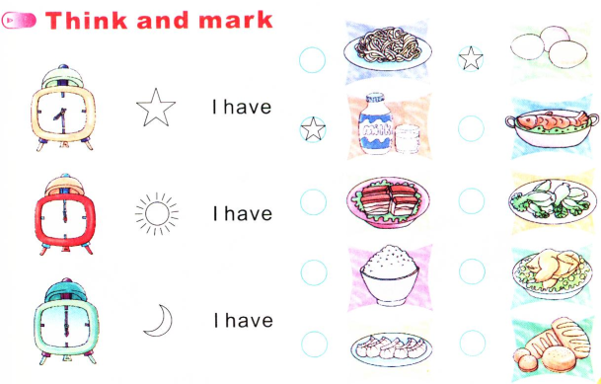
Think and mark

Slide 5
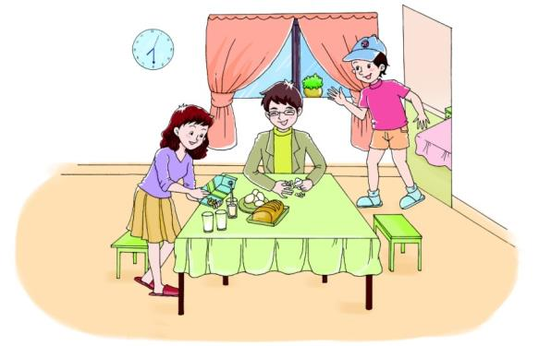
Let’s talk
This is Liu Zhaoyang, and these are…
?

Slide 6
Good morning, Mom and Dad! What’s for breakfast?
We have eggs, bread and milk.
Great! Thank you, Mom.

Slide 7
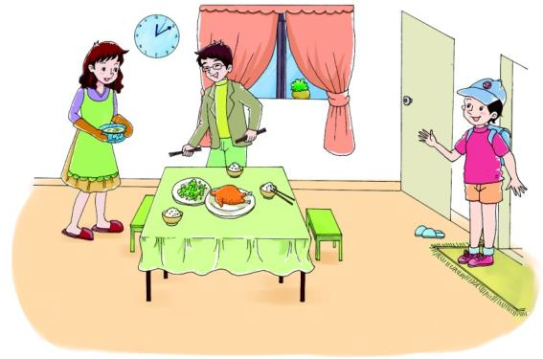
Let’s talk
听录音，回答问题：
Liu Zhaoyang: What is for lunch?

Slide 8
Look! We have rice, chicken, vegetables and soup.
Hi, Mom. What’s for lunch?
Very good!

Slide 9
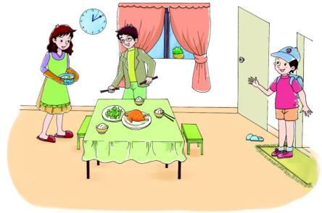
Role play
用句型：What’s for breakfast/ lunch?
We have…

Slide 10
Summary
英语中进行一日三餐的话题交流时用：What’s for…?
回答用：We have…

Slide 11
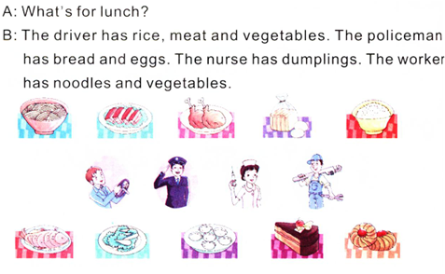
Read and match

