Slide 1
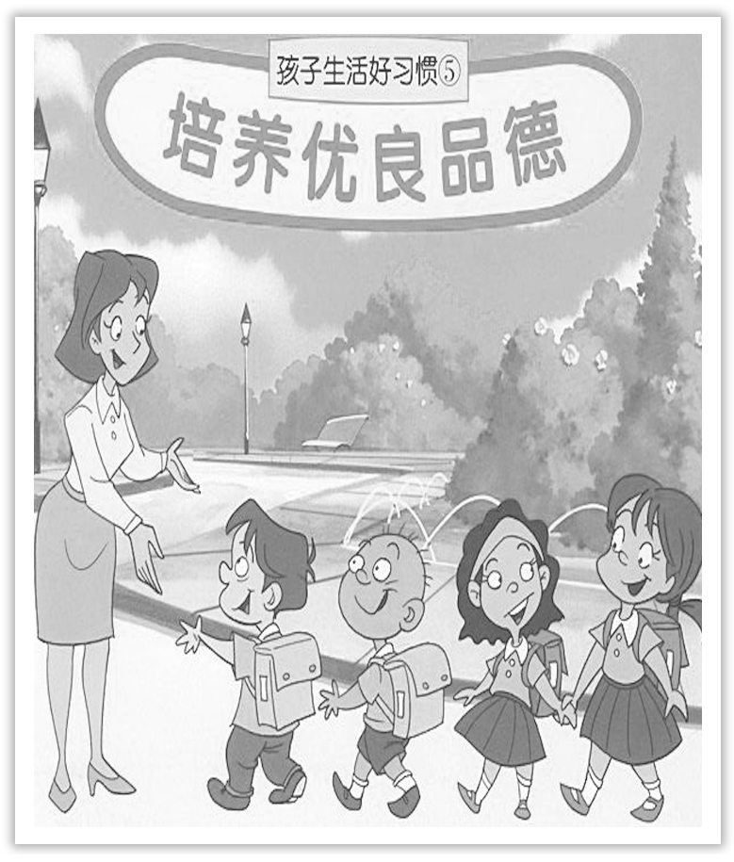
Unit 2 Morals and Virtues
Section Ⅰ Listening and Speaking
WWW.PPT818.COM

Slide 2
主题语境——人与自我之优秀品行
【语境概说】 本单元的主题语境为人与自我中的优秀品行，该主题语境主要包括与优秀品行相关的道德品质、人生态度、职业倾向、认识自我、丰富自我、完善自我等。本单元主要涉及道德品质、人生态度、职业倾向、完善自我。该主题与学生生活密切相关，在此主题意义的引领下，有助于整合优秀品行方面的学习内容，促进学生语言能力、文化意识、思维品质和学习能力的整合发展。

Slide 3
The best portion of a good man’s life is his little，unremembered acts of kindness and love.一个好人一生最好的部分是他细小的不被人记得的善良的行为和爱。
Morals ought to shape humanity，cultivate virtues and make the good come true.道德本来是要成就人、成就德性、成就善的。
We should practice thrift in our daily life because it is one of our Chinese traditional virtues.我们应该在日常生活中实践节约，因为它是我们中华民族的传统美德之一。

Slide 4
1.Translate the following words and phrases.
①moral adj. _________________
n. _________________
道德的；道义上的
品行；道德；寓意

Slide 5
②virtue n. _____________________________
③dilemma n. _____________________
④moral dilemma ____________
⑤faint vi. ____________
高尚的道德；美德；优秀品质
进退两难的境地；困境
道德困境
昏倒；晕厥

Slide 6
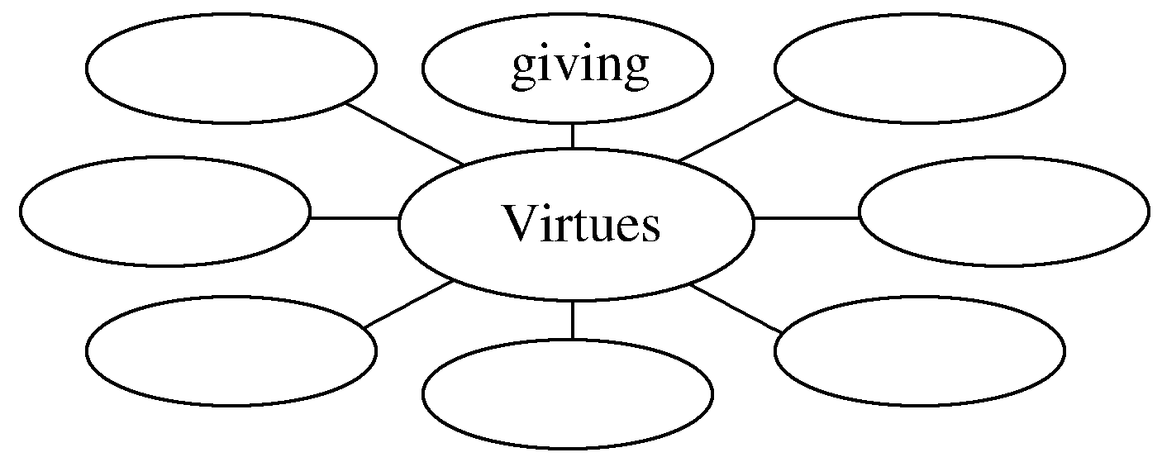
2.Brainstorming：Can you think of some virtues that are admired in our culture?
________________________________________________________________________
friendship，hope，kindness，generosity，help，honesty，responsibility，courage...

Slide 7
3.Look at the picture on Page 14 and tell your classmates what happened to the boy in the cartoon.
He had a moral dilemma and didn’t know whether he should help the woman in trouble or go to school at once in order not to be late for class.
________________________________________________________________________
________________________________________________________________________
4.Finish Ex.1 on Page 14.

Slide 8
5.Try to translate the sentence in various ways.
他不相信命运。
①____________________________________________________________________
②____________________________________________________________________
③____________________________________________________________________
④____________________________________________________________________
⑤____________________________________________________________________
He doesn’t believe in fate.
He doesn’t trust fate.
He lacks faith in fate.
He doesn’t have any belief in fate.
He has no belief in fate.

Slide 9
1.Finish Ex.2 on Page 14.
2.Finish Ex.3 on Page 14.
3.Finish Ex.4 on Page 15.

Slide 10
1.Speaking—Finish Ex.5 on Page 15 by following the example.
A：If I were ever in a situation like the one (that) the girl faced，I think I would choose to help her and send her to the nearest hospital.
B：Why? Are you sure?
A：Because I think that for us life is the most important.What about you?
B：I think I would do the same as you.

Slide 11
2.Pronunciation
The meaning of rising intonation in the conversations.
(1)A：Jean，can you bring me the newspaper?
B：↗Sorry?
Jean用升调说Sorry，其意思是I didn’t hear you.Could you say that again，please?
(2)A：Jean，can you bring me the newspaper?
B：↙Sorry.
Jean用降调说Sorry，显然其意思是拒绝帮助或无能为力。

Slide 12
(3)A：Mr.Smith thinks we ought to get the money in hand first.
B：↗Who?
A：Mr.Smith.
B用升调说Who，表示听不清对方谈话中的某一部分，要求对方再重复那一部分。
(4)A：We’d like to have someone to say a word at the beginning to welcome the group.
B：↙Who?
A：We thought that you or Dr.Johnson might do it.
B用降调说Who，其意思是问，对方想让谁在开场时致欢迎词。

Slide 13
语言知识积累
表示个人态度的常用表达
1.He is always eager to win.
他总是渴望能赢。
2.I believe he is most painfully anxious about Diana.
我相信他肯定非常担心黛安娜。
3.I have no doubt that it will bring about closer ties between us.
毫无疑问，它将使我们双方建立更紧密的联系。
4.He doubts being able to finish in time.
他怀疑能否及时完成。

Slide 14
5.We admire his working so hard.
我们钦佩他工作努力。
6.We believe him an excellent student.
我们认为他是个优秀学生。
7.Jocelyn says he didn’t do it，but I still wonder.
杰斯林说他没那样做，可我仍然怀疑。
8.I disagree totally with this policy.
我完全不赞成这项政策。

Slide 15
文化知识习得
为什么德非常重要？
有德有才是正品，有德无才是次品，无德无才是废品，有才无德是危险品。如果追溯，早在北宋时期司马光就曾给出了最为精辟的论断：才者，德之资也；德者，才之帅也；自古以来，国之乱臣，家之败子，才有余而德不足也。

Slide 16
学习策略形成
1.学会用不同的句式表达态度。
2.学会根据句子中的语调判断说话人的态度。
句子的语调意义
一句话除了词汇意义(lexical meaning)还有语调意义(intonation meaning)。
语调意义就是说话人用语调所表示的态度或口气。一句话的词汇意义加上语调意义才算是完全的意义。
同样的句子，语调不同，意思就会不同，有时甚至会相差千里。

Slide 17
moral adj.道德的；道义上的 n.品行；道德；寓意
Talk about moral dilemmas (教材P₁₄)谈论道德困境
[合作探究] 体会moral的用法和意义
①The moral of this story is that one must see the beauty in what one has.
故事的____________是一个人必须看到已有之物的美处。
②Confucius felt happy with this，because it is moral to take possession of things like this.
孔子为此感到很高兴，因为这种获取是合乎道德的。
寓意

Slide 18
[自主发现]
③the moral ____________... ……的道德教训，寓意
④it’s moral ____________... 做……是合乎道德的
[词块积累]
a moral tale一个道德故事
a moral person 有道德的人
a moral judgement 道德判断
moral standards 道德标准
improve public morals 改善社会道德
of
to do

Slide 19
[巩固内化] 单句语法填空
①The moral ____________ the story is that “solidarity is strength”.
②It is not moral ____________(do) so.
of
to do

