Slide 1

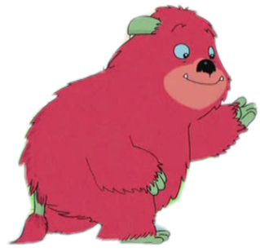

Unit3 look and see
第一课时
WWW.PPT818.COM

Slide 2

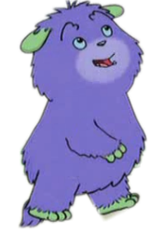
Humf’s father
Humf

Slide 3
Free talk
A: What’ s the weather
like today?
B:It’s…
A: Do you like …?
B: Yes, I do. /No, I don’t.

Slide 4

cloudy
sunny
windy
rainy

Slide 5
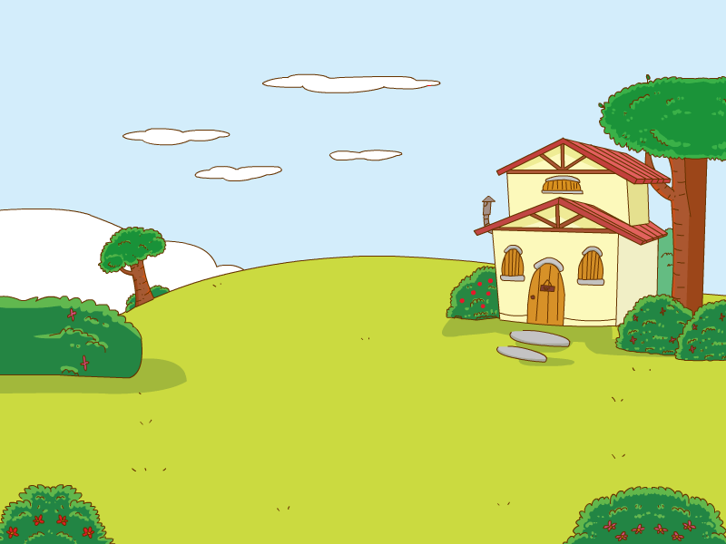

OK! Let’s go !
It is a sunny day. Let’s go out.
PPT模板：www.1ppt.com/moban/ PPT素材：www.1ppt.com/sucai/
PPT背景：www.1ppt.com/beijing/ PPT图表：www.1ppt.com/tubiao/
PPT下载：www.1ppt.com/xiazai/ PPT教程： www.1ppt.com/powerpoint/
资料下载：www.1ppt.com/ziliao/ 范文下载：www.1ppt.com/fanwen/
试卷下载：www.1ppt.com/shiti/ 教案下载：www.1ppt.com/jiaoan/
PPT论坛：www.1ppt.cn PPT课件：www.1ppt.com/kejian/
语文课件：www.1ppt.com/kejian/yuwen/ 数学课件：www.1ppt.com/kejian/shuxue/
英语课件：www.1ppt.com/kejian/yingyu/ 美术课件：www.1ppt.com/kejian/meishu/
科学课件：www.1ppt.com/kejian/kexue/ 物理课件：www.1ppt.com/kejian/wuli/
化学课件：www.1ppt.com/kejian/huaxue/ 生物课件：www.1ppt.com/kejian/shengwu/
地理课件：www.1ppt.com/kejian/dili/ 历史课件：www.1ppt.com/kejian/lishi/
Look! Dad!The sun rises in the morning.

Slide 6



I find a friend.
Can you guess?

Slide 7

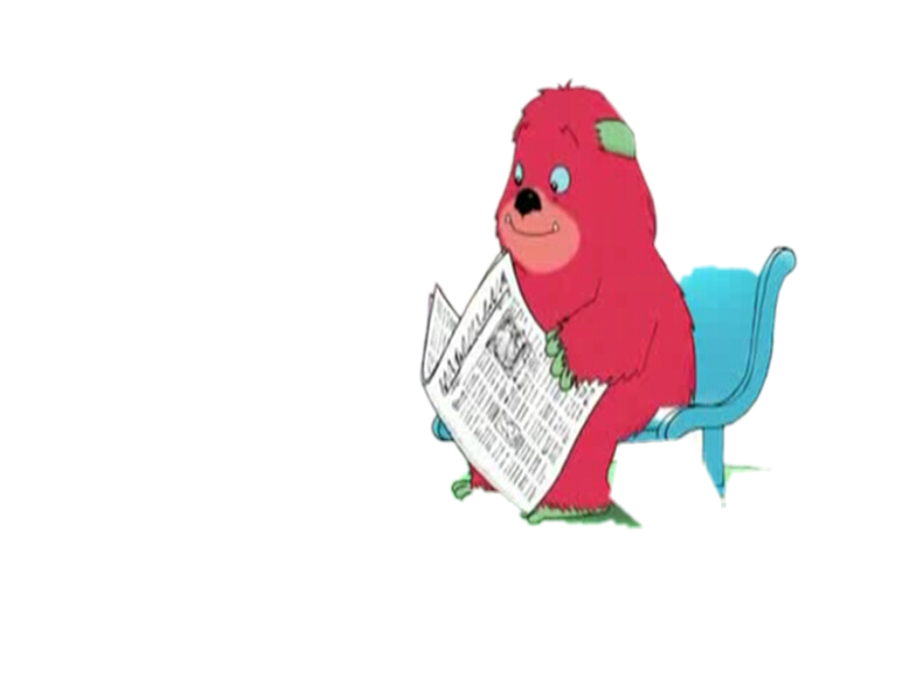
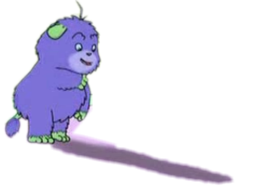
Look!Dad! It’s my shadow. It’s long.
Haha.The shadow is your friend.
But why the shadow is long?

Slide 8



Do you know?
How do our shadows change
from morning to evening?

Slide 9
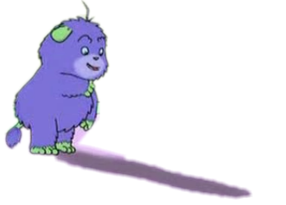
Dad!I know the reasons. I like my shadow.

Slide 10
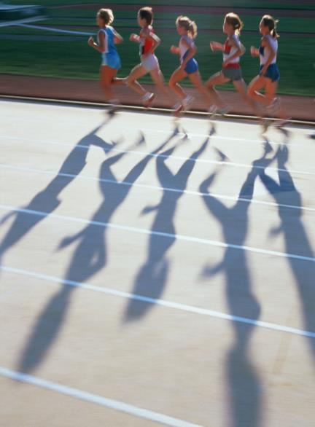
Let’s guess
sh_d_ _
a
o w
fat
blow
bad
window

Slide 11

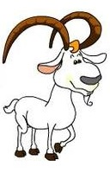




Let’s guess
Whose shadow is it?

Slide 12

rise
rise
s
rises
The sun rises in the morning.

Slide 13

in the morning

Slide 14

At noon, the sun is high in the sky.

Slide 15

at noon

Slide 16
go down
go
es
goes down
The sun goes down in the evening.

Slide 17
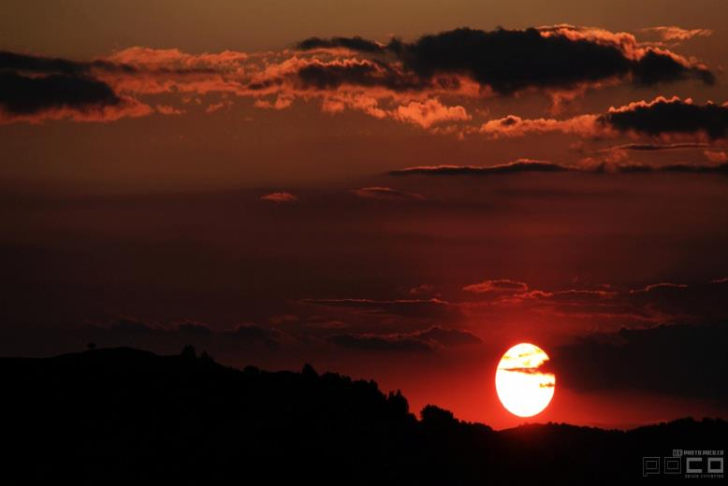
in the evening

Slide 18



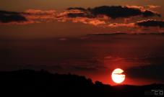
Sing a song
The sun rises in the morning.
The sun rises in the morning.
The sun goes down in the evening.
The sun goes down in the evening.

Slide 19




The green balloon rises in the sky.
The red balloon goes down in the sky.

Slide 20

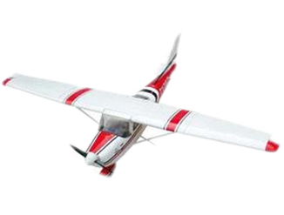
The plane rises in the sky.
20

Slide 21
The plane goes down in the sky.
21

Slide 22



a. at noon
b. in the evening
c. in the morning

Slide 23
Role play
Let’s act the story.

Slide 24
OK! Let’s go !
It is a sunny day. Let’s go out.
Look! Dad! The sun rises in the morning.

Slide 25
I find a friend.
Can you guess?

Slide 26
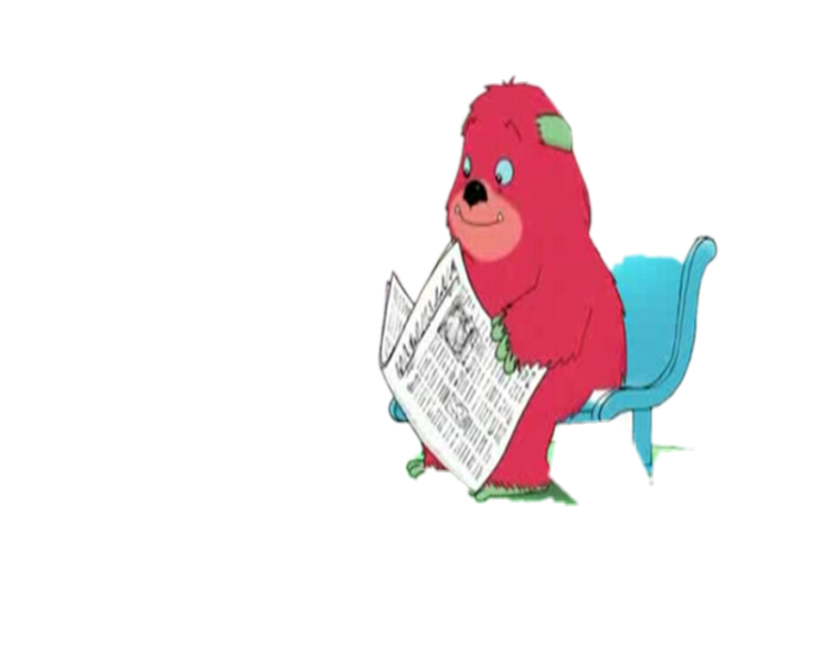
Look! Dad! It’s my shadow. It’s long.
But why the shadow is long?

Slide 27
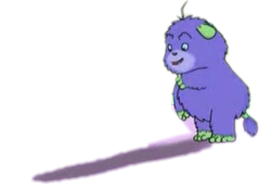

The sun rises in the morning.
The shadow is long.

Slide 28

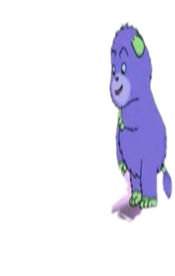
At noon, the sun is high in the sky.
The shadow is short.

Slide 29

The sun goes down in the evening.
Look at the shadow.
It is long again.

Slide 30
Dad!I know the reasons. I like my shadow.

Slide 31
Read and choose
in the morning
in the evening
at noon
The sun goes down ________________.
Look at the shadow. It is long again.
in the evening
___________, the sun is high in the sky. The shadow is short.
At noon
The sun rises _________________.
The shadow is long.
in the morning

Slide 32

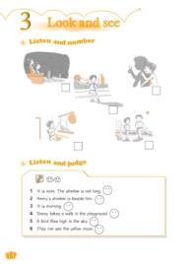
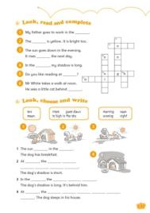
Homework
1. Read the passage on page 10 twice.
2. Sing the song on page 11.

