Slide 1
Unit 4
Don’t eat in class.
Section B
WWW.PPT818.COM

Slide 2
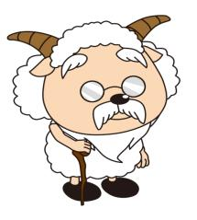
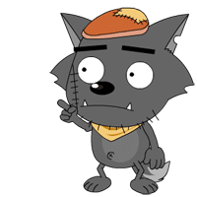
What can we do at school? What can’t we do? And what do we have to do? Talk about school rules.
创设情境
Are there any rules at home? What can you do? What can’t you do? And what do you have to do? Make a list.

Slide 3
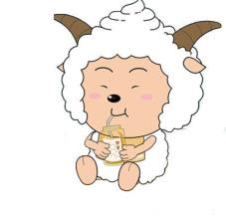
启发思考
Let’s look at the rules of the Jones family.

Slide 4
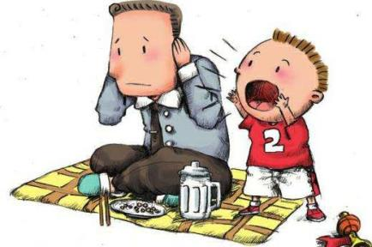
FAMILY RULES
Don’t talk loudly.
Notes:
4
中国英语教师网

Slide 5
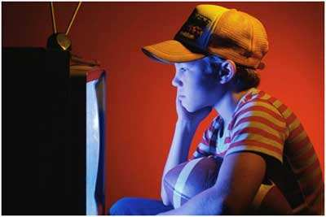
FAMILY RULES
Don’t watch TV late at night.

Slide 6
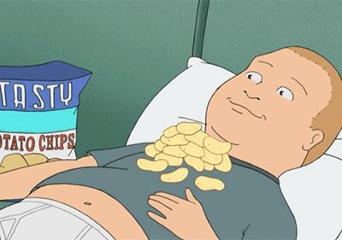
FAMILY RULES
Don’t eat in bed.

Slide 7
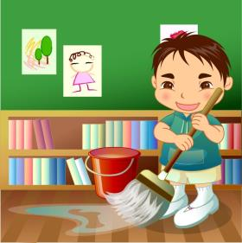
FAMILY RULES
Clean the bedroom on Saturdays.

Slide 8
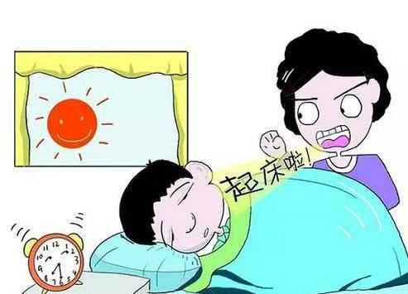
FAMILY RULES
Don’t get up late on Sundays.

Slide 9
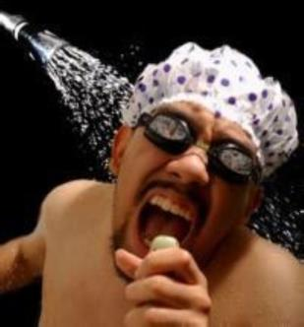
FAMILY RULES
Don’t sing loudly at night.

Slide 10
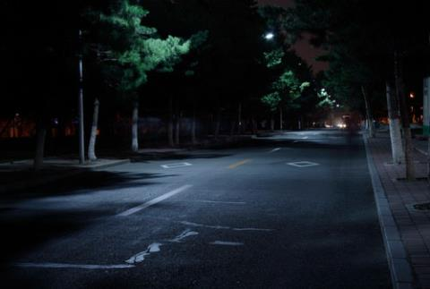
FAMILY RULES
Don’t go out on school nights.

Slide 11
FAMILY RULES
Do your homework after school.

Slide 12
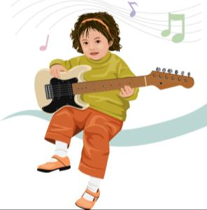
FAMILY RULES
Practice the guitar every day.

Slide 13
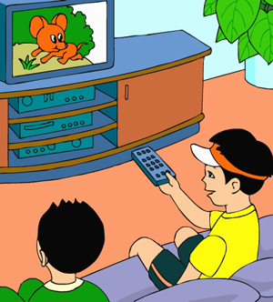
FAMILY RULES
Don’t watch TV after school.

Slide 14
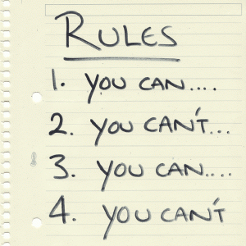
Do you have any other family rules?

Slide 15
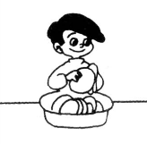
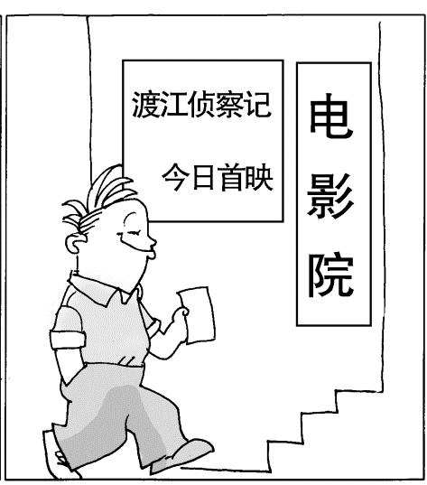
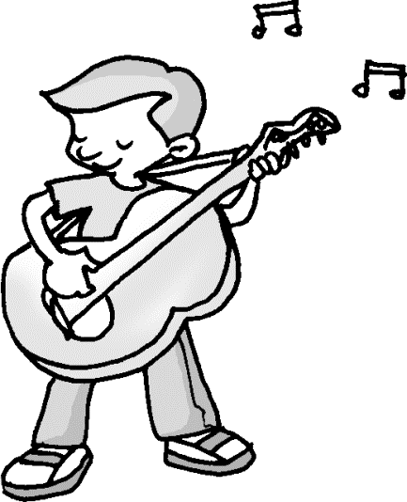
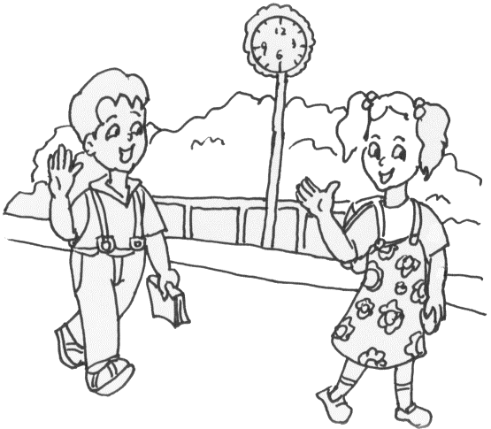
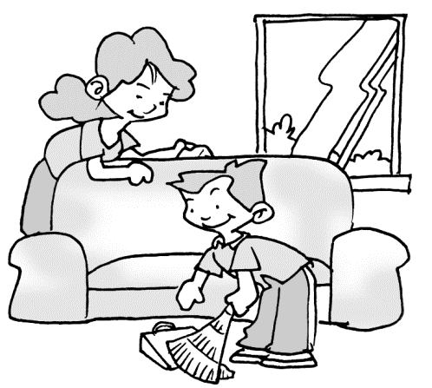
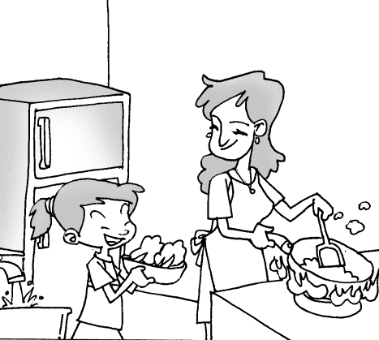
Main phrases
go out
practice the guitar
do the dishes
see friends
clean his room
help mom make breakfast

Slide 16
1a Read the rules in the chart in 1b. Then match the picture〔a-h〕with the rules.
自主或小组探究
 | Rules | Can’t (×) | Have to/ Must (√) | When
a | go out | × |  | on school nights
 | see friends
 | do his homework
 | practice the guitar
 | do the dishes
 | watch TV
 | help his mom make breakfast
 | clean his room
h
c
e
b
g
d
f

Slide 17
1b Listen and put an × for things Dave can’t do and a √for things he has to do.
 | Rules | Can’t (×) | Have to/ Must (√) | When
a | go out | × |  | on school nights
 | see friends
 | do his homework
 | practice the guitar
 | do the dishes
 | watch TV
 | help his mom make breakfast
 | clean his room
h
c
×
e
√
b
√
g
√
d
×
f
√
√

Slide 18
1c Listen again.
 | Rules | Can’t (×) | Have to/ Must (√) | When
a | go out | × |  | on school nights
 | see friends
 | do his homework
 | practice the guitar
 | do the dishes
 | watch TV
 | help his mom make breakfast
 | clean his room
on school days
after class
before dinner
after dinner
in the evening
every morning
every Saturday

Slide 19
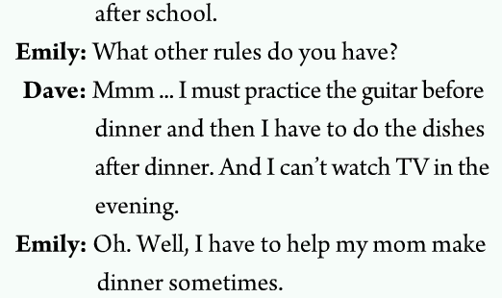
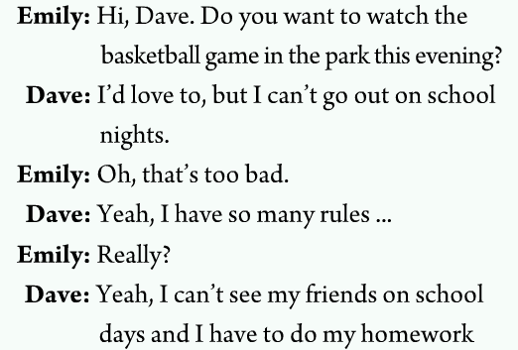
Tapescript

Slide 20
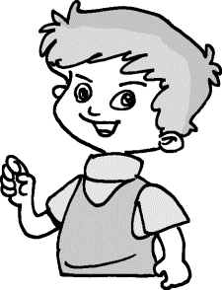
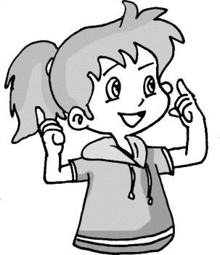
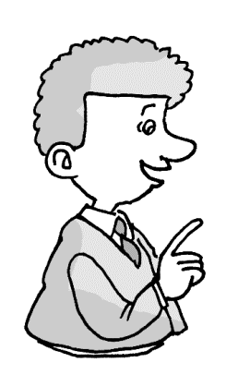
1d Talk about the rules in Dave’s house in groups.
He can’t watch TV in the evening.
He can’t go out on school nights.
He can’t see his friends on school days.

Slide 21
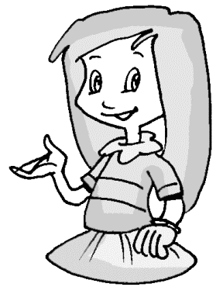
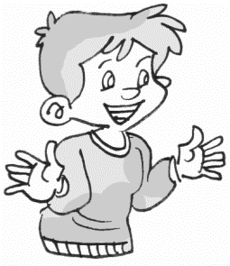
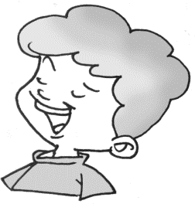
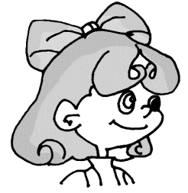
He has to help his mom make breakfast every morning.
He has to do his homework after school.
He must clean his room every Saturday.
He must practice the guitar before dinner.

Slide 22
Report
Report Dave’s rules. See who is the best?
He can’t go out on school nights. He can’t see his friends on school days. He has to do his homework after school. He must practice the guitar before dinner. He can’t watch TV in the evening. He has to help his mom make breakfast every morning. He must clean his room every Saturday.
Notes:
22

Slide 23
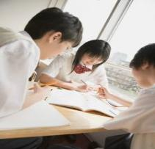
Task 1 : My family rules
Let students talk about their family rules in groups, and then report.
Sample:
I have many rules in my
family. I have to do my home-
work after school. I can’t
watch TV on school nights...

Slide 24
Task 2 : Class survey
Make a list of the rules at your houses.
Make a survey.
Do a quick check to see which rules
are the most common.
A: Maria, do you have to go to bed by 10:00?
B: Yes, I do.

Slide 25
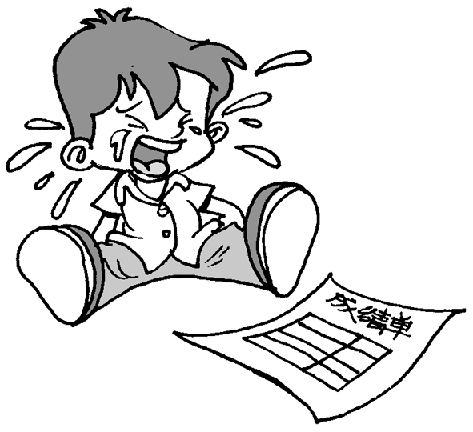
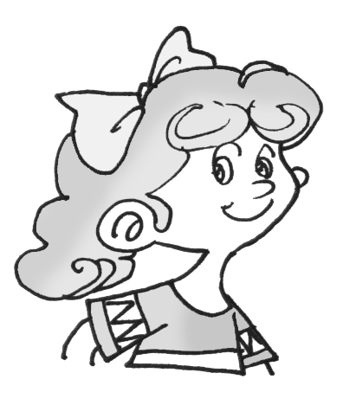
协作交流
2a When you are unhappy about something, who do you like to talk to.
My good fiend? My father? My mother? My cousin? My teacher?
You can talk to Dr Know. He knows everything.

Slide 26
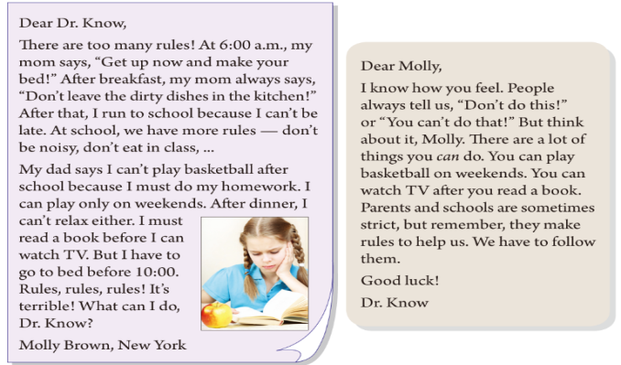
2b Read the passage. Underline the rules for Molly.

Slide 27
阅读指导
通读全文，掌握文章的大意。
2. 题目要求我们寻找有关Molly在家庭及在学校里的规则。表达规则的句子常为祈使句、或含有must及have的句子。
3. 读短文寻找这种类型的句子。根据句意确定是否是她的规则。
4. 最后, 再读一遍课文, 检查一下答案的正确性。

Slide 28
2c Read the letters and complete the sentences with have to/ must, can or can’t.
Molly _______ play basketball on school days, but she ______ play it on weekends.
2. Molly ___________ do her homework first when she gets home.
can’t
can
has to/must

Slide 29
3. Molly __________ read a book after dinner before she ______ watch TV.
4. At school, Molly _____ be noisy or eat in class.
5. Parents and schools make rules to help students. So students _____________ follow the rules.
has to/must
can
can’t
have to/ must

Slide 30
3a Complete Zhao Pei’s letter to Dr. Know using have to/must, can or can’t.
Dear Dr. Know, ______ you help me? I’m not happy because there are too many rules at home. Every morning, I ___________ get up at six o’clock. At school, I ___________ wear a school uniform, and I _____________ keep my hair short.
Can
have to/ must
have to/ must
have to/ must

Slide 31
After school, I ________ play with my friends or watch TV because I _____________ do my homework. I ______relax on weekends either because I _____________ learn to play the piano. I never have fun. What ____________ I do? Zhang Pei
can’t
have to/ must
can’t
have to/ must
can

Slide 32
3b Complete the chart with the rules in your home and school. Check the rules you think are unfair.
Things I have to do | Things I can’t do
I must get up before 6:30 and practice English.
I can’t go out on school nights.
I must do the homework first after school.
I can’t watch TV before I practice the piano.
I have to wear the uniform at school.
I can’t be noisy or eat in class.
I have to keep my hair short.
I can’t see friends on school days.

Slide 33
Reading
1. Is Zhao Pei happy? Why or why not?
2. When does she have to get up every morning?
3. Can she play with her friends after school? Why?
No, she isn’t.
Because she has many rules in her family.
She has to get up at six o’clock.
No, she can’t.
Because she has to do her homework.

Slide 34
4. Can she watch TV on school nights?
5. What does she have to do on weekends?
6. Does she have any fun?
No, she can’t.
She has to learn to play the piano.
No, she doesn’t.

Slide 35
Can you list the rules of Zhao Pei’s family?
1. Get up at 6 o’clock.
2. Wear a school uniform, keep my hair short.
3. Can’t play with friends after school.
4. Can’t watch TV after school.
5. Do homework after school.
6. Learn the piano.

Slide 36
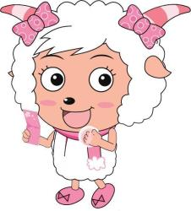
If you are Zhao Pei, will you be happy? Why or why not?

Slide 37
Task 1
If you have a chance to make some rules for your parents, what rules would you like to make?

Slide 38
Task 2
Write a letter to your parents in a polite way to make them accept your suggestions.

Slide 39
Language points
总结提高
1. Dear Dr. Know
Dr.为doctor（博士；医生；医师）一词的缩写形式，放于姓氏之前，表示对人的尊称。Dr.采用的是首尾缩写法，取首字母和词尾字母将单词进行缩写。
2. make the bed/make one’s bed 整理床铺
e.g. Bob always makes his bed himself. 鲍勃总是自己整理床铺。
Can you make the bed? 你会整理床铺吗？

Slide 40
3. noisy adj. 意为“吵闹的”
e.g. We can’t be noisy in class. 我们不能在教室里大吵大闹。
4. practice v. 意为“练习”后面可跟名
词、代词或动名词。
e.g. I must practice English every morning. 我每天早晨必须练习英语。
Mr. Xu practices doing Kong fu every
day. 许先生每天练习功夫。

Slide 41
5. After dinner, I can’t relax either. 晚饭后我也不能轻松。
副词either表示“也”，用于否定句句末，用法与表示肯定或陈述的副词too相似，可用逗号与语句的主题隔开。
e.g. You like English. I like it, too.
你喜欢英语，我也喜欢。
My father can’t speak English. My
mother can’t (speak it), either.
我爸不会讲英语，我妈也不会。

Slide 42
6. before 在……之前; after 在……之后；
它们的后面可以跟表示时间的点，也可以跟一个从句表示时间。
e.g. Wash your hands before dinner.
饭前洗手。
Do your homework after school.
放学后做作业。

Slide 43
Brush your teeth before you go to bed. 睡觉前刷一下牙。
Mrs. Wu usually makes dinner for the family first after she gets home. 吴太太在到家之后通常先为家人做饭。
7. be strict (with sb.) (对某人)严格的
e.g. Our math teacher is very strict. 我们的数学老师很严格。
Are your parents strict with you? 你的父母对你严格吗？

Slide 44
8. There are a lot of things you can do.
有许多你可以做的事情。
此句中a lot of things you can do是一个名词短语，句子you can do起着修饰，限定名词things的作用。英语中当句子限定修饰名词时要放在该名词之后。
e.g. There are a lot of songs you can sing.
有许多歌曲你可以唱。

Slide 45
Write a letter to Dr. Know. Tell him about all the rules and how you feel about them.

Slide 46
Dear Dr. Know,
________________________________________________________________________________________________________________________________________________________________________________________________________________________________________________________________________________________________________________________________________________________________________________________Li Yan
Can you help me? I’m not happy because there’re too many rules in my life. I must get up before 6:30 and practice English every morning. I can’t go out on school nights. I can’t meet friends on school days. I must do my homework first after school. I can’t watch TV before I practice the piano.
I have to wear the school uniform at school. I have to keep my hair short. I can’t be noisy or eat in class. What can I do?

