Slide 1
Unit 2 I’ll help to clean up the city parks.
Section A 1a—2d
WWW.PPT818.COM

Slide 2
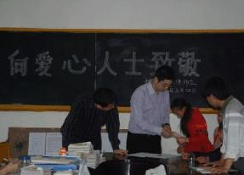
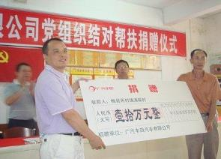
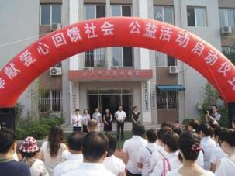
Look and say

Slide 3
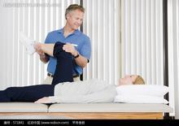
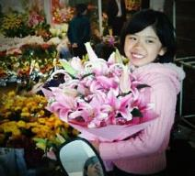
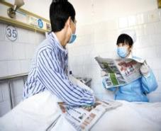
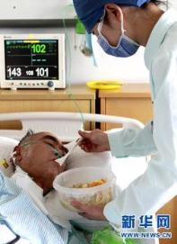
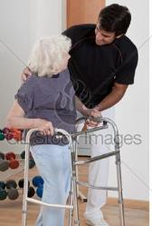
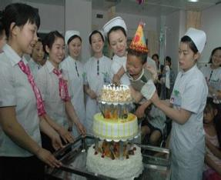
Look and say
—What can you do to help sick people?
—I could…/I’d like to …/I hope to…

Slide 4
1b Listen and number
___ The girl could visit the sick kids in the
hospital to cheer them up.
___ The boy could give out food at the food bank.
___ The girl could volunteer in an after-school
study program to teach kids.
___ The boy could help to clean up the city
parks.
PPT模板：www.1ppt.com/moban/ PPT素材：www.1ppt.com/sucai/
PPT背景：www.1ppt.com/beijing/ PPT图表：www.1ppt.com/tubiao/
PPT下载：www.1ppt.com/xiazai/ PPT教程： www.1ppt.com/powerpoint/
资料下载：www.1ppt.com/ziliao/ 范文下载：www.1ppt.com/fanwen/
试卷下载：www.1ppt.com/shiti/ 教案下载：www.1ppt.com/jiaoan/
PPT论坛：www.1ppt.cn PPT课件：www.1ppt.com/kejian/
语文课件：www.1ppt.com/kejian/yuwen/ 数学课件：www.1ppt.com/kejian/shuxue/
英语课件：www.1ppt.com/kejian/yingyu/ 美术课件：www.1ppt.com/kejian/meishu/
科学课件：www.1ppt.com/kejian/kexue/ 物理课件：www.1ppt.com/kejian/wuli/
化学课件：www.1ppt.com/kejian/huaxue/ 生物课件：www.1ppt.com/kejian/shengwu/
地理课件：www.1ppt.com/kejian/dili/ 历史课件：www.1ppt.com/kejian/lishi/

Slide 5
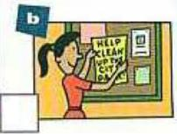
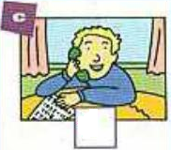
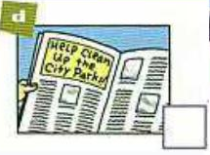
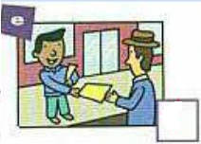
2a Listen and check

Slide 6
2b Listen and fill in the blanks
1. We need to _____ _____ _____ a plan to tell people about the city park clean-up.
2. Clean-up Day is only two weeks from now. We can’t _____ _____ making a plan.
3. We could _____ _____ signs.
4. Let’s make some notices, too. Then I’ll _____
them _____ after school.
5. We could each _____ _____ 10 students and ask them to come.

Slide 7
2d Role-play the conversation
Q: What do they think they should do to the
old people?
They think they should listen to the old people and care for them.

Slide 8
Read and answer
Q1 When did Tom work in the old people’s
home?
Q2 How did most old people feel?
Q3 What did Tom learn from the old people?
He worked there last summer.
They feel lonely.
He learned stories about the past
and how things used to be.

Slide 9
Key points
(1) help out with sth. / doing sth. 帮助……做……
eg. She often helped out with washing in the hotel. 她经常帮助那家旅馆洗东西。
Bob helped out with milking every morning. 每天早晨鲍勃帮着挤牛奶。
(2) used to 过去经常
eg. We used to live in the same house. 我们过去住在同一栋房子里。
I used to go swimming on Saturdays but now I don’t. 我过去常常在星期六去游泳，但现在不。
He used not to like fish, but now he does. 他过去一直不喜欢吃鱼，但现在他喜欢了。

Slide 10
(3) We should listen to them and care for them. 我们应该倾听他们并照料他们。
care for sb. / sth. / v.-ing 喜欢；照料，服侍
eg. I care for music. 我喜欢音乐。
He doesn’t care for money. 他不爱财。
She cares for the children as if they were her own. 她就像照顾自己的孩子一样照看这些孩子们。
Who is going to care for our sick friend? 谁将照顾我们有病的朋友？
She always cares for my health. 她一直关心我的健康。
We must care for each other, must love and help each other. 我们必须互相关心，互相爱护，互相帮助。

Slide 11
Homework
Please choose one of them as your homework.
A. Listen to the tape and read after the tape of 1b,2a, 2b, 2d for three times and try to remember the new words and expressions of this lesson.
B. Make a conversation according to the conversation in Section A 2d.

