Slide 1
Unit 6 Lesson 1
My father has short hair.
WWW.PPT818.COM

Slide 2
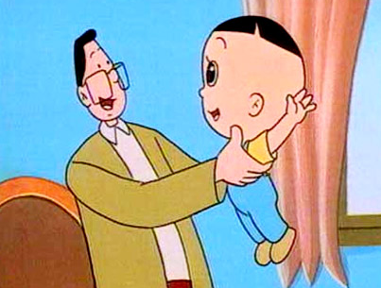
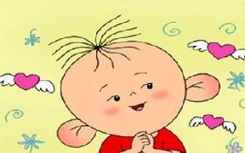
Head, head, I have big head.
Eyes, eyes, I have small eyes.
Ears, ears, I have big ears.

Slide 3
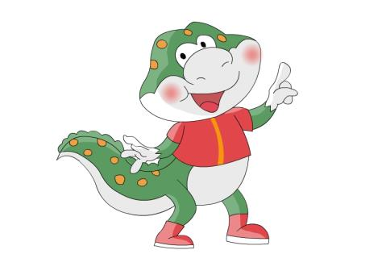
He has big head.

Slide 4
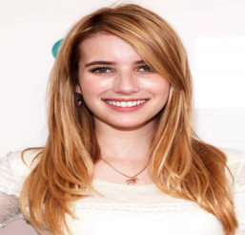
Listen and answer
What’s Tom’s mother like?
Tom的妈妈是什么样子？
She has long hair.

Slide 5
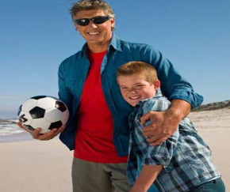
Listen and answer
What’s Tom’s father like?
Tom的爸爸是什么样子？
He has short hair.

Slide 6
Listen and answer
What’s Tom’s father like?
Tom的爸爸是什么样子？
He is _______ and ________.
tall
strong

Slide 7
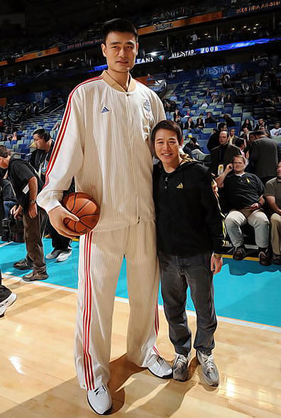
t
all
tall
short

Slide 8
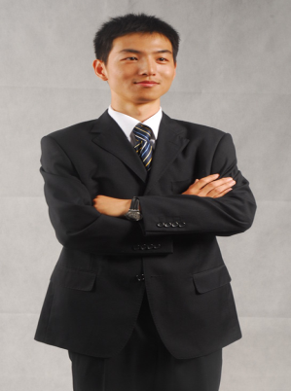
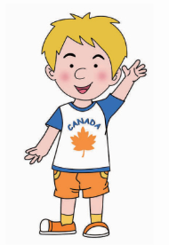
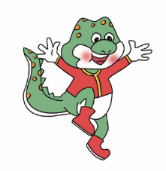
Is that your
father?
No. My father is
_____and______.
tall
strong

Slide 9
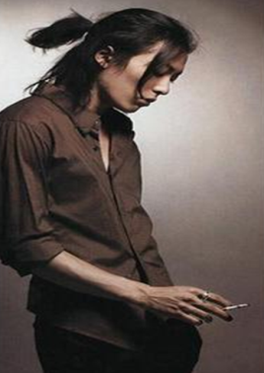
Is that your
father?
No. My father has ______ hair.
short

Slide 10
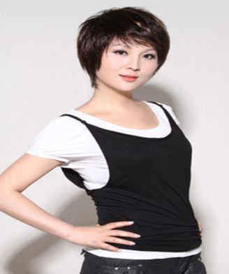
Is that your mother?
No. My mother has _____ hair.
long

Slide 11
Let's chant!
Is that your father?
No No
My father is tall.
My father is strong
Is that your mother?.
No No
My mother has long hair.

Slide 12
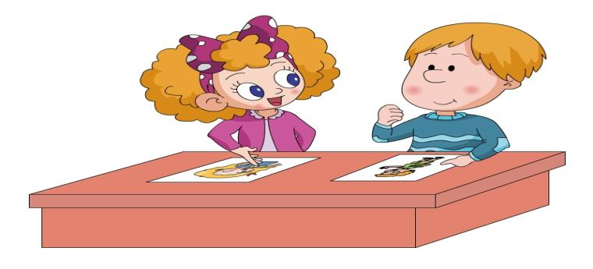
Let’s talk!
This is my brother.
He’s tall. He has big eyes.
Look! This is my sister.
She has long hair.

Slide 13
Group work
He is/She is ______.
He/She has ______.
He/She likes__________.

Slide 14
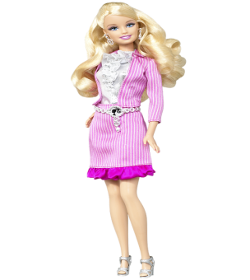
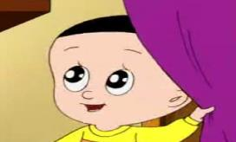
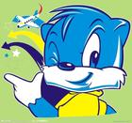
芭比
I like _____.
He/she has ____.

Slide 15
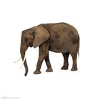
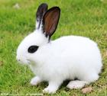
It’s an animal. It’s big and strong.
It has four legs. It has two big ears. It has long nose.
What is it? Guess.
你能猜到吗？
It’s an animal. It’s small.
It has two long ears. It has two red eyes.
And it’s has a short tail.
What is it? Guess.

Slide 16
Homework：
1、Listen to the tape and read after the tape
2、用今天所学的句型向你爸爸妈妈描述你的朋友。

