Slide 1
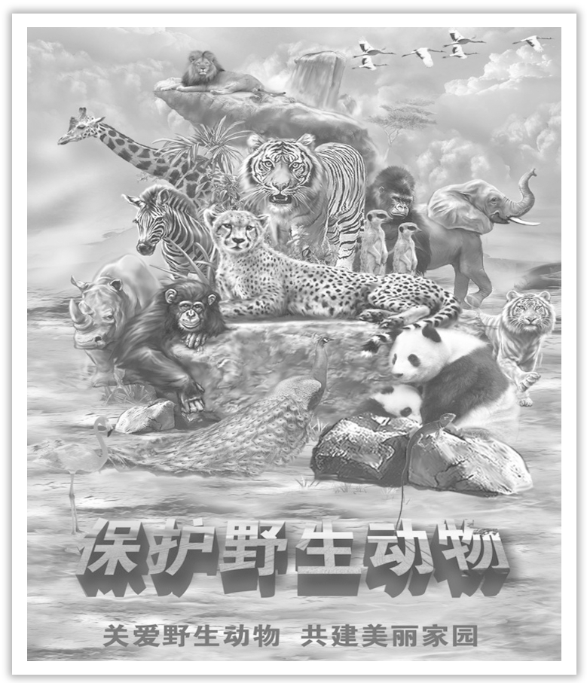
Unit 2 Wildlife Protection
Section Ⅲ Reading and Thinking(2)
WWW.PPT818.COM

Slide 2
Ⅰ.单词语境记忆——根据汉语提示写出单词的适当形式
1.The book is ____________ (保留) to whoever comes first.
2.The farmer gained a lot of experience by ____________ (观察) the growth of his vegetables.
3.If sales continue to recover, they can hire more workers and still make ____________ (利润).
4.The man was walking in the wood when he was ____________ (攻击) by a snake.
reserved
observing
profits
attacked

Slide 3
5.The medicine is an ____________ (有效的) cure for a headache.
6.He is ____________ (恢复) now.There is no need to call in a doctor.
7.The patient had to have one of his legs ____________(去除) because of infection.
8.It is a big surprise to learn that you ____________(打算) to spend your winter holiday in China.
9.Drunk driving not only affects our everyday life, but may also ____________(威胁) people’s lives.
10.As we all know, water ____________(存在) in three forms：solid, liquid and gas.
effective
recovering
removed
intend
threaten
exists

Slide 4
Ⅱ.短语语境填空——根据汉语提示写出适当的短语
1.It is convenient for parents to ________________(监督) their children’s net activities.
2.He worked ________________(日日夜夜), hoping to earn more money for his family.
3.His writing is so confusing that it’s hard to ________________(分清) what it is that he’s trying to express.
4.To protect our environment and live ________________(与……和谐) animals is every citizen’s duty.
5.He put up a picture of Yao Ming beside the bed to ________________ (提醒自己) his own dream.
watch over
day and night
make out
in harmony with
remind himself of

Slide 5
Ⅲ.句式语境仿写
1.This is why we’re here—to observe Tibetan antelopes.
这就是我们来这里的原因——观察藏羚羊。
[仿写] 这就是我想找一个母语是英语的寄宿家庭的原因。
________________________________________ a host family who are native English.
2.They are being hunted illegally, for their valuable fur.
它们因为珍贵的皮毛而正在被非法猎杀。
[仿写] 一项调查正在进行，以找出今天的年轻人最喜欢什么。
_______________________________________ what today’s young people enjoy most.
That’s why I want to find
A survey is being conducted to find out

Slide 6
3.Only when we learn to exist in harmony with nature can we stop being a threat to wildlife and to our planet.
只有当我们学会与自然和谐相处时，我们才能停止对野生生物和地球的威胁。
[仿写] 只有当他看到这幅画时，他才能决定这幅画是否值得买。
________________________________________________ whether the painting is worth buying.
Only when he sees the painting can he decide

Slide 7
记单词
语境串记多义词
1.In the reserve, lots of animal species are reserved very well, and the reserve of food for rare animals is guaranteed.If you come to pay a visit, you must reserve the ticket.
该保护区内许多动物物种被保存得很好，而且为珍稀动物储藏的食物是有保证的。如果你要来参观，你必须预订门票。
2.The people who live on the plain are usually very plain in character, and they live a plain life in a plain way.
这些生活在平原上的人们通常在性格上很直率，而且他们以一种简单明了的方式过着平凡的生活。

Slide 8
3.When George observed the flowers, other villagers were observing their Flower Festival.They all observed a habit of sending beautiful flowers to their loved ones.
当乔治观察这些花时，其他村民在庆祝他们的花节。他们都遵守着一个习惯，送美丽的花给他们所爱的人。

Slide 9
句型公式
1.This/That is why...，why引导表语从句。
2.“be＋being＋过去分词”，进行时的被动语态。
3.“only＋状语”位于句首的倒装句式。

Slide 10
Understanding in context
A DAY IN THE CLOUDS
The air is thin and we have to rest several times on the short hike from camp.To our left, snow-covered mountains disappear into clouds that seem almost close enough to touch.On the plain in front of us, we can just make out a herd of graceful animals.This is why we’re here—to observe Tibetan antelopes.
Tibetan antelopes live on the plains of Tibet, Xinjiang, and Qinghai.Watching them move slowly across the green grass, I’m struck by their beauty.I’m also reminded of the danger they are in.They are being hunted，illegally, for their valuable fur.

Slide 11
My guide is Zhaxi, a villager from Changtang.He works at the Changtang National Nature Reserve.The reserve is a shelter for the animals and plants of northwestern Tibet.To Zhaxi, the land is sacred and protecting the wildlife is a way of life.“We’re not trying to save the animals，” he says.“Actually, we’re trying to save ourselves.”

Slide 12
[文化视窗]
藏羚羊生活在中国的青藏高原，被称为“可可西里的骄傲”，其底绒非常柔软，是国家一级保护动物。藏羚羊背部呈红褐色，腹部为浅褐色或灰白色。 成年雄性藏羚羊脸部呈黑色，腿上有黑色标记，头上长有竖琴形状的角可以御敌；雌性藏羚羊没有角。 成年雌性藏羚羊身高约75厘米，体重约25-30公斤； 雄性藏羚羊身高约80-85厘米，体重约35-40公斤。

Slide 13
1.observe vt.观察(到)，看到，注意到；注视；遵守；庆祝
[合作探究] 体会observe的用法和意义
①We often observe the behavior of birds.我们经常____________鸟类的行为。
②With a joyful heart we observed our National Day.
我们满怀喜悦的心情____________国庆节。
③Anyone who comes here must observe the rules.
来这儿的任何人都必须____________规定。
④I observed her walk away with a smile.我____________她微笑着走开了。
⑤Mr.Wang observed a man trying to force the lock.
王先生看到/注意到有个人正在设法撬锁。
观察
庆祝
遵守
看到/注意到

Slide 14
[自主发现]
⑥observe sb ____________ sth 看到/注意到某人做了某事
⑦observe sb ____________ sth 看到/注意到某人正做某事
do
doing

Slide 15
[巩固内化]
单句语法填空/同义替换
①He observed a stranger ____________ (hang) around the store at 12 pm last night.
②Last night Bruce was observed ____________ (leave) the building with two young men and take a taxi away.
③Masses of people observe (＝____________) the Chinese Farmers’ Harvest Festival which falls on the Autumnal Equinox(秋分) of the lunar calendar each year.
hanging
to leave
celebrate

Slide 16
2.reserve n.(动植物)保护区；储藏(量)vt.预订；预留；保留
[合作探究] 体会reserve的用法和意义
Zhalong Nature Reserve is one of the world’s most important wetlands.
扎龙自然保护区是世界上最重要的湿地之一。
We reserved/booked two tickets in the name of Brown.
我们以布朗的名义预订了两张票。
You’d better reserve your strength for tomorrow’s climb.你最好为明天爬山留点力气。
She told me all about it without reserve.她毫不保留地告诉我这件事。
[自主发现]
____________ reserve 有/无保留地
with/without

Slide 17
[常用词块]
nature reserve 自然保护区
reserve a table 预订餐桌
reserve the right 保留权利
[巩固内化] 单句语法填空
Sorry, these two tables have been already ____________ (reserve).You may book the one over there.
[思考] 表示“预订”的词还有哪些？
____________________________________________________________________
reserved
book, order

Slide 18
3.make out看清；分清；听清；辨认出；理解
①It was difficult to make out the doctor’s handwriting.
这名医生的字迹很难辨认。
[短语记牢] 记牢下列短语
make up 组成；编造；化妆；弥补
make of 由……组成 (可以看出原材料)
make from 由……组成 (看不出原材料)
make it 获得成功；渡过难关；准时到达

Slide 19
②Kate heard a man’s voice in the background, but she couldn’t make out what he was saying.
凯特在背景中听到一个男人的声音，但她听不清楚他在说什么。
③The teacher asked the students to make up a poem about this story.
老师让学生们就这个故事编一首诗。
④You will make it if you try.你会成功的，如果你努力的话。

Slide 20
[巩固内化]
(1)介、副词填空
①We have to drive fast to make ____________ the hours we lost in Boston.
②Nylon is made ____________ air, coal and water.
③This salad is made ____________ apples, pears, potatoes and celery.
(2)翻译句子
④我不能理解这段文章的意思。
________________________________________________________________________
up
from
of
I can’t make out the meaning of this passage.

Slide 21
4.This is why we’re here—to observe Tibetan antelopes.这就是我们来这里的原因——观察藏羚羊。
【句式解读】 This is why...中why引导的是表语从句，意为“这就是……的原因。” why引导的表语从句表示结果。
【用法总结】
(1)“This is why...”有时也用“That is why...”表达。
①That’s why I must trust you to keep this secret.
那就是我必须得相信你会保守这个秘密的原因。

Slide 22
(2)This/That is because...“这/那是因为……”，为because引导的表语从句，表示原因。
②This is because plants can make food from air, water and sunlight.
这是因为植物可以从空气、水和阳光中制造食物。

Slide 23
[巩固内化] 翻译句子
①这就是我们取得如此大的进步的原因。
________________________________________________________________________
②那是因为我太在乎你了！
________________________________________________________________________
This is why we made so great progress.
That is because I care too much about you!

Slide 24
Understanding in context
The 1980s and 1990s were bad times for the Tibetan antelope.The population dropped by more than 50 percent.Hunters were shooting antelopes to make profits.Their habitats were becoming smaller as new roads and railways were built.
In order to save this species from extinction, the Chinese government placed it under national protection.Zhaxi and other volunteers watched over the antelopes day and night to keep them safe from attacks.Bridges and gates were added to let the antelopes move easily and keep them safe from cars and trains.

Slide 25
The measures were effective.The antelope population has recovered and in June 2015, the Tibetan antelope was removed from the endangered species list.The government, however, does not intend to stop the protection programmes, since the threats to the Tibetan antelope have not yet disappeared.
In the evening, I drink a cup of tea and watch the stars.I think about the antelopes and what Zhaxi told me.Much is being done to protect wildlife, but if we really want to save the planet, we must change our way of life.Only when we learn to exist in harmony with nature can we stop being a threat to wildlife and to our planet.

Slide 26
[文化视窗]
中国政府十分重视藏羚羊等野生生物的保护工作。1981年中国加入《濒危野生动植物种国际贸易公约》。1988年《中华人民共和国野生动物保护法》颁布后，由中国国务院随即批准发布的《国家重点保护野生动物名录》将藏羚羊确定为国家一级保护野生动物，严禁非法猎捕。截止到2005年底，青海可可西里国家级自然保护区和周边藏羚羊种群数量已从1998年的不足2万只恢复到5万多只；西藏的藏羚羊种群数量已经从1999年的7万只恢复到目前近10万只；新疆境内现有藏羚羊约5至6万只。

Slide 27
5.attack n.&v.攻击；抨击
[合作探究] 体会attack的用法和意义
The man died of a heart attack，which is caused by his lifestyle.
这名男子死于由他的生活方式引起的心脏病。
When an animal is under attack, it can run away or fight back.
当动物受到攻击时，它会逃跑或还击。
If you go there alone after dark, you might get attacked or robbed.
如果你天黑后一个人去那里，可能会被攻击或抢劫。

Slide 28
[自主发现]
①heart attack/disease ____________
②____________ 受到攻击
③be/get ____________ 被攻击；被袭击
心脏病
under attack
attacked

Slide 29
[巩固内化]
(1)单句语法填空
①Even plants can run a fever, especially when they’re ____________ attack by insects or disease.
(2)补全句子
②If someone ____________________________ (患了心脏病), his heart begins to beat irregularly or stops completely.
③Travelling to forests can also be dangerous as people have to face the risk of _____________________________________ (被动物攻击).
under
has a heart attack
being attacked by animals

Slide 30
6.recover vi.恢复；康复vt.找回；寻回 recovery n.康复；恢复
[合作探究] 体会recover及其派生词的用法和意义
He’s now fully recovered from his stroke.他现已从中风病中完全康复了。
I nearly fell but managed to recover myself.
我差一点倒下，但最后还是站稳了脚跟。
To the delight of his proud parents, he has made a full recovery.
令他自豪的父母高兴的是，他已经完全康复了。

Slide 31
[自主发现]
①recover ____________ 从……中康复
②recover oneself 站稳；静下心来；恢复过来
③make a full recovery 全面康复
from

Slide 32
[巩固内化] 单句语法填空
①When the girl recovered ____________ shock, she called 110.
②She seemed upset but quickly recovered ____________ (her).
③This medicine is quite beneficial to his ____________ (recover) after the operation.
from
herself
recovery

Slide 33
7.remove vt.去除；移开；脱去；搬走
[合作探究] 体会remove的用法和意义
Remove the old wallpaper and fill any holes in the walls.
撕下旧墙纸，把墙上的洞都填平。
As soon as the cake is done, remove it from the oven.
蛋糕一烤好，立即把它从烤箱中取出。
Our office has removed to Shanghai from Beijing.我们的办公室已从北京迁到上海。
[自主发现]
①remove ____________ 从……中移开/搬走/去除
②remove ____________...from... 从……搬到……
from
to

Slide 34
[巩固内化] 单句语法填空
①They have decided to remove ____________ a warm climate.
②When fat and salt are removed ____________ food, the food tastes as if it is missing something.
to
from

Slide 35
8.intend vi.&vt.打算；计划；想要 intention n.打算；意图；目的
[合作探究] 体会intend的用法和意义
I intend to take/taking full advantage of this trip to buy the things we need.
我打算充分利用这次旅行来购买我们所需的物品。
This book is intended for the general readers.这本书是为一般读者而写的。
The school is intended to remove the bad effect brought by the lab explosion.
学校打算消除由实验室爆炸带来的不良影响。

Slide 36
[自主发现]
①be intended ____________ 专为……而设计的
②be intended ____________ sth 打算做某事
③intend ____________ sth 打算/计划/想要做某事
for
to do
doing/to do

Slide 37
[巩固内化]
(1)单句语法填空
①I looked carefully at the text and realized that it was intended ____________ women who lived in the countryside.
②Jack came to China with the ____________ (intend) of realizing his dream.
(2)补全句子
③He had intended _____________________________________，but it rained.
他本打算周天去看望祖父母的，但是那天下雨了。
for
intention
to visit his grandparents on Sunday

Slide 38
9.threat n.威胁；恐吓 threaten vt.威胁；危及
[合作探究] 体会threaten及其派生词的用法和意义
We all have been aware that there are too many threats to the environment.
我们都已经意识到环境面临着太多的威胁。
The robber threatened the girl with a knife.劫匪用刀威胁那个女孩。
The escaped prisoner threatened to blow up the tallest building in the city.
那个逃犯威胁要炸毁这座城市的最高大楼。
Over 2，200 years ago, Chengdu was threatened by frequent floods.
2 200多年前，成都经常遭受洪水的威胁。

Slide 39
[自主发现]
①(a) threat ____________ 对……的威胁
②threaten sb ____________ sth 用某物威胁某人
③threaten ____________ sth 威胁要做某事
④be threatened ____________ 受到……的威胁
to
with
to do
by

Slide 40
[巩固内化] 单句语法填空
①It’s no doubt that these unsafe foods ______________ (threaten) the public safety.
②David threatened ____________(report) his neighbor to the police if the damages were not paid.
③The threats ____________ the health of astronauts in space are very different from those on earth.
are threatening
to report
to

Slide 41
10.watch over保护；照顾；监督
①He can watch over you as you sleep.你睡觉时他可以保护你。
[短语记牢] 记牢下列短语
watch out 当心；提防；密切关注
watch out for 当心；提防
keep a close watch on 密切注视或看守
②Please watch out when crossing the dangerous cross.
通过危险的交叉路口时要小心。
③Do watch out for cars when crossing roads.过马路时当心汽车。
④Please keep a close watch on that man.请密切注视/严密监视那个人。

Slide 42
[巩固内化]
(1)介、副词填空
①The officer ordered to keep a close watch ____________ everything that happened on the island.
②Watch ____________！ Anyone who is caught smoking here will be fined.
(2)同义替换
③It was this mother’s duty to watch over (＝_____________________) the children.
on
out
take care of/look after

Slide 43
11.Only when we learn to exist in harmony with nature can we stop being a threat to wildlife and to our planet.
只有当我们学会与自然和谐共存，我们才会停止成为野生生物和我们星球的威胁。
【句式解读】 句中Only when...can we stop...是“only＋状语”位于句首的倒装句式。
【用法总结】 “only＋状语”位于句首的倒装句式有以下几种情形：
(1)“only＋副词”位于句首
①Only then did I realize that I was wrong.只是那时我才意识到是我错了。

Slide 44
(2)“only＋介词短语”位于句首
②Only in this way are you able to finish the work on time.
只有这样你才能按时完成这项工作。
(3)“only＋状语从句”位于句首
③Only after her mother came to help her for the first few months was she allowed to begin her project.
几个月来只有在她妈妈来帮助她的时候，她才被允许开始她的计划。
[名师提醒] “only＋名词或代词”位于句首时，句子通常不用倒装。
④Only a few mistakes he made in the maths exam.
他在数学考试中只犯了几个错误。

Slide 45
[巩固内化]
(1)补全句子
①Only through a lot of practice _________________________________well.
只有通过大量的练习，我们才能学好一门外语。
②Only five girl students in our class ____________________________.
我们班只有5名女生没通过体育测试。
(2)翻译句子
③只有在我努力学习时，我才觉得我过得充实。
________________________________________________________________________
can we learn a foreign language
failed the PE test
Only when I study hard do I feel that I live a full life.

