Slide 1
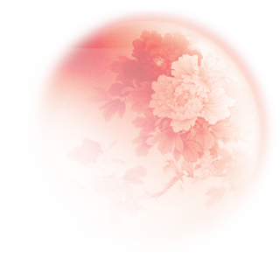
Unit 4
I used to be afraid of the dark.
Section A (第3课时)
WWW.PPT818.COM

Slide 2
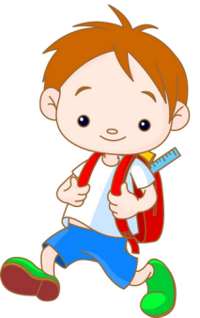
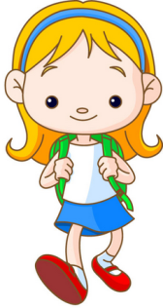
Warming up
Talk about the past. You can use the following sentences.
Yes, I did./
No,I didn't.
Did you use to ...?

Slide 3
You used to ...,
didn't you?
Yes, I did./
No,I didn't.

Slide 4
Grammar
Focus
I used to be short. | I didn’t use to be popular in school.
Paula used to be really quiet. | She didn’t use to like tests.
You used to be short, didn’t you? | Yes, I did. / No, I didn’t.
Did he use to wear glasses? | Yes, he did. / No, he didn’t.

Slide 5
Write sentences about the past using used to.
4a
1. Grace / watch a lot of TV / watch a lot of movies
Grace used to watch a lot of TV. She didn't use to
watch a lot of movies.
2. my mom / have curly hair / have straight hair
My mom used to have curly hair.She didn't use to
have straight hair.

Slide 6
3. Jerry / read books on European history / read books on
African culture
4. Sandy / teach British English / teach American English
Jerry used to read books on European history. He
didn't use to read books on African culture.
Sandy used to teach British English.She didn't use to
teach American English.

Slide 7
Look at the information and write sentences
about Emily.
4b
Five years ago | Now
didn’t eat a lot of vegetables | loves carrots and tomatoes
listened to pop music | enjoys country music
watched scary movies | hates scary movies
didn’t read a lot of books | reads at least six books a year
e.g. Emily didn’t use to eat a lot of vegetables, but now she loves carrots and tomatoes.

Slide 8
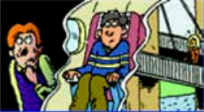
Which of these things did you use to be afraid of? Which ones are you still afraid of? Check the boxes
and then ask your partner.
4c
 | Me |  | My partner
 | I used to be afraid of ... | I'm still afraid of ... | My partner used to be afraid of ... | My partner is still afraid of ...
the dark
being alone
flying
high places
giving a speech in public

Slide 9
语法拓展
used to 的用法：
【教材典句】以下均为关于used to 用法的句子。
1. —Mario,you used to be short,didn’t you?
—Yes,I did.
2. Paula used to be really quiet.
3. —Did he use to wear glasses?
—Yes,he did. / No,he didn’t.
4. She didn’t use to like tests.
（反意疑问句）
（陈述句）
（一般疑问句及其答语）
（否定句）

Slide 10
【语法全解】
 | 构成或意义 | 例句
构成 | used to +动词原形 | He used to play basketball after school. 他过去常常放学后打篮球。
用法 | 表示过去的习惯动作或状态，现在已不再发生或不发生。其中to为不定式符号，后接动词原形。 | He used to be a very poor man.他过去是一个很穷的人。（暗指现在已经不穷了）

Slide 11
句型变化 | 否定句 | used not to, usedn’t to 或didn’t use to | She didn’t use to have long hair. (=She usedn’t to have long hair.) 她以前不留长发。
 | 一般 疑问句 | Did sb. use to ...? Used sb. to ...? | Did you use to play the piano ? =Used you to play the piano ? 你过去经常弹钢琴吗？
 | 反意 疑问句 | 附加疑问部分可以用didn’t 或usedn’t | He used to drink,usedn’t he? 他过去常常喝酒，对吗？ He didn’t use to drink,did he? 他过去不经常喝酒，对吗？

Slide 12
相似短语 | be / get / become used to doing sth. 意为“习惯做某事” | My grandfather is used to going for a walk after dinner. 我爷爷习惯于晚饭后去散步。
 | be used to do sth. 意为“被用于做某事” | Wood can be used to make paper.木头能用来造纸。

Slide 13
Exercise
单项选择。
( )1. He used to ______ to school late,but now he doesn’t.
A. go B. going C. went D. goes
( )2. He ______ practicing speaking English in the morning.
A. used to B. is used to C. uses to D. is using to
( )3. Lucy used to go to bed late,_____ she?
A. didn’t B. doesn’t C. hadn’t D. isn’t
A
B
A

Slide 14
A
( )4. —_______ new buildings ! I can’t believe it.It ______ a poor village.
—Yes.Everything has changed here these years.
A. So many;used to be B. So much;is used to being
C. Too many;used to D. Too much;used to
( )5. Her son ______ Coke,but now he ______ milk.
A. used to drink;is used to drinking B. used to drinking;drinks
C. is used to drinking;used to drink D.is used to drink;is drinking
A

Slide 15
Homework
Write a short passage about changes in your life.
(at least five sentences)
Begin with: I used to ... ,but now I ...

Slide 16
Thank you!

