Slide 1
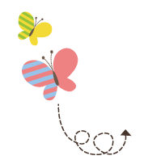
11111111
Unit 2 In Beijing
五年级下册
Lesson 12 A Visit to the Great Wall
WWW.PPT818.COM

Slide 2
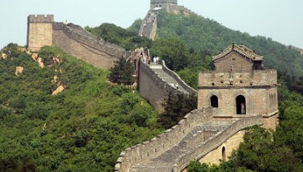
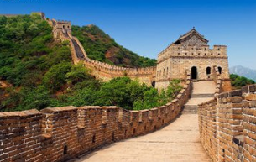

Slide 3
Story time
Today，Mrs. Li，Jenny，Danny and Li Ming are going to the Great Wall by bus.
“In China, we call the Great Wall ‘The Ten Thousand Li Great Wall’，”says Li Ming.
“ The Great Wall is very old and very long. The oldest part is more than 2000 years old，”Li Ming goes on.
Danny and Jenny want to know more about the Great Wall.
“ Well，in China, people say ‘He who does not go to the Great Wall is not a true man’，”says Li Ming.

Slide 4
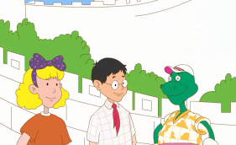
Story time
“ Great！So now I am a true man！Let me write my name on the Great Wall，” says Danny.
“ No, Danny！Don’t draw or write on the Great Wall！Let’ s keep it clean and beautiful，”says Li Ming.
“ What a wonderful place to visit ！” says Jenny. “We are lucky to see it.”

Slide 5
在中国，众所周知的一句话是：不到长城非好汉。本课就描述了大家去爬长城的情景。期间，李明提醒丹尼不能在长城上写字画画，要保持它的干净与美丽。同学们，出去游玩的时候，你能做到像李明这样吗？

Slide 6
能听懂和理解这个简单的故事，并根据故事进行简单的问答活动
完成配套的课后作业。

Slide 7
Thank you!

