Slide 1
Unit6 What Subjects Do They Have This Morning? 第2课时
陕旅版四年级上册
WWW.PPT818.COM

Slide 2
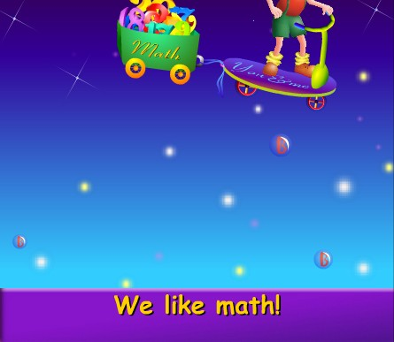
Let’s sing--- We like Math

Slide 3
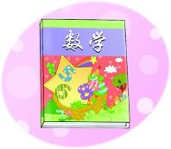
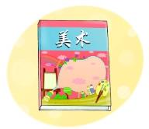
Review
练一连
Math English Music Art Chinese

Slide 4
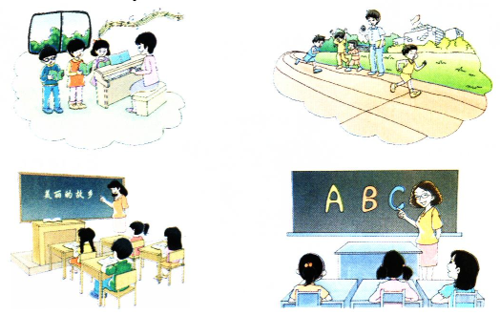
Look and think
Who teaches you…?

Slide 5
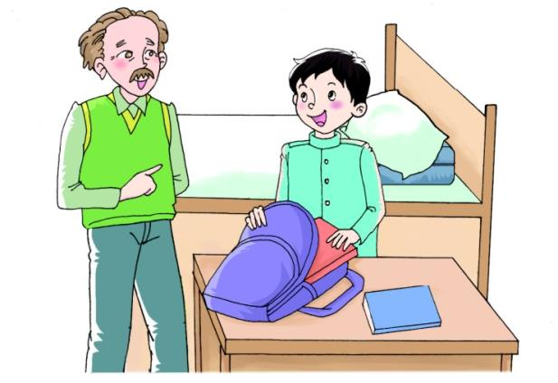
Let’s talk
听录音，回答问题：
What subjects does Su Nan have this morning?

Slide 6
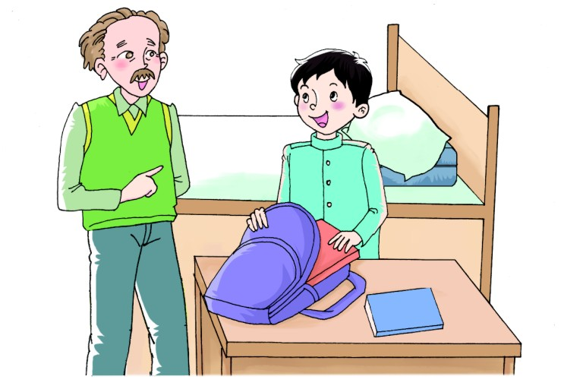
How many subjects do you have this morning?
We have four.
What are they?
Let me see. Chinese, Math, English and Music.

Slide 7
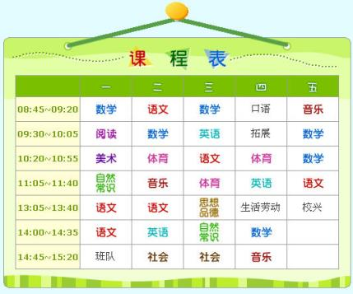
Role play
同桌之间根据课程表，一个扮演爷爷，一个扮演苏楠对话。例如：
Grandpa: How many subjects do you have this morning?
Su Nan: I have…
Grandpa: What are they?
Su Nan:…

Slide 8
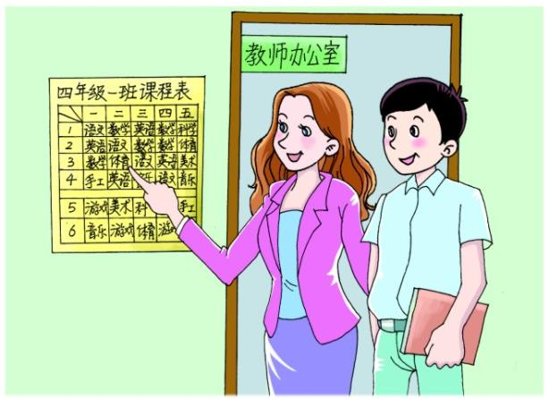
Let’s talk
听录音，回答问题：
What subjects do they have this morning?

Slide 9
Look! They have Math, Chinese, PE and English. And they have Art and games in the afternoon.
What subjects do they have this morning?

Slide 10
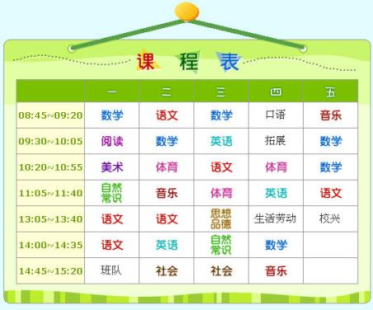
Role play
同桌之间根据课程表，各扮演一位老师表演对话。例如：
Teacher1：What subjects do they have this morning?
Teacher2：They have…

Slide 11
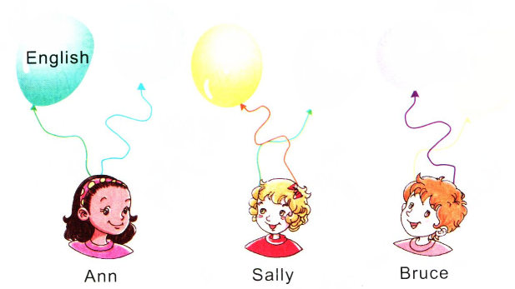
Listen and write
Music
Science
PE
Math
Chinese

Slide 12
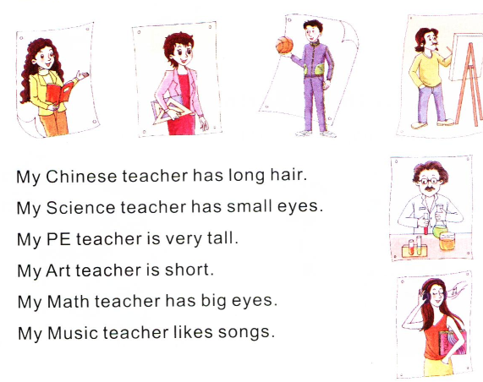
Read and match

Slide 13
Summary
用英语表达所学科目：
—How many subjects do you have this morning?今天上午你有多少门课程？
—We have four.
我们有四门。
—What are they?
它们是什么？
—They are…
它们是……
—What subjects do they have this morning?
他们今天上午有什么科目？
—They have…/ Let me see…
他们有……/ 让我想想……

