Slide 1
Unit 4 Li Ming Comes Home
Lesson 22 Surprise!
WWW.PPT818.COM

Slide 2
Warm-up
Greetings
Hello, boys and girls!
Hello, Miss …
Nice to meet you!
Nice to meet you, too!

Slide 3
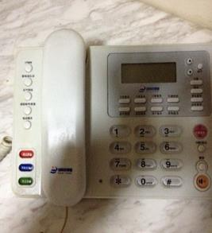
Review
Do you like a party?
Li Ming has lived in Canada for ten months. Let’s have a a party for him. I think we can invite some friends for the party. Who do you want to invite? Please call them.

Slide 4
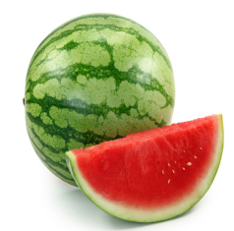
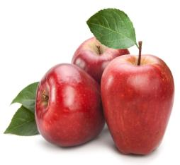
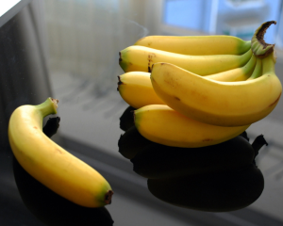
Presentation
Free Talk
What are they?
watermelon
apples
bananas

Slide 5
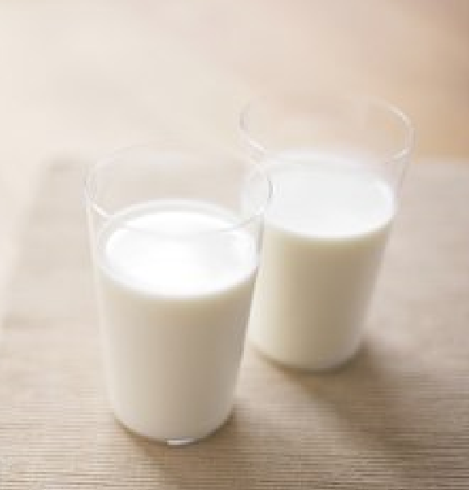
We also need:
fruit
milk
pizza
cakes
cookies

Slide 6
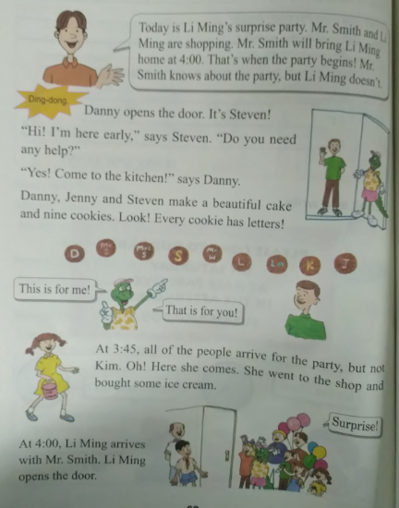
A surprise party

Slide 7
Questions:
Does Li Ming know the party?
No, he doesn’t.
Does Danny need help?
Yes, he does.
What does every cookie have?
Every cookie has letters.
When does Li Ming arrive for the party?
At 4:00, Li Ming arrives with Mr. Smith.

Slide 8
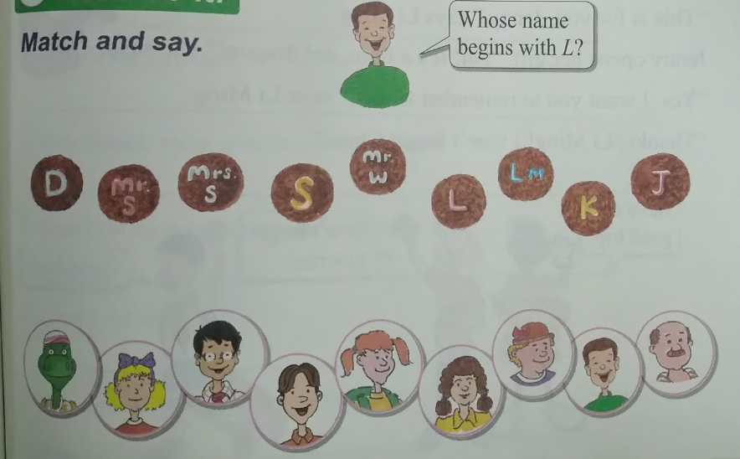
Practice
1.单词卡片游戏。
2.Match and say.

Slide 9
Consolidation and Extension
主要句型：
What do you need for the party?
How do you make cookies?
Who will come to the party?
How do you have the party?

Slide 10
Homework
1.学生分组活动，要求根据自己不同的活动和动作，说出与本节相关的词语和句子 。
2.做完本课配套的课后练习题。

Slide 11
Thank You!

