Slide 1
Module 9 Unit 2
They’re waiting for buses or trains.
WWW.PPT818.COM

Slide 2
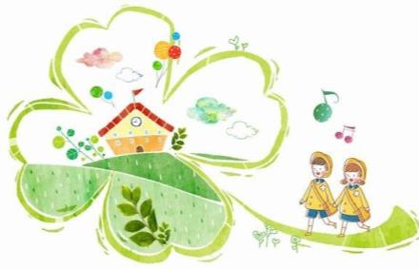
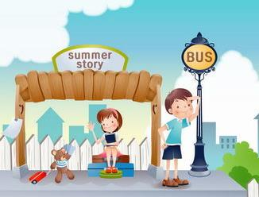
Lead in
hat is she / he doing? She / He is …
What are they doing? They’re…
They are leaving for school.
They are waiting for the bus.

Slide 3
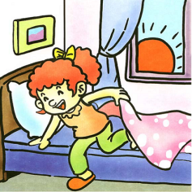
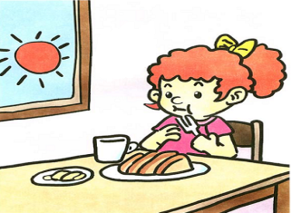
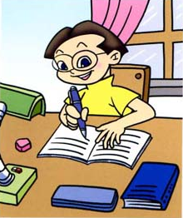
What are they doing?
have breakfast

Slide 4
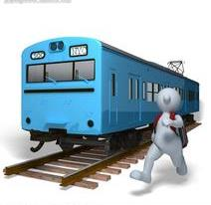
What are they doing?
He is running for the train.
He’s getting dressed.

Slide 5
New words and expressions
drive
get off
leave
restaurant
moment
place
most
star
v. 驾驶；驾车
下(飞机、火车、公共汽车等)
v. 离开
n. 饭店；餐馆
n. (某事发生的) 时刻, 时候
n. 地点
adj. 大部分(的); 大多数 (的)
n. 明星；星；星状物

Slide 6
Focus on
Words & Phrases:
drive, off, get off, leave, restaurant, moment, place, thing, most, still, star,
Patterns:
People aren’t having dinner.
Some people are still working and some are going home from work.
Some people are seeing friends, calling home or shopping.

Slide 7
Language points
1. At this moment, in different places of the world, people are doing different things.
此时此刻，世界不同地方的人们正在做着不同的事情。
at this moment意思是“现在，此刻”
常与现在进行时连用, 也可写作at the moment, 近义词为now。

Slide 8
Language points
2. Some are having afternoon tea at home
or having a drink.
一些人正在家里吃茶点或喝点东西。
Do you know how comes the
afternoon tea?
你知道下午茶的来历吗?
afternoon tea 意思是 “下午茶, 午后茶休”。

Slide 9
Language points
3. They’re waiting for buses and running
for trains.
他们有的在等公共汽车，有的正跑去
乘火车。
Hurry up! Everyone is waiting!
快点儿！大家都等着呢！
wait 意思是 “等待，等候”，是不及物动词。

Slide 10
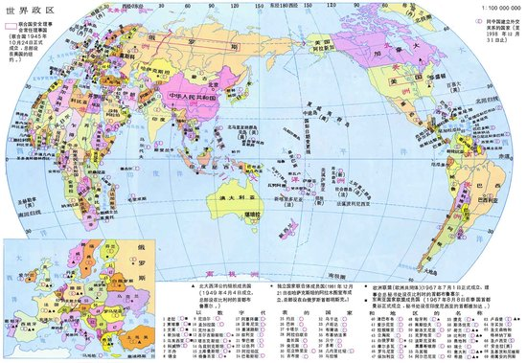
Moscow
London
New York
Los Angeles
Los Angeles
Beijing
What are people in these places doing?

Slide 11
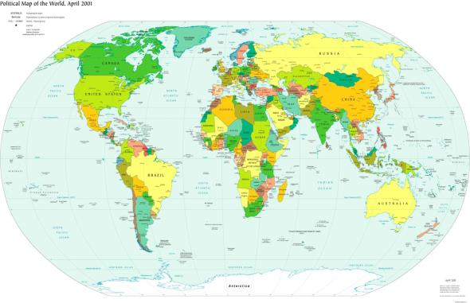
时差
Beijing 1:00 = London 17:00
=Moscow 20:00 = Los Angeles 9:00
= New York 12:00

Slide 12
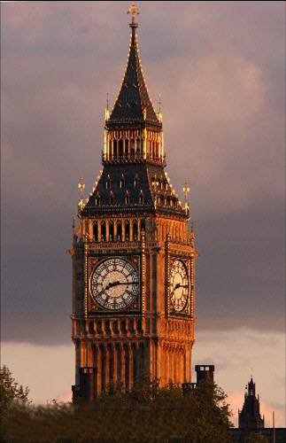
In London it’s 5:00 p.m.. People are…
They aren’t…

Slide 13
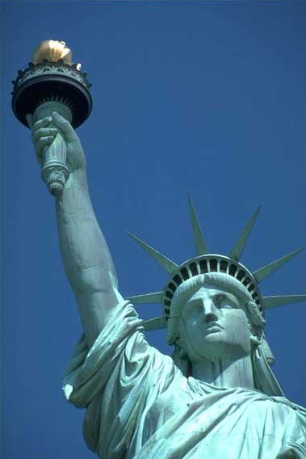
In New York it’s 12:00a.m..
People are…
They aren’t…

Slide 14
Read the postcard and check the true sentences.
This is a postcard from Betty’s mum.
Betty’s mum is visiting her friends in Hollywood.
Betty is enjoying the movie.
Betty’s mum is taking a lot of photos.
√
√
√

Slide 15
Write Betty’s postcard to her grandmother from the Great Wall.
Start like this: Dear Grandma,
Say what she’s doing.
Say if she’s enjoying her visit.
Finish like this: Love, Betty

Slide 16
Thank you！

