Slide 1
Unit 8 How do you make a banana milk shake?
WWW.PPT818.COM

Slide 2
Review: Use many or much to fill in the blanks :
much
1、A: How _____ watermelon do we need ?
B: We need four pieces of watermelon .
2、A: How _____ watermelons do we need ?
B: We need four .
many
3、A: How _____ oranges do you need ?
B: Two .
many
4、A: How _____ orange do you need ?（小心）
B: Two cups .
much
5、A: How _____ are the shoes ?
B: Ten yuan .
much

Slide 3
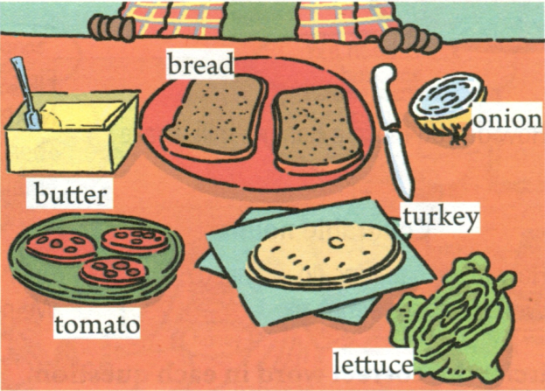
1a Make a list of the things you like in a sandwich.
I like ____________________________________
_____________________________________
tomatoes and lettuce, but I don’t like butter or onion.

Slide 4
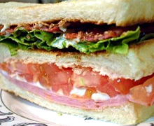
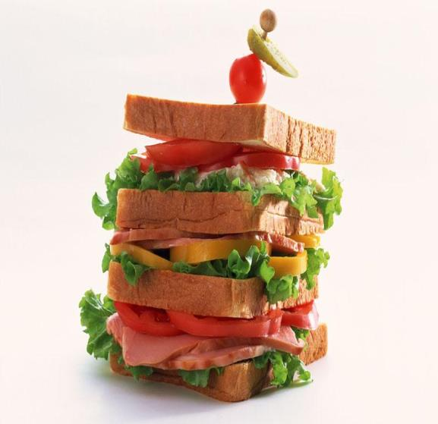
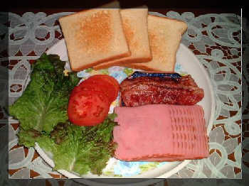

Slide 5
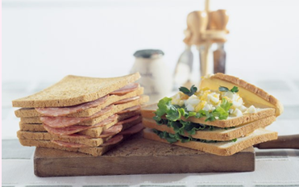
Sandwich [c] n : two pieces of bread with
cheese, meat, vegetables, cooked egg, etc
between them.
PPT模板：www.1ppt.com/moban/ PPT素材：www.1ppt.com/sucai/
PPT背景：www.1ppt.com/beijing/ PPT图表：www.1ppt.com/tubiao/
PPT下载：www.1ppt.com/xiazai/ PPT教程： www.1ppt.com/powerpoint/
资料下载：www.1ppt.com/ziliao/ 范文下载：www.1ppt.com/fanwen/
试卷下载：www.1ppt.com/shiti/ 教案下载：www.1ppt.com/jiaoan/
PPT论坛：www.1ppt.cn PPT课件：www.1ppt.com/kejian/
语文课件：www.1ppt.com/kejian/yuwen/ 数学课件：www.1ppt.com/kejian/shuxue/
英语课件：www.1ppt.com/kejian/yingyu/ 美术课件：www.1ppt.com/kejian/meishu/
科学课件：www.1ppt.com/kejian/kexue/ 物理课件：www.1ppt.com/kejian/wuli/
化学课件：www.1ppt.com/kejian/huaxue/ 生物课件：www.1ppt.com/kejian/shengwu/
地理课件：www.1ppt.com/kejian/dili/ 历史课件：www.1ppt.com/kejian/lishi/

Slide 6
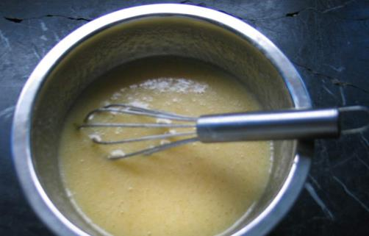
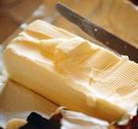
butter 黄油 a slice of butter

Slide 7
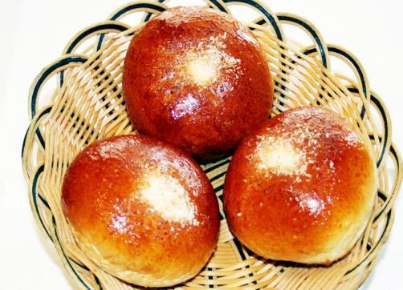
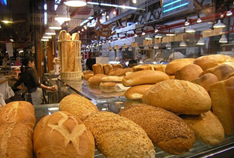
bread 面包 a piece of bread

Slide 8
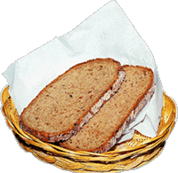
bread
two slices of bread

Slide 9
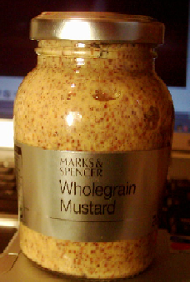
relish
a teaspoon of relish

Slide 10
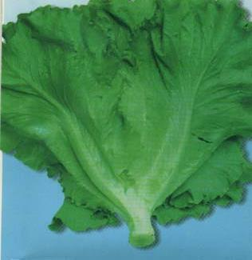
lettuce
some lettuce

Slide 11
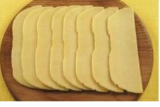
cheese

Slide 12
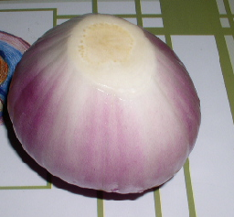
onion
an onion

Slide 13
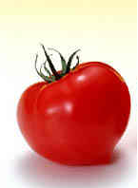
tomato
a tomato

Slide 14
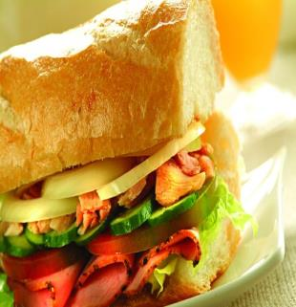
1b. Pairwork
A: Do you like lettuce in
sandwiches?
B: Yes, I do.
A: Do you like tomatoes?
B: No, I don’t.

Slide 15
1c. Listening and circle the words
that you hear.

Slide 16
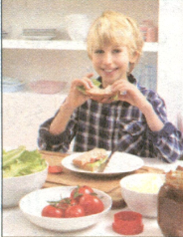
1d Listen and write the ingredients in the order.
First | Next | Then | Finally
butter
tomato
lettuce
another slice of bread
a slice of bread
onion
cheese

Slide 17
1e. Pairwork
A: First, put some relish
on a slice of bread.
B: How much relish?
A: About one teaspoon.

Slide 18
Exercises

Slide 19
一、选词填空。
turkey finally relish
tomato then put
First _____ the butter on the two slice of
bread. ______ cut up one ________. Put
the tomato on the bread. Next, add
two slice of ________. _________ put
two teaspoons of ________ on the
turkey.
put
Then
tomato
turkey
Finally
relish

Slide 20
二、单项选择。
B
1. It’s getting dark. Can you ______ the
light?
A. turn off B. turn on C. turn over
2. — ________ yogurt do you need?
— One teaspoon.
A. How many B. How much C. Which
B

Slide 21
C
3. The baby can eat ____ bread for
breakfast.
A. two B. many of C. two slices of
4. I have _______ bananas in the fridge.
A. a lot B. many C. much
5. Would you like ____ relish on the bread?
A. many B. any C. some
B
C

Slide 22
Write a recipe for your parents’ favorite food.
Homework

Slide 23
Thank you for your listening!

