Slide 1
Unit2 What’s your number?
人教精通版四年级上册
WWW.PPT818.COM

Slide 2
Review
What’s five and ten?
+
= ?
five
ten
fifteen
It’s fifteen.

Slide 3
Review
What’s six and ten?
+
= ?
six
ten
sixteen
It’s sixteen.

Slide 4
Lead-in
Guessing game
Guess, What’s this?
How many
ducks?

Slide 5
Presentation
Let’s count
What’s one and three?
one
three
It’s four.

Slide 6
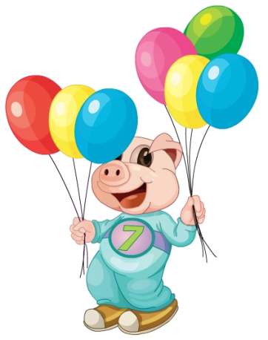
Presentation
Think and say
What’s three and four?
It’s seven.

Slide 7
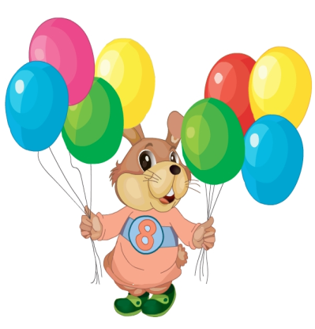
Presentation
Think and say
What’s four and four?
It’s eight.

Slide 8
Presentation
Count and say
seven
seventeen

Slide 9
Presentation
Count and say
eight
eighteen

Slide 10
Presentation
Just read and write

Slide 11
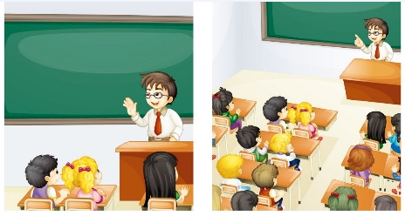
Presentation
Listen and say
What do they talking about?

Slide 12
Presentation
Listen and imitate
3
Let’s count from one to eighteen.
1
Good morning, class!
4
One!
5
2
Two!
Good morning, Mr Zhang.
6
Three!
7
Four!

Slide 13
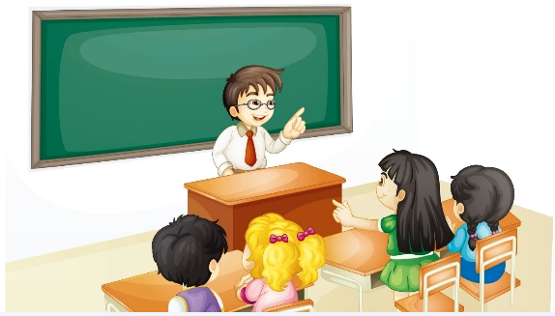
Presentation
Listen and imitate
8
What’s eight and nine?
9
It’s seventeen.
10
Very good!

Slide 14
Show time
六人一组，练习对话并表演，其他同学评价。
 | 模仿录音中的语音语调，有感情地朗读。
 | 可以脱离课本，适当改动其中部分，语音地道。
 | 适当添加内容，意思完整，有创新，表演生动。
Good
Great
Excellent

Slide 15
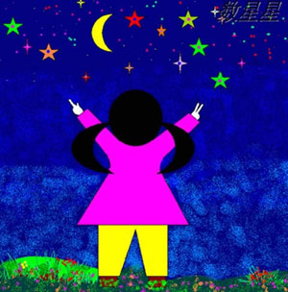
Count and write
seven
eight
What’s ____ and ____?
It’s ________.
fifteen

Slide 16
Count and write
eight
What’s ____ and ____?
six
fourteen
It’s ________.

Slide 17
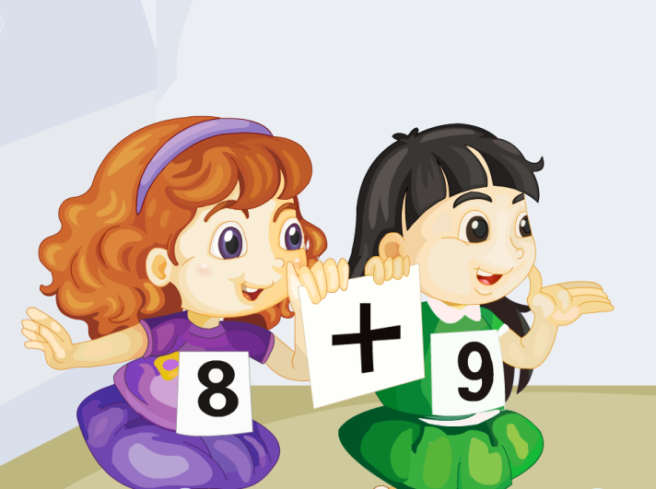
Let’s chant

Slide 18
Practice
活动
传球游戏

Slide 19
Summary
本课学习的数字类单词有:
seventeen
eighteen

Slide 20
Summary
本课的重点句型:
—What’s eight and nine?
—It’s seventeen.

Slide 21
Homework
1. 跟读Just talk部分的课文录音，并注意语音、语调。
2.让父母给自己出5道20以内的加法算数题，自己写出这些题的英文表达，并算出得数。
3. 预习Lesson11。
Close

