Slide 1
Unit 4
Don’t eat in class.
Section A
WWW.PPT818.COM

Slide 2
创设情境
Do you know these signs in a city?
What do they mean?
Walk.
Don’t walk.
Run.
Don’t run.

Slide 3
Don’t turn left.
No smoking.
Be careful!
No parking!

Slide 4
What does the sign mean?
You can’t smoke here.
Don’t smoke!
No smoking!
What does the sign mean?
You can’t take photos here!
Don’t take photos here!
No photos!

Slide 5
What does the sign mean?
You can’t park cars here!
Don’t park cars here!
No parking!
What does the sign mean?
You can’t spit here!
Don’t spit here!
No spitting!

Slide 6
What does the sign mean?
You can turn right here!
Please turn right!
What does the sign mean?
You can’t swim here.
Don’t swim here!
No swimming!

Slide 7
There are many rules in our life.
We can’t break the rules, we must obey/keep the rules.
break the rules:
obey/keep the rules:
违反规则
遵守规则

Slide 8
We should follow/obey the rules.
[ru:l]
We shouldn’t break the rules.
[ breɪk ]

Slide 9
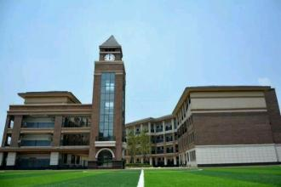
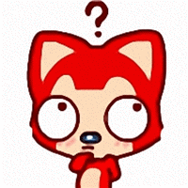
启发思考
What rules do we have at school?

Slide 10
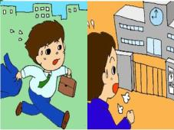
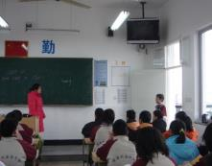
Ask and answer.
Can we arrive late for class?
[ əˈraɪv ]
No, we can’t.
Don’t
arrive late for class.
Don’t be late for class.

Slide 11
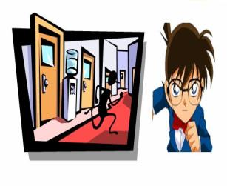
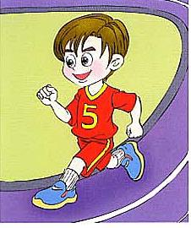
Can we run in the hallways?
[ ˈhɔ:lweɪ ]
No, we can’t.
Don’t
run in the hallways.
We can run on the playground.

Slide 12
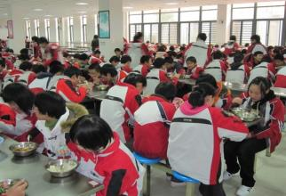
Can we eat in class?
No, we can’t.
Don’t
eat in class.
We can eat in the dinning hall.
[ 'daɪnɪŋ ]

Slide 13
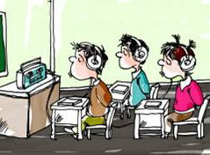
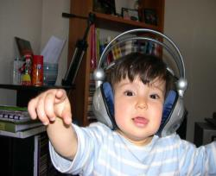
Can we listen to music in the classroom?
No, we can’t.
Don’t
listen to music in the classroom.
We can listen to music at home.

Slide 14
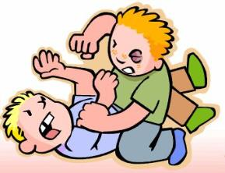
[ faɪt ]
Can we fight at school?
No, we can’t.
Don’t
fight.

Slide 15
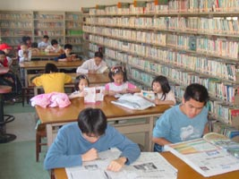
in the library
Please
be quiet.
Don’t be noisy.

Slide 16
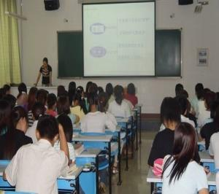
Can we talk in class?
No, we can’t.
Don’t talk in class.
Stop talking in class.

Slide 17
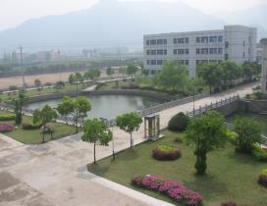
School Rules
1.Don’t arrive late for class.
2.Don’t run in the hallways.
3.Don’t eat in the classrooms.
4.Don’t listen to music in the classrooms or the hallways.
5.Don’t fight.

Slide 18
What else do you have to do ?
1. Don’t forget to turn off the light when you leave.
2. Don’t draw on the wall.
3. Don’t watch TV after school.
4. Don’t play football in the street.
5. You must get up early.
…

Slide 19
We can’t rule the country without rules.
没有规章制度就不能治理好国家。
keep rules
break rules
school rules
class rules
family rules
library rules
dining rules
遵守规则
违反规则
校规
班规
家规
图书馆规则
就餐规则

Slide 20
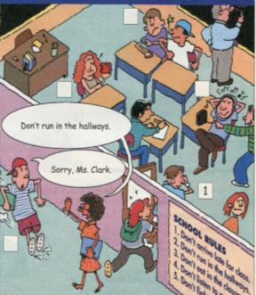
自主或小组探究
1a. Write the number of the rule next to the student.
SCHOOL RULES
1. Don’t arrive late
for class. You must
be on time.
2. Don’t run in the
hallways.
3. Don’t eat in the
classroom. You must
eat in the dining hall.
4. Don’t listen to music
in the classrooms
or the hallways.
5. Don’t fight.
5
3
4
2

Slide 21
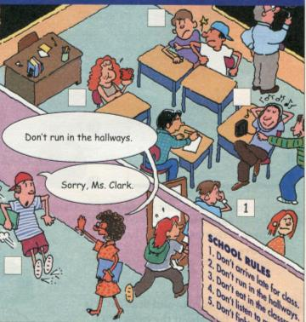
1b. Listen. What rules are these
students breaking? Write the
numbers after the names.
Peter _____
Amy _____
Mike _____
3
4
2
3
4
2

Slide 22
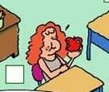
What are the rules ?
We can’t arrive late for class.
Don’t arrive late for class.
We can’t eat in the classroom.
Don’t eat in the classroom.

Slide 23
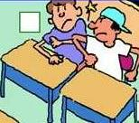
What are the rules ?
We can’t listen to music in the classroom.
Don’t listen to music in the classroom.
We can’t fight.
Don’t fight.

Slide 24
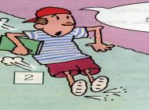
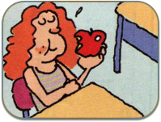
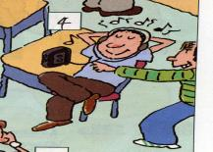
Let’s practice in pairs
A: What are the rules?
B: Well, we can’t______
A: Can we _______
B: No, we can’t.
A: …
B: …

Slide 25
Check the activities.
Activity
1. ___ listen to music in the classrooms or hallways | can | can’t
2. ___ listen to music in the music room | can | can’t
3. ___ listen to music outside | can | can’t
4. ___ eat in the classrooms | can | can’t
5. ___ eat in the dinning hall | can | can’t
6. ___ eat outside | can | can’t
7. ___ wear a hat | can | can’t
8. ___ fight | can | can’t
√
√
√
√
√
√
√

Slide 26
Check your answers!
Activity
1. ___ listen to music in the classrooms or hallways | can | can’t
2. ___ listen to music in the music room | can | can’t
3. ___ listen to music outside | can | can’t
4. ___ eat in the classrooms | can | can’t
5. ___ eat in the dinning hall | can | can’t
6. ___ eat outside | can | can’t
7. ___ wear a hat | can | can’t
8. ___ fight | can | can’t
√
√
√
√
√
√
√

Slide 27
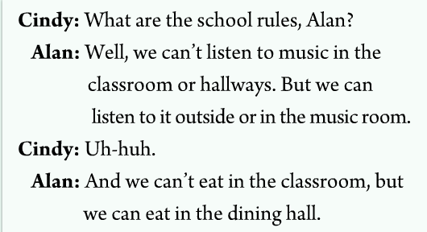
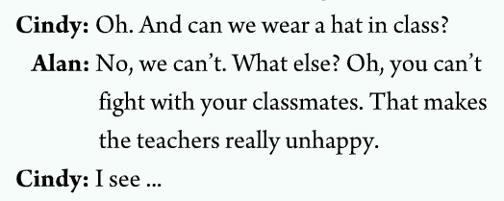
Tape script
2a
2b

Slide 28
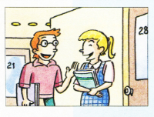
Suppose you are Alan and your partner is Cindy. Talk about the rules in 2a.
协作交流
A: Can we _______?
B: No, we can’t. But we can... /Yes, we can.
A: ………
B: ………

Slide 29
Reading——P20 2d
1. How many rules are mentioned(提及)
in the passage?
2. What are the rules?
Four rules
Don’t be late for class.
Students can’t bring music player to school.
Students have to wear the school uniform.
Students have to be quiet in the library.

Slide 30
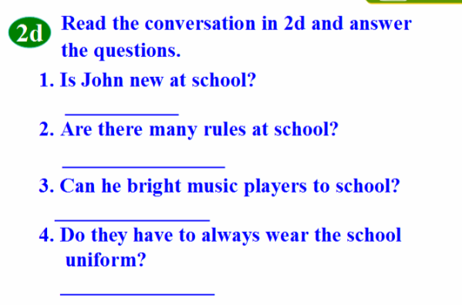
Yes, he is.
Yes, there are.
No, he can’t.
Yes, they do.

Slide 31
总结提高
Language points
1. arrive 到达= get (to)
1) arrive 后面可以不跟到达的地点。
Don’t arrive late for school. 不要上学迟到。
2) arrive后面也可以跟到达的地点。但后面必须要跟介词in （大地方）或 at（小地方）。
They arrived in Beijing at six. 他们六点钟到的北京。
We usually arrive at the village in the morning. 我们通常在早上到那个小村庄。

Slide 32
选词填空: in, at, to
to
1. My mother usually get ___ school at 7:40 in the morning.
2. When do you usually arrive ____ the bus station?
3. Jenny’s uncle usually arrives ___ Shanghai in the evening.
at
in

Slide 33
2. listen 的用法；
1) listen 听；用来提醒某人注意，后面不跟事物。
Listen! Who’s singing in the classroom?
听！谁在教室里唱歌？
2) 如果后面跟要听的事物，应跟介词to再跟事物。
Listen to our teacher carefully.
认真听老师讲。
Notes:
33

Slide 34
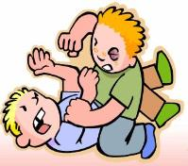
3. fight 打架，争吵
1) 作动词用
Jack never fights with his brother. 杰克从不和他的弟弟打架。
2) 作名词，意为“打架；争吵”; 常用词组have a fight“打架；吵架”
Did you have a fight with her? 你和她吵过架吗？

Slide 35
4. wear 意为“穿、戴”
My aunt wears a blue skirt and a white T-shirt. 我姑姑穿着蓝色的裙子，白色的T恤。
Does he wear glasses? 他戴眼镜吗？

Slide 36
5. have to与must
1) have to意为“必须做某事”强调“客观需要”
They have to wear school uniforms every day. 他们每天必须穿校服。
2) must 意为“必须”强调主观上的愿望
It’s late. I must go home now. 天晚了。现在我必须要回家。
练一练：用have to, must 填空
1. It’s cold outside. We ________ stay at home.
2. We ______ be good with our parents.
have to
must

Slide 37
不要在上课时听音乐。
__________________________
2. 我们必须准时。
___________________________
3. 我们能把音乐播放器带到学校里来吗？
___________________________________
在图书馆里我们必须保持安静。
________________________________
不要在楼道里跑 。
_________________________________
Don’t listen to music in class.
We must be on time.
Can we bring the music player to school?
We must keep quiet in the library.
Don’t run in the hallways.

Slide 38
Language points
一、祈使句
1. 用法：一般以动词原形开头，表示请求、命令、
劝说、警告等。在祈使句中，通常省略句子主语第二人称you。
2. 句子结构
(1) 肯定句：__________+ 其他
在餐厅里吃东西。
________________________________
在音乐教室里听音乐。
________________________________
骑自行车去上学。
_________________________________
动词原形
Eat in the dining hall.
Listen to music in the music room.
Ride the bike to school.

Slide 39
(2) 否定句: _____ + _________+ 其他
不要和同学们打架。
_______________________________
不要在教室里打篮球。
________________________________
Don’t 动词原形
Don’t fight with your classmates.
Don’t play basketball in the classroom.
以let引起的句子 ____+ sb.+动词原形
让我们步行去上学吧。 _________________
(4) No + 动词-ing形式。表示“禁止、规劝”
禁止停车！No Parking.
禁止吸烟！No Smoking.
Let
Let’s walk to school.

Slide 40
拓展
情态动词can的用法
1. 表示能力（如体力和脑力方面），意为
“能；会”等。例如：
Can you speak English? 你会讲英语吗？
2. 表示请求或允许，多用在口语中，意为“可以；能”等。例如：
Can I help you? 我能帮助你吗？
用于否定句表示不允许。例如：
You can’t play basketball.
你不能玩篮球。

Slide 41
拓展
情态动词can的用法
用于疑问句中用来提出要求。例如：
Can you...？“请你……好吗？”表示说话人的请求。
Can I...？“我可以……吗？”用来征求对方是否允许自己做某事。如在句末加上please一词就显得更有礼貌了。例如：
Can you help me, please?
请你帮助我好吗？

Slide 42
拓展
情态动词can的用法
3. 表示可能。例如：
He can be at home now.
他现在可能在家。
The moon can’t always be full.
月亮不可能常圆。
4. 表示怀疑。在表达此意时，只能用于一般
疑问句中，带有感情色彩。例如：
Can it be true?
那会是真的吗？

Slide 43
拓展
have to与一般情态动词的异同
相同点：
一般的情态动词不能单独作谓语，后面必须接动词原形一起构成谓语，have to 也是这样。

Slide 44
拓展
have to与一般情态动词的异同
不同点： 1、一般的情态动词没有人称和数的变化，而
且所用的时态也受到一定的限制，而have
to 有人称和数的变化。可用于多种时态中：
一般现在时中当主语是第三人称单数时要用has to，其余的人称用have to，一般过去时中要用had to。如：
She has to go to school by bus. 她不得不乘公汽上学。

Slide 45
拓展
have to与一般情态动词的异同
2、否定句和疑问句的构成方式不同： ①一般的情态动词直接在后面加not构成否定句，
把这些情态动词提到句首就构成一般疑问句。 ②而have to 的否定句和疑问句的构成往往要借助
于助动词do的适当形式或助动词will即have to,
has to, had to的否定式分别为don't have to,
doesn’t have to, didn’t have to，疑问句是在句
首加助动词do的相应形式,句中还原成have to。
What does she have to do? 她必须做什么？
You didn’t have to wait for me yesterday. 昨天你没有必要等我。

Slide 46
根据句意，用can和can’t填空。
1. Mr Green_______ smoke here because there’s a sign on the wall. It says “No smoking.”
2. It’s very hot outside. You______ wear a hat.
3. We _______ eat in the classroom because it’s impolite to teachers.
4. I ______ go to bed after 11:00 on school night.
5. The students _____ read books and magazines in the library.
can’t
can
can’t
can’t
can

Slide 47
用have to或has to填空。
1.We ________ clean our classroom after school.
2.She _________ make her bed after getting up.
3.It’s late. Mr Beckman ______ go to work by car.
4.Emily and Peter join a music club. They _______ practice the guitar every day.
have to
has to
has to
have to

