Slide 1
Unit 5 Topic 2
I’m feeling better now
Section B
WWW.PPT818.COM

Slide 2
Competition：Make sentences with the phrases.
good/bad at
good/bad for
worry about
strict with
pleased with
afraid of
sorry for
interested in
angry with
fond of
popular with
be

Slide 3
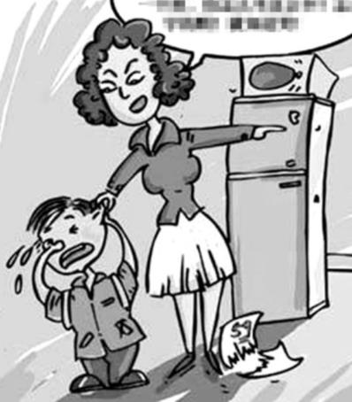
The mother is very ______with her son.
angry
sad
The boy feels very____.
Why?
Because he did badly in the exam.
= He failed the exam.
考砸了！
fail 失败

Slide 4
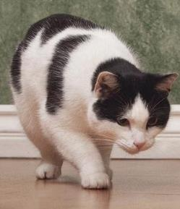
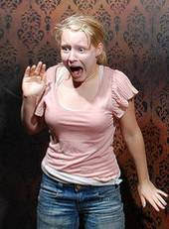
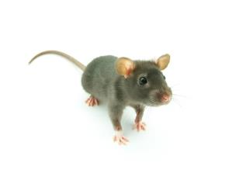
But the cat feels happy when he sees the mouse.
Happy, frightened, sad, angry, and so on, are all words about feelings.
How does she feel?
feeling n. 感觉，感触；想法
She is very frightened.
Why is she frightened?
Because she is afraid of the mouse.

Slide 5
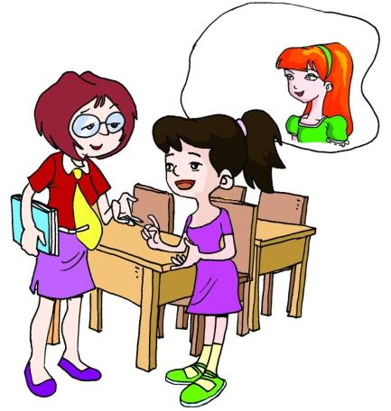
What’s Li Hong like ?
How is she feeling these days?
Why is she feeling sad?
Why does she feel lonely?
What’s Miss Wang’s advice?
She’s a quiet and shy girl.
She’s feeling sad and lonely.
Because she did badly in the English exam.
Because she has no friends to talk with.

Slide 6
Listen to 1a and tick the problems and suggestions you hear.
1b
Problem
A. feels sad
B. doesn’t know how to talk with others
C. failed the English exam
Suggestion
1. find others to talk to
2. have a good rest
3. make friends with Helen

Slide 7
Listen to 1a and follow

Slide 8
Ask and answer
Why doesn’t Li Hong talk to others?
Because she is…
What does Miss Wang tell her?
Miss Wang tells her…

Slide 9
Competition
Act 1a out in pairs.

Slide 10
Read 1a and fill in the blanks with the correct phrases.
1c
Li Hong is feeling sad because she ________________. She doesn’t know how to talk with others about it. Miss Wang tells her that everyone _____________ at her age. Li Hong wants to ______________ Helen because Helen always ____________ and ______________. Miss Wang is sure Helen would like to be her friend. Li Hong is ____________ after a talk with her teacher.
failed the English exam
gets these feelings
make friends with
tells her jokes
makes her laugh
feeling better

Slide 11
Find out and learn the key points.
fail the exam: 不及格
fail to do sth. 未能做到。如：
He failed to get to the top of the mountain.
someone: somebody 某人
at one’s age: 在某人这样的年龄时，如：
Your father began to work at your age.
tell sb. jokes 给某人讲笑话
开某人玩笑: play a joke/ trick on sb.
There, there. 好啦，好啦！there在这为语气词，表示安慰别人。

Slide 12
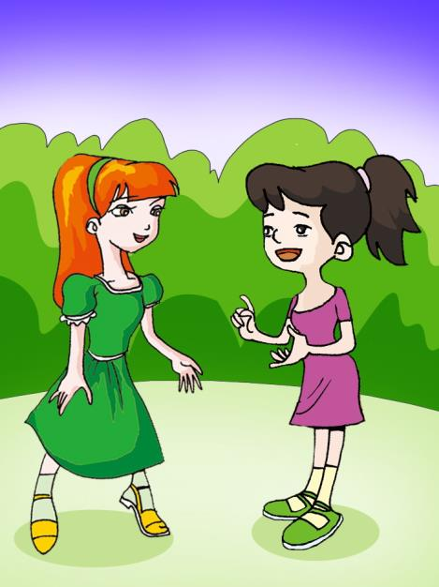
Listen to the conversation and fill in the blanks.
2a
Helen: Hi, Li Hong! Are you OK today? Li Hong: Oh, yes. After talking with Miss Wang, I’m feeling ________ now. Helen: I’m ______ to hear that. By the way, Miss Wang says that you want to be friends with me. Li Hong: Yes. Would you like to become my friend, Helen? Helen: I’d love to. If you have any ________ with your studies, just let me know. Li Hong: Yeah, I find it ________ to learn English well. Helen: Don’t _______. I’ll help you with it. Li Hong: Thank you. You’re so ______ to me.
better
BTW, 顺便提一下
glad
problems
difficult
worry
kind

Slide 13
Retell 2a according to the key words
OK → after→ glad→ be friends with → would you like → have trouble with →difficult → worry→ kind

Slide 14
2b
Suppose Tom is new in your class and feels lonely. Talk with him and try to help him. The following phrases may help you.
Problem | Suggestion
miss his family have no friends know little about Chinese | call your parents often talk to others find new friends ask … for help

Slide 15
Read the following pairs of words and pay attention to the sounds of the underlined letters. Then listen and try to imitate.
3a
hear – hair fear – fair
dear – dare really – rarely

Slide 16
3b
Read the following sentences, paying attention to the pause, weak form and incomplete plosion. Then listen and try to imitate.
She always tells me jokes / an(d) makes me laugh.
Mr. Brown was disappointe(d) because he couldn’(t) buy a ticke(t) to the film.
I’m feeling really sa(d) / because I faile(d) the English exam.
I fel(t) lonely a(t) firs(t) / bu(t) now I’m use(d) to
everything here.
You can pause briefly before the conjunction such as and, but and because.

Slide 17
Project
Make a survey to find out your friends’ unhappy feelings. Talk about the reasons and try to give them advice. Then make conversations to talk about it.
Name | Feeling | Reason

Slide 18
Summary
We learn
New words and phrases:
feeling, fail, someone, joke, at one’s age, by the way
Some sentences of comforting others:
Don’t worry.
There, there! It’ll be OK.
Phonetics: , pause, weak form and incomplete plosion.
We can
Give advice to people in bad moods.
Deal with unhappy feelings.

Slide 19
- I’m worried about my son.
- ____ ____ ____ (别紧张). Children ___ ___ ____ (在他这个年龄) like to have their own ideas. ____ ___ ___ (顺便提一下 ), don’t _____ so _____ _____ him(对他这么严格).
- I ________ (失败) the driving test yesterday.
- Oh, I’m sorry to hear that. But ____ _____ _____ (这没什么).
- I have some ________ (麻烦)with my English. Could you help me?
- No problem!
- Why is Lucy angry?
- Because ________ (有人)played _____ (玩笑) on her just now.
Take it easy
at his age
By the way
be strict with
failed
it doesn’t matter
problems
someone
jokes
Exercise

Slide 20
Homework
Review the key words and sentences in Section B.
2. Write something about your unhappy feeling and how you solve it.
3. Preview Section C of Topic 2.

Slide 21
The end.
Thanks!

