Slide 1
陕旅版六年级下册
第四课时
WWW.PPT818.COM
0

Slide 2
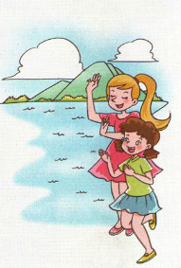
>>Warm-up
Let’s sing
Over the mountain, by the ocean,
There are two little girls.
One is Mary, the other is Helen,
They enjoy singing and dancing.
Over the mountain, by the ocean,
There are two little girls.
One is Mary, the other is Helen,
They are lucky and happy.

Slide 3
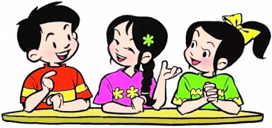
>>Lead-in
Free talk
What’s your favorite subject?
Who is your … teacher?
What do you think of him/her?
What does your father do?
What’s he like?

Slide 4
>>Presentation
Read the words
when what white
/w/
who whose
/h/
photo phone elephant
/f/

Slide 5
>>Practice
Try to read more
wheel whale wheat
whom whole
physics dolphin geography

Slide 6
>>Practice
Listen and tick or cross
×
1. Susan’s new school is small but beautiful. ( )
×
2. Miss White teaches Susan Science. ( )
√
3. Susan’s English teacher is really kind. ( )
√
4. Susan’s Math teacher is a little serious. ( )
√
5. Mr. Zhou is a hard-working teacher. ( )

Slide 7
>>Practice
Match and talk
clever
shy
friendly
lazy
hard-working

Slide 8
>>Practice
Match and talk
A: What’s your favorite animal?
B: The elephant.
A: What’s it like?
B: It’s big and strong.
A: What do you think of it?
B: It’s hard-working.

Slide 9
>>Practice
Read and write T(true) or F(false)
My name is Su Nan. I like traveling. I go traveling once a year. I went to Shanghai with my parents. We met a happy family from the USA on Nanjing Road. Mr. Green is a doctor. He is tall and strong.
He looks a little serious, but he is very friendly. Mrs. Green is a nurse in Mr. Green’s hospital.

Slide 10
>>Practice
Read and write T(true) or F(false)
She is kind and is always smiling. Their boy Tom is a pupil with glasses. He is outgoing and he likes to talk with us in Chinese. Their little girl Sue is only six years old. She is clever but a little shy.

Slide 11
>>Practice
Read and write T(true) or F(false)
( )1. Su Nan goes traveling to Shanghai once
a year.
F
( ) 2. Mr. Green is Su Nan’s father.
F
( ) 3. Mrs. Green works in a hospital.
T
( ) 4. Tom can’t speak Chinese.
F
( ) 5. Sue is 6. She is a clever girl.
答案
T

Slide 12
>> Summary
能够正确认读以下单词：
when what white
who whose
photo phone elephant

Slide 13
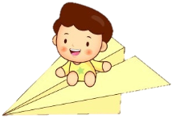
>> Homework
1.听课文录音并跟读，按照正确的语音、语调朗读并表演课文对话。 2.朗读课文Read the words。
3.预习Unit6 A Let’s learn。
close

