Slide 1
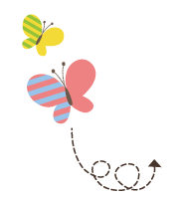
111111111111111111111111111111111111111111111111111111111111111
Unit 1 My Family
JJ 五年级上册
Lesson 3 What Do They Do?
WWW.PPT818.COM

Slide 2
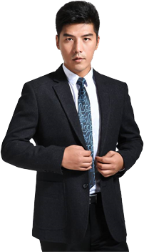
What do your parents do?

Slide 3
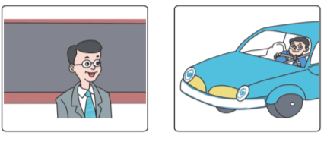
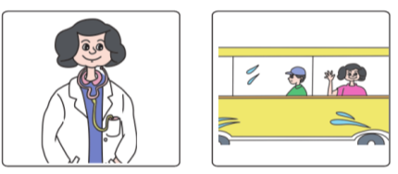
1. What does your father do?
My father is a teacher.
Where does he work?
He works at a school.
He drives to work.
My mother is a doctor.
She works at a hospital.
She goes to work by bus.

Slide 4
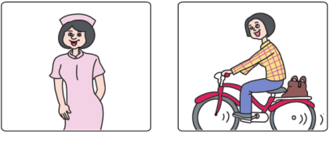
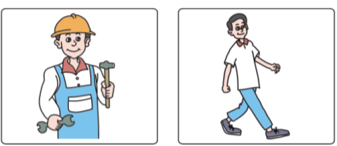
1. What does your father do?
My aunt Wanrong is a nurse.
How does she go to work?
She goes to work by bike.
My uncle Zhiwei is a worker.
He walks to work.

Slide 5
讲解
What does your father do?
你的爸爸是做什么工作的？
知识点 1
用法：
此句为常见的询问某人职业的句型：What do/does + sb. + do?
其同义句型还有：What + be + sb.? What’ s sb’ s job?
答语：
主语 +be 动词 +a/an+ 表示职业的名词 .

Slide 6
讲解
例句：
—What does your uncle do? / What is your uncle?
/ What’ s your uncle’ s job?
你的叔叔是做什么工作的？
—He is a teacher.
他是一名教师。
does, cousin, what, do, your (?)（连词成句）
______________________________________
典例
What does your cousin do?

Slide 7
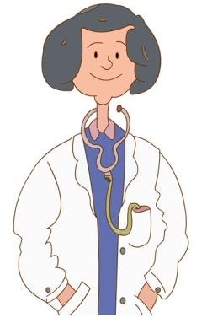
讲解
知识点 2
表示职业的词汇【四会】
doctor /'dɒktə(r)/ n. 医生
She is a doctor.
她是一名医生。
例句：
daughter /'dɔːtə(r)/ 女儿
音近词：
see a doctor 看医生
短语：

Slide 8
讲解
If you are sick (生病的), you should see a __________.
A. policeman B. doctor C. teacher
典例
B

Slide 9
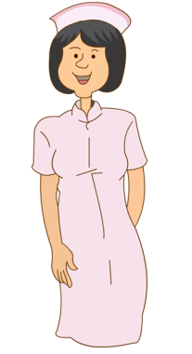
讲解
nurse /nɜːs/ n. 护士
字母组合 ur 发的是 /ɜː/。
发音：
My aunt is a nurse.
我的阿姨是一名护士。
例句：
形近词记忆法：
purse 钱包

Slide 10
讲解
worker /'wɜːkə(r)/ n. 工人
字母组合 er 发的是 /ə(r)/。
发音：
His uncle is a worker.
他的叔叔是一名工人。
例句：

Slide 11
讲解
doctor 医生把病瞧，nurse 护士药拿到。
farmer 农民起得早，
辛勤耕耘收成好。
driver driver 是司机， 开车引路滴滴滴。
player player 运动员， 为国争光不怕难。
魔法记忆：

Slide 12
讲解
知识点 3
Where does he work? 他在哪里工作？
work /wɜːk/ v. 工作
字母组合 or 发的是 /ɜː/。
发音：
例句：
I work in a supermarket.
我在一家超市工作。
短语：
work hard 努力工作 work out 计算出
at work 起作用

Slide 13
讲解
询问工作地点的常用句式
Where do/does sb. work?
句型：
Sb. + work/works + 介词 + 冠词 + 地点名词 .
答语：
—Where does your aunt work?
你的姑母在哪里上班？
—She works in a factory.
她在一家工厂上班。
例句：

Slide 14
讲解
知识点 4
drive to 开车去
My father drives to work.
我的爸爸开车去上班。
例句：
用所给单词的正确形式填空。
My brother __________ (drive) to work every day.
典例
drives

Slide 15
讲解
知识点 5
hospital /'hɒspɪtl/ n. 医院
There is a hospital in the town.
这个镇上有一家医院。
例句：
联想记忆法：
doctor 医生 patient 病人 nurse 护士

Slide 16
讲解
in a/the hospital 和 in hospital
辨析：
in a/the hospital | 在医院，可能是在医院工作，也可能是看护病人 | 例句：My uncle works in a hospital. 我的叔叔在一家 医院工作。
in hospital | 住院（生病在医院） | 例句：My grandfather is ill and he is in hospital. 我的爷 爷生病了，他在住院。

Slide 17
讲解
知识点 6
How does she go to work? 她怎样去上班？
She goes to work by bike. 她骑自行车去上班。
句型：How do/does + sb. + go to ...?
经常用来询问某人去某地的交通方式。用 do 还是does，根据人称的变化而变化。
用法：

Slide 18
讲解
例句：
How do you go to school? 你怎样去上学？
How does your grandma go to the park?
你的奶奶怎样去公园？
典例
I often go to work by bike. （对画线部分提问）______________________________________
How do you often go to work?
本题是对交通方式的提问，应该用How引导的特殊疑问句，主语you是第二人称，所以借助do构成疑问句。
点拨：

Slide 19
讲解
by bike 骑自行车，为介词短语，表示交通方式。
拓展
常见各种交通方式
(1) by + 表示交通工具的名词单数：
by bus 乘公共汽车 by ship 乘轮船
by plane 乘飞机 by train 乘火车

Slide 20
讲解
易错点
提示
1. by后面要直接加表示交通工具名词的
单数形式。
2. “by+表示交通工具的名词单数”短语
不可作谓语。

Slide 21
讲解
(2) take a + 表示交通工具的名词单数：
take a bus 乘公共汽车 take a plane 乘飞机
take a train 乘火车 take a ship 乘轮船
拓展
“骑自行车”要用 ride a bike。
注意：
He goes to the park by bike.=He rides a bike to the park.
他骑自行车去公园。
例句：

Slide 22
讲解
(3) 步行去某地：go to + 某地 + on foot = walk to + 某地
例句：I go to school on foot every day.=
I walk to school every day.
我每天步行去学校。
拓展

Slide 23
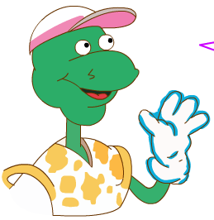
2. Let’s do it!
Pair work. Tick, talk and write.
What does your father / mother do?
Where does he / she work?
How does he / she go to work?

Slide 24
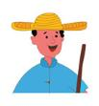
2. Let’s do it!
My father/mother is a...
□farmer □teacher □doctor
□bus driver □worker ...
He/She works...
□hospital □school □farm
…

Slide 25
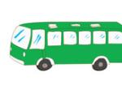
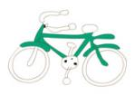
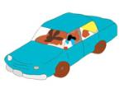
2. Let’s do it!
He/She goes to work...
□by bus □by bike □by car
…
My father is…

Slide 26
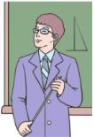
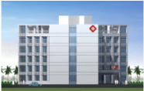
习题
一、根据图片及首字母提示补全单词。
(1) My brother is a t__________.
(2) She works at a h__________.
(3) He d__________ to work every day.
eacher
ospital
rives

Slide 27
习题
二、根据汉语提示完成句子。
1. —Where does your father ________ (工作)?
—On a farm.
2. My father usually goes to work __________ (步行)．
work
on foot
点拨：
本题考查“步行”的表达方式：walk to...和go to...on foot。由于句子中已经有了谓语动词，所以不能再用动词walk表示“步行”， 应用on foot。

Slide 28
习题
三、给句子选择合适的答语。
( ) (1) What does your mother do?
( ) (2) Where does she work?
( ) (3) How does she go to work?
( ) (4) Does your mother like her work?
A. Yes, she does.
B. By bus.
C. She works at a hospital.
D. She is a nurse.
D
C
B
A

Slide 29
本节课我们学习了以下知识，请同学们一定加强巩固，以便能和同学们进行灵活交流哦！
重点词汇：doctor, nurse, worker, work, hospital
重点短语：drive to, by bike
重点句式：What does your father do?
Where does he work?
How does she go to work?
She goes to work by bike.

Slide 30
Thank you!

