Slide 1
Dr Sun Yatsen
WWW.PPT818.COM

Slide 2
Fun with language
1 Look and find
(1)他/她带领人们，并告诉人们该干些什么。
leader
(2)她教你新的东西。
teacher
(3)她创作或者演奏音乐很好。
musician
(4)他在戏剧或电影中表演。
actor
(5)他的工作是唱歌。
singer

Slide 3
Fun with language
1 Look and find
(6)他发明新的东西。
inventor
(7)她的工作是写书。
writer
(8)他帮助生病的人。
doctor
(9)他画画很好。
painter

Slide 4
Who can say more “job” words?
PK Game
请各组同学们说出更多表示职业的名词，要求各组发言同学所说的职业不重复。

Slide 5
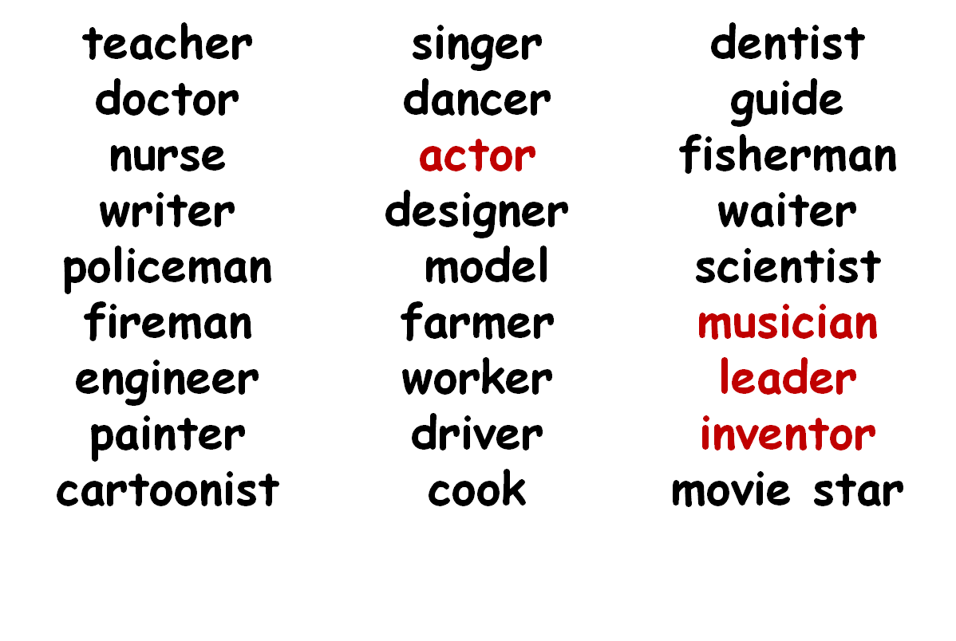
请各位同学仔细观察（相同词根）。
jobs

Slide 6
Observe & Try
请各位同学试着将下页PPT上的职业活动与职业名称匹配起来。

Slide 7
musician
invent new things
发明新东西
actor
write or play music
创作或者演奏音乐
inventor
act in a play or a movie
演戏剧或电影

Slide 8
Quick response
操练词组：老师说词组，同学们说相应职业；老师说职业，同学们说词组。见下页。

Slide 9
操练词组
musician -- write/play nice music
doctor -- help sick people
writer -- write interesting stories
actor -- act in a movie
painter -- paint great pictures
inventor -- invent new things
singer -- sing nice songs
创作/演奏动听的音乐
帮助生病的人
写有趣的故事
演电影
画漂亮的图片
发明新东西
唱动听的歌

Slide 10
2 Listen and number
1.He was the first Chinese runner to win the first prize in the Olympic games.
2.He invented the telephone and made life easy for people.
3.He was the first Chinese writer to win the nobel prize.
4.He was the American leader and he freed the black people.

Slide 11
2 Listen and number
5.He was a great Chinese painter.He painted many wonderful pictures.
6.He was a great American film maker.He made a lot of cartoon films.

Slide 12
Summary（总结）
Today what do you learn ?
今天你学到了什么？
1、学习了如何描述一个人的职业
2、学习了一些职业的含义
3、认识了一些名人
4、懂得如何用新学的短语玩游戏
5、……

Slide 13
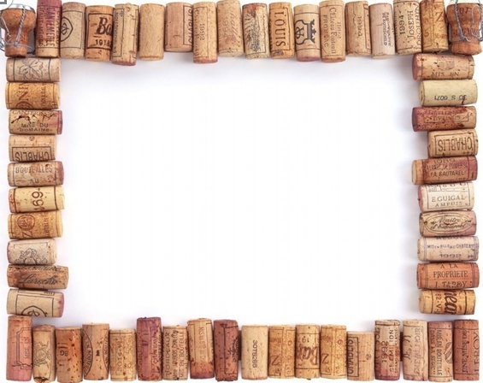
Homework
1. 掌握Unit5生词，抄写并背诵Unit5课文+家长签名，用作业A本
2.熟读Unit5对话，用英文将你所了解的中山先生与家人及同学分享。

Slide 14
Thank you!

