Slide 1
I’d like some noodles.
Section B 第2课时
WWW.PPT818.COM

Slide 2
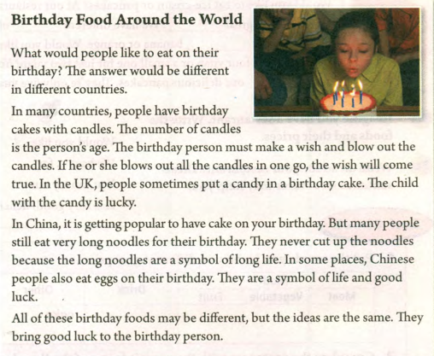

Slide 3
Birthday Food Around the World
What would people like to eat on their birthday? The answer would be different in different countries.
In many countries, people have birthday cakes with candles. The number of candles is the person’s age. The birthday person must make a wish and blow out the candles. If he or she blows out all the candles in one go, the wish will come true. In he UK, people sometimes put a candy in a birthday cake. The child with the candy is lucky.
1. the number of表示“……的数量”，跟复数名词连用作主语时，中心词是number，谓语动词要用单数。
The number of candles is the person’s age.
2. a number of表示“许多”，相当于 many，修饰可数名词复数。作主语时，谓语动词用复数。
A number of students are planting trees on the hill．

Slide 4
Birthday Food Around the World
What would people like to eat on their birthday? The answer would be different in different countries.
In many countries, people have birthday cakes with candles. The number of candles is the person’s age. The birthday person must make a wish and blow out the candles. If he or she blows out all the candles in one go, the wish will come true. In the UK, people sometimes put a candy in a birthday cake. The child with the candy is lucky.
1. in one go 一口气
2. come true 实现
3. If 引导的条件状语从句：
常见的if条件状语从句表示在某条件下，某事很可能发生，条件是可能存在的；从句用一般现在时，主句用一般将来时，即主将从现。

Slide 5
In China, it is getting popular to have cake on your birthday. But many people still eat very long noodles for their birthday. They never cut up the noodles because the long noodles are
a symbol of long life. In some places, Chinese people also eat eggs on their birthday. They are a symbol of life and good luck.
All of these birthday foods may be different, but the ideas are the same. They bring good luck to the birthday person.
1. a symbol of …的象征
2. 当food作 “食物；粮食(与饮料相对的)食品”解时， 均用作不可数名词。
We like Chinese food very much.
当表示特定种类的食物时，food 作可数名词，其复数形式为foods。
frozen foods冷冻食品

Slide 6
根据汉语提示补全句子
1. The answer would be different___ _______ ________ .
（在不同的国家里）
2. The birthday person must ____ __ ____ ___ ____ ___ ___ _____.（许愿，吹蜡烛）
3. In China, ___ __ ______ _______ __ have cake on your birthday. （开始流行）
4. They are __ ______ __life and good luck.（…的象征）
in different countries
make a wish and blow out the candles
it is getting popular to
a symbol of

Slide 7
单项选择
1. --- A number of students ________ in the dinning hall.
--- Let me count . The number of the students ________ about 400.
are; is B. is; are C. are; are D. is; is
2. If you _____ to the party tomorrow, you’ll have a great time.
A. will go B. went C. go D. going
A
C

Slide 8
短语
区分a number of 和 the number of
a symbol of
in one go
come true…
语法内容
if引导的条件状语从句

