Slide 1

Unit 5 Let’s celebrate!
Reading (II)
WWW.PPT818.COM

Slide 2
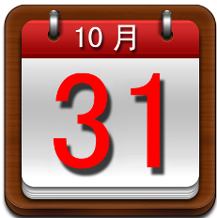


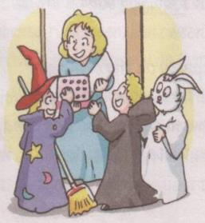
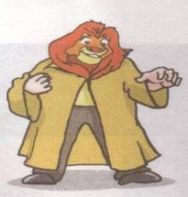
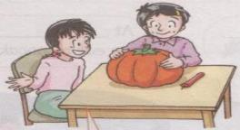
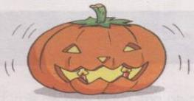
On October 31.
What activities do people usually do on Halloween?

Slide 3
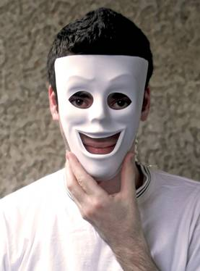
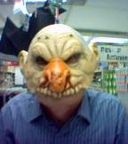
wear masks

Slide 4
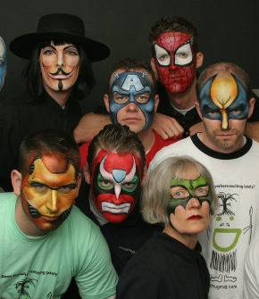
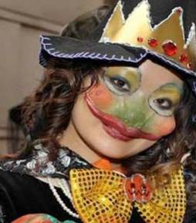
paint our faces

Slide 5
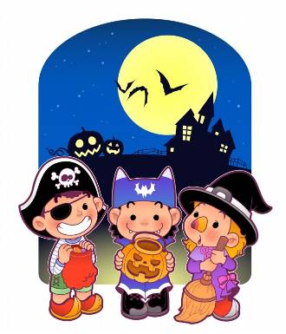
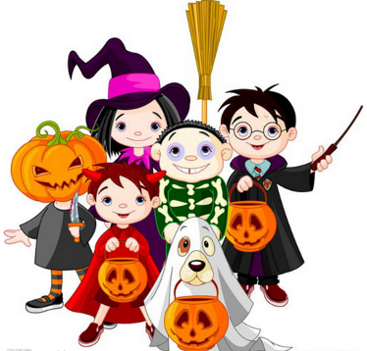
wear special clothes
dress up
wear masks
paint faces

Slide 6
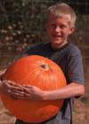

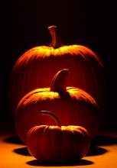
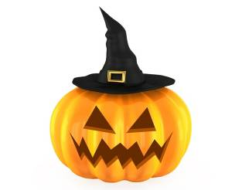
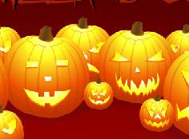
make pumpkin lanterns

Slide 7
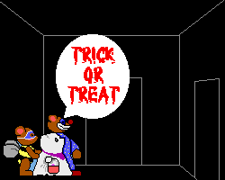

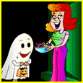
play a game with the people inside
knock on the door
shout “trick or treat”

Slide 8
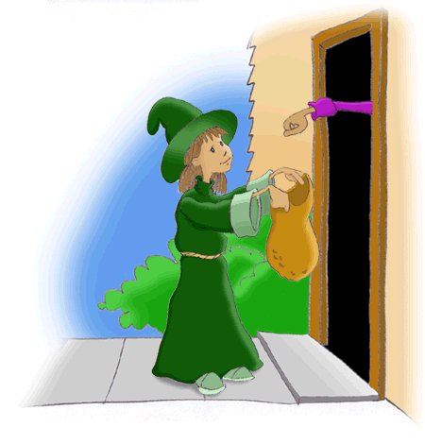
give us some candy as a treat
play a trick on sb

Slide 9
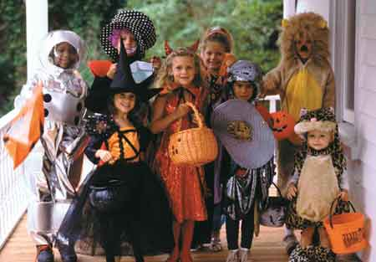
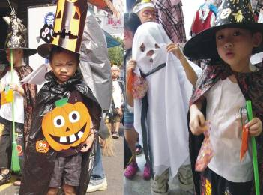
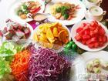
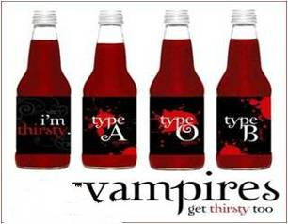
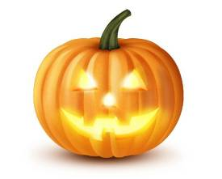
have a party
enjoy nice food and drinks

Slide 10

Review the phrases
1. Thank you for doing …
2. have lots of fun
3. dress up
4. wear masks
5. paint our faces
6. make pumpkin lanterns
7. play a game with the people inside
8. knock on the door
9. shout “trick or treat”
10. give us some candy as a treat
11. play a trick on sb
12. enjoy nice food and drinks
13. a special day

Slide 11

捉弄某人
装扮，乔装打扮
玩得很开心
用颜料涂脸
戴面具
做南瓜灯笼
和屋里的人玩游戏
敲门
喊“不招待就使坏”
给我们糖果作为招待
感谢你做某事
享受美食和饮料

Slide 12
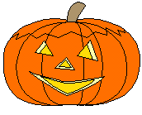
Language points
What does Wendy say at the beginning of her letter?
Thank you for telling her about the Mid-Autumn Festival.
Thank you for
= Thanks for
+ sth/doing sth
谢谢你帮忙。
help
Thank you/Thanks for your _____.
Thank you/Thanks for ________ me.
helping
—You are welcome. / That’s all right. /
Not at all.

Slide 13

Pair work
What does your classmate do for you?
Please make a small dialogue to say
“thank you” to him/her.
A: …, thank you/thanks for ...
B: You are welcome. / That’s all right. /
Not at all.
Notes:
13

Slide 14
How do children feel on Halloween?
have (lots of) fun
have (great) fun
doing sth
have a good time
我们在公园里放风筝玩的很开心。
We _____ a good _____ _______ kites in the park.
We have ____ ____ fun _______ kites in the park.
have time flying
lots of flying
great
_________

Slide 15
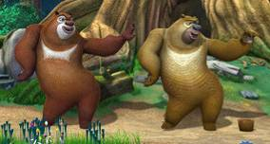
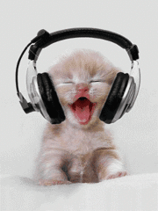
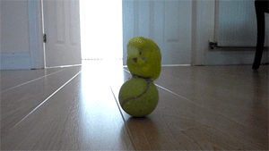
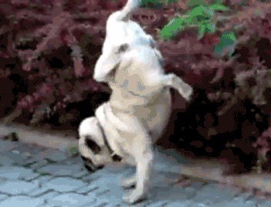
Say something about the pictures
have (lots of/great) fun doing sth
have a good time doing sth

Slide 16
When is Halloween?
on 31 October
在星期日
在2014年10月29号
on Sunday
on 29 October, 2014
在早晨
在下午
在晚上
在夜里
in the morning
In the afternoon
in the evening
at night
on a Wednesday morning
on an autumn afternoon
on the evening of 1 October
on a cold night
在一个星期三的早晨
在一个秋天的下午
在10月1日的晚上
在一个寒冷的夜里

Slide 17
What do people do on Halloween?
They dress up and wear masks.
dress up (as …) 装扮（成…… ）
dress sb 给……穿衣
wear 穿着（状态）
put on 穿上（动作）
1. It’s cold outside. Please _________ your coat.
2. Students ______ school uniforms at school.
3. His mother often _______ him in blue.
4. Amy likes _______________ a ghost on
Halloween.
put on
wear
dresses
dressing up as

Slide 18
☆ sth是it或者them时，it或者them只能放中间：
give it/them to sb
What do people usually do when children knock on their doors?
They give children some candy as a treat.
give sb sth = give sth to sb
give the book to me
give me the book = __________________
an apple
it
the present
the pumpkin lantern
some flowers
them
me
my teacher
an old man
his friend
the children

Slide 19
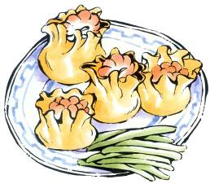
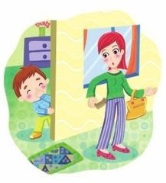
What do children do if people don’t give them a treat?
give sb a treat (of …)/give sb sth as a treat
Children play a trick on people.
He often ________ foreign guests ____ ______ of the traditional Chinese food.
gives a treat
He often _______ foreign guests the traditional Chinese food _______ ______ _______.
gives
as a treat
play a trick on/play tricks on
to play tricks on
It’s not polite _____ _____ ______ _____ others.

Slide 20
Retell
Para 2.
How do we celebrate Halloween?
Halloween is on … → have lots of fun → dress up → wear … → paint … → make …
Para 3.
How do we play “trick or treat”?
When … → visit → play a game with → knock on → shout → give … as a treat → play a trick on …
Para 4.
What do we do in the evening and how do we feel?
have a party on … → enjoy … → a special day

Slide 21
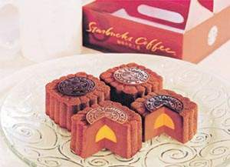
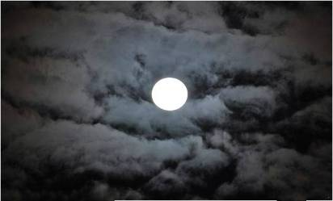
What festival is it?
Mid-Autumn Festival
get together
watch the moon
eat moon cakes

Slide 22
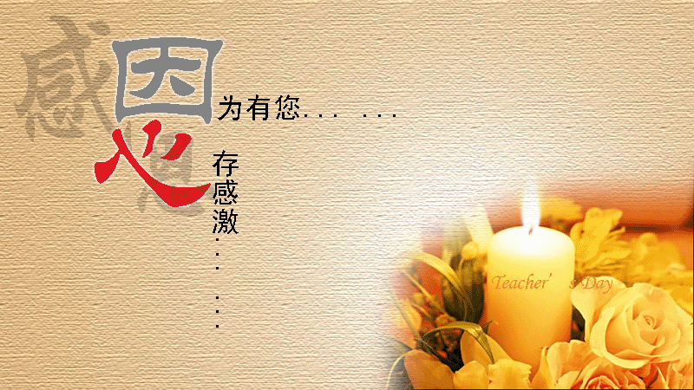

Teachers’ Day
give flowers or cards to teachers
say “Thank you” to teachers

Slide 23
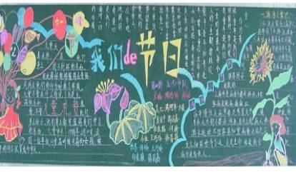
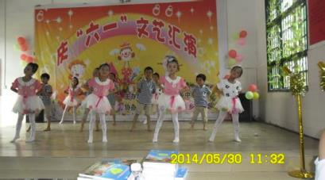
Children’s Day
get a lot of presents
have activities to celebrate it

Slide 24
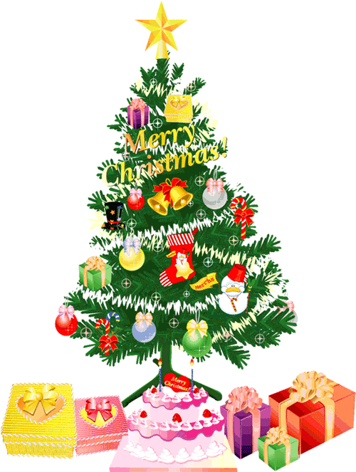
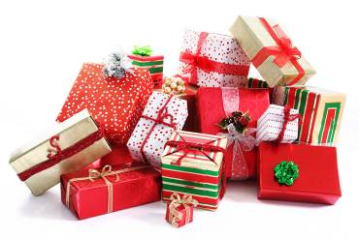
Christmas
get a lot of presents
Christmas tree

Slide 25
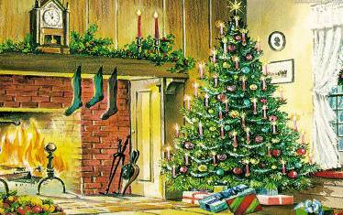

Group work: Talk about festivals

Slide 26
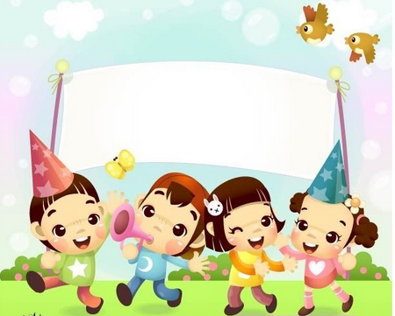
Homework
My favourite festival
Write about your favourite festival in about 70 words.

