Slide 1
Unit 3
I am more outgoing than
my sister.
Section B
WWW.PPT818.COM

Slide 2
Objectives
To learn to talk about the important personal traits in a friend
Listen to learn about Molly’s and Mary’s friends
To learn new words: talented, truly, care about…

Slide 3
talented: adj. 有才能的，有才干的
truly：adv.真正；确实
care: v.在意；担忧
care about：关心，在意
laugh：v.&n. 笑；笑声

Slide 4


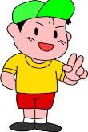

Warming up
I have a good friend. He is really outgoing.
I have a good friend. She’s cute and smart.
My good friend works very hard.
My good friend is good at music.

Slide 5
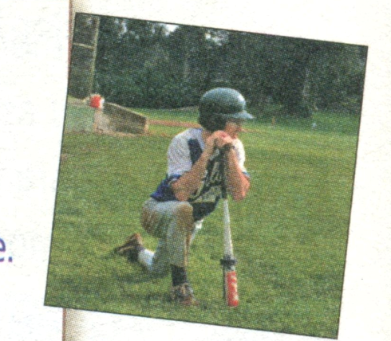
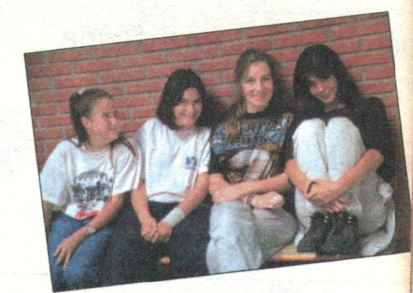
1a. Discuss: What kind of things are important
in a friend? Rank the things below [1-7]
(1is the most important).

Slide 6

A good friend …
_____ a. has cool clothes.
_____ b. is talented in music.
_____ c. likes to do the same things as me.
_____ d. is good at sports.
_____ e. truly cares about me.
_____ f. makes me laugh.
_____g. is a good listener

Slide 7

A good friend…
is good at sports.
is good at school work.
is popular at school.
likes to do the same things as me.
has cool clothes and hair style.
makes me laugh.
is more outgoing than me.
has good grades.
likes telling jokes.
keeps secrets（秘密）……
My view

Slide 8
1b. Talk about what you think a good
friend should be like.
A : I think a good friend makes me laugh.
B : For me, a good friend likes to do the
same things as me.
C : Yes, and a good friend is talented in
music, too.
D : That’s not very important for me ...

Slide 9
1c&1d. Listen and fill in the chart.
 | Likes about best friend | The same as best friend | Different from their best friends
Molly
Mary
likes to do the same things, popular,
good at sports
pretty
outgoing
Peter plays basketball better and speaks louder. Molly’s quieter and studies harder.
a good listener
look similar, tall, have long curly hair
Lisa is quieter and smarter. Mary is more outgoing.

Slide 10
1e Talk about Molly and Mary and their
best friends.
A: Molly studies harder than her best friend.
B: Well, Mary and her best friend are both tall.

Slide 11
What’s important in a good friend?
A good friend…
is good at sports.
is good at school work.
is popular at school.
likes to do the same things as me.
has cool clothes and hair style.
makes me laugh.
is more outgoing than me.
has good grades.
likes telling jokes.
is a good listener……

Slide 12
Language points
1. I think a good friend makes me laugh.
make sb. do sth. 让 (使) 某人做某事
(make后跟不带to的不定式)
e.g. His words made us feel so exciting.
The boss made the workers work all
day and all night.

Slide 13
2. A good friend is a good listener.
listener 本意是“ 听者；听众”，根据语境
a good listener 应译为“ 作为一个好朋友
应当乐于倾听朋友的倾诉。
类似词语还有 ：说话者 speaker

Slide 14
3. Is she a lot like you?
= Is she like you very much?
a lot 表程度, 相当于very much,
但位置不同。
2) be like 像……， like为介词。

Slide 15
Translate and write them down.
1. 对我来说，好朋友喜欢做我喜欢的事。
2. 我认为一个好朋友能让我笑口常开。
3.你的好朋友跟你有什么不同吗？
For me, a good friend likes to do the same things as me.
I think a good friend makes me laugh.
Is your best friend different from you in any way?

Slide 16
3. 我最好的朋友莉莉在音乐方面很有天分。
My best friend Lily is talented in music.
4. 我们的父母是真的关心我们。
Our parents truly care about us.
5. 我喜欢丽萨，因为她是一位很好的聆听者。
I like Lisa because she is a good listener.

Slide 17
Thank You!

