Slide 1
陕旅版小学英语三年级上册
Unit2 How Are You? 第2课时
WWW.PPT818.COM

Slide 2
教学目标
1．能正确认读、书写字母Hh, Ii，Jj，Kk，并通过相关词汇了解这些字母的基本读音规则。
2．能听、说、读、写单词hair, ice-cream，juice, key并能在日常会话中熟练运用。

Slide 3
Warming up
Let’s sing---How are you?

Slide 4
Let’s sing—I Can Say My A B C

Slide 5
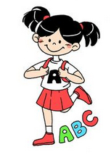
抢答
A is in “apple”.
___is in “boy”.
___ is in “cat”.
___ is in “dog”.
___ is in “egg”.
___ is in “fish”.
___ is in “girl”.

Slide 6
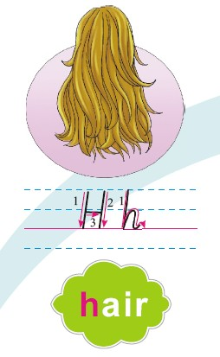
Let’s learn
This is Hh, Hh is in “hair”.

Slide 7
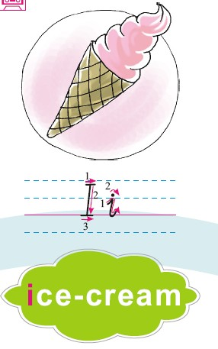
This is Ii, Ii is in “ice-cream”.

Slide 8
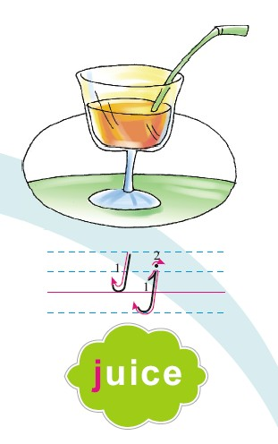
This is Jj, Jj is in “juice”.

Slide 9
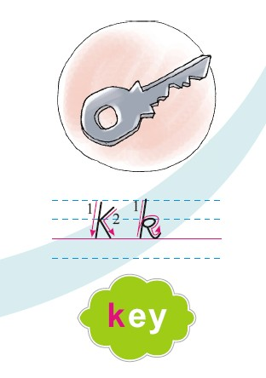
This is Kk, Kk is in “key”.

Slide 10
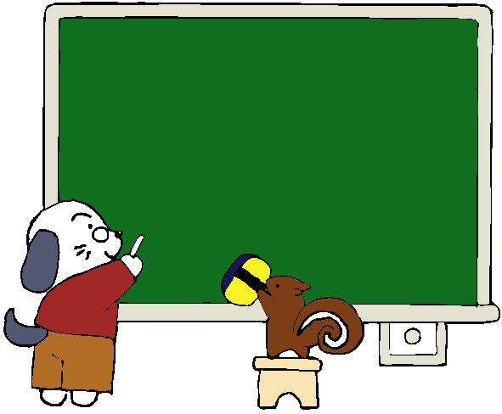
想一想学过的单词哪些是以H，I，J,K开头的？

Slide 11
Let’s play a game
想一想学过的单词哪些是以H，I，J,K开头的？
找朋友：每人一张Hh～Kk的大小写字母卡片，背靠背，老师倒计10秒的时间，同学们找到与自己的卡片相对应的大小写字母卡片，最快的一组为本次的赢家。

