Slide 1
Module9 Friendship
Unit2 I believe that the world is what you think it is .
WWW.PPT818.COM

Slide 2
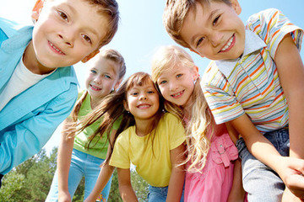
We have own friends and can form the close friendships.
Are you happy with your friends ?

Slide 3
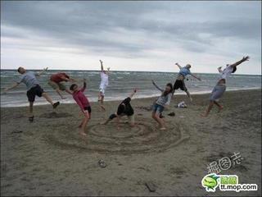
Are you afraid to make friends with anyone ?

Slide 4
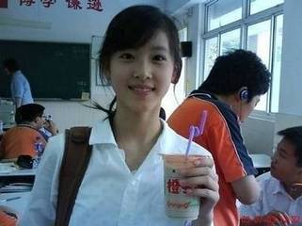
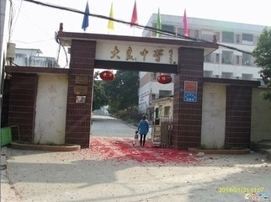
Do you have friends ?
Wang Hui
Daliang Middle School
This is my classmate .She is Wang Hui and she is in Daliang Middle School.

Slide 5
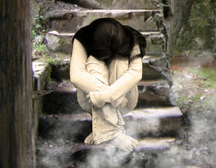
a lonely girl
I was a lonely girl ,and afraid to make friends with anyone.
I always sit in silence.

Slide 6
Can you guess what she will give me as a gift?
A beautiful smile

Slide 7
How do the beautiful smile make me?
It makes me feel happy, lively and warm. It was like a hidden treasure.

Slide 8
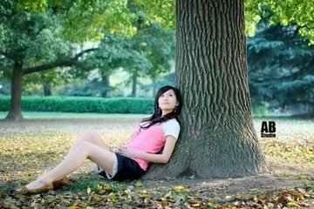
My suggestion is :smile at the world and it will smile back.

Slide 9
Listening
1.Did she feel lonely when she was in her new school at first?
Yes,she did.
2. Who changed the writer’s life?
The girl with the beautiful smile.
3. Did the smile change her life?
Yes, it did.

Slide 10
Choose the best answer
(C)
1. Why was the smile an important gift?
A. Zhang Bei’s old school was far away.
B. Zhang Bei didn’t know who the girl was.
C. It made Zhang Bei feel happy ,lively and warm.
(A)
2. Why couldn’t Zhang Bei talk to anyone
about her problem ?
A. Because she didn’t want her parents to worry about her.
B. Because she didn’t have any friends in her new school.
C. Because she was in the first year at a junior high school.

Slide 11
(C)
3. Why do you think the girl smiled?
A. She was happy to see his friends.
B. She saw Zhang Bei was unhappy.
C. She was a very friendly girl and smiled at everyone
(A)
4. How did the smile change her life?
A. She began to make friends.
B. She became best friends with the girl.
C. She became best friends with the boy.
(C)
5. Where does she now think her feeling of
unhappiness came from?
A. From her old school.
B. From other people in the world.
C. From herself.

Slide 12
Read the passage and complete the sentences.
At first
(1) _______ knew me.
I felt (2) ______
_______ and was afraid to (3) _____
______ with anyone.
Then one day
A girl looked at me and (4) ___________
_____________.
I felt (5)_______,
lively and warm.
Now
The girl has become my (6) ___________.
I believe that the world is (7)______
__________ it is.
No one
very
lonely
(without a
word) smiled
best friend
make
friends
happy
what
you think
Fact
Opinion: Smile at the world and (8) __________________.
it will smile back

Slide 13
Complete the sentences with the words in the box.
circle glue silence stick suggestion treasure trust
suggestion
My father made the _________ that I should find a hobby.
Even today, some people search for _________ under the sea.
You can _______ them to look after the house.
4 You must make the stamp wet before you ______ it to the letter.
5 Have you got any _______? I want to stick these pieces of paper together.
6.John’s _______ of friends includes some students from the UK.
7.I like the _______ in the countryside. The city is too noisy for me!
treasure
trust
stick
glue
circle
silence

Slide 14
Language points
1.every time, 表示“每次”。在本句中引导一个状语从句every time等于each time
2.in silence, 表示“安静地，沉默地”。
3.day by day, 表示“一天天地，渐渐地”。
4.turn back 转身
5.smile at 对……微笑
6.bright表示“明亮的，欢快的”，形容词
7.trust sb.=believe in sb.表示“信任，相信”。
8.include表示“包括，把……列为一部分”
9.stick表示“粘，粘贴”。10. stick …to…把……贴到…..上
suggestion是可数名词，表示“建议”。同意词：advice 为不可数名词它的动词形式为suggest

Slide 15
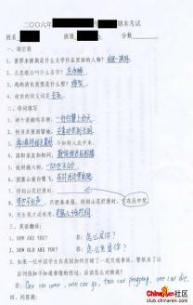
59
Why I felt sad?
bad mark

Slide 16
Discuss and report
When was the last time you felt unhappy?
Who did you tell that you were unhappy?
What did you do to feel better?
Last Saturday, I felt unhappy because I
got the bad mark.At that moment, A boy gave
me a smile and helped me .That made me feel
happy. Then I past the exam. Now I thinks that smile at the world and it will smile back.

Slide 17
Homework
1. Write a passage about someone or
something that changed your life.
2. Read the passage after class.

