Slide 1
Unit 7 Know Our World
Body Language
WWW.PPT818.COM

Slide 2
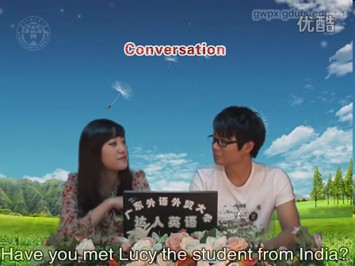
Let’s enjoy the video now.

Slide 3
objectives
To understand the text
To use the words correctly:
European, kiss, nod, polite,
shake hands

Slide 4
Review
Vocabulary

Slide 5
greet
European
kiss
cheek
nod
v. 欢迎；迎接
n. 欧洲人
adj. 欧洲(人)的
v.&n. 吻
n. 脸颊；脸蛋
v. 点头

Slide 6
thumbs-up
polite
lip
rude
Italian
shake hands
n. 翘拇指
adj. 有礼貌的
n. 嘴唇
adj. 粗鲁的；粗野的
n. 意大利人；意大利语
adj. 意大利(人)的
握手

Slide 8
Listen and write true (T) or false (F).
In some European countries, people like to kiss each other to show friendship and love.
( )
2. Nodding your head means “yes” and shaking your head means “no” everywhere in the world. ( )
3. A thumbs-up means “well done” in Germany. ( )
4. When Americans wave goodbye, it looks like “no” in some European countries. ( )
T
F
F
T

Slide 9
Reading

Slide 10
Read the lesson again and complete the table.
Gestures | Meanings | Countries
shake hands | greeting, friendship and trust
 | friendship and love | in some European countries
nod one’s head | yes | in most places
 |  | in India
shake one’s head | yes
 | no | in most places
thumbs-up | okay and well done | in many countries
 | not polite
 | five | in Japan
 | one
in China and some other countries
kiss
no
in India
in Australia
in Germany

Slide 11
Fill in the blanks with the words in this lesson. The first letter is given.
His mother k_____ him goodbye every morning when she leaves for work.
A: What do you do when you meet new
friends?
B: I say hello and s____ hands with them.
3. If you agree, please n___ your head.
4. Italy is a E________ country. It has a long history.
5. It’s p____ to say “thank you” when someone helps you.
isses
hake
od
uropean
olite

Slide 12
Let's practice
Different cultures have different body language. Work in groups. One student acts out a kind of body language while the others guess the meaning.

Slide 13
Language Points

Slide 14
shake hands 握手
shake hands with sb. 与……握手
Men, women, and children shake hands all the time.
男人、女人、小孩、时时刻刻都在握手。
He waited in the lobby to shake hands with prospective customers.
他在大厅等着与贵客握手。

Slide 15
2. In China and some other countries, friends shake hands to greet each other.
greet 向…致敬(或致意)；问候；
greet sb. with…
以……方式向某人问候/打招呼
He greeted me at the door.
The teacher greeted each child with a friendly “Hello!”

Slide 16
3. It’s another way to show friendship and love.
动词不定式“to show friendship and love”修饰another way，作后置定语。该句中二者为同位关系。
我们制定了一个向雷锋学习的计划。 We have made a plan to learn from Lei Feng.

Slide 17
Fill in the blanks.
polite
1. He was too ______ (有礼貌的) to point out my mistake.
2. It’s _____ (粗鲁的) not to say “Thank you” when you are given something.
3. She looked up and ______ (点头) for me to come in.
4. He _____ (吻)the children goodbye every morning.
5. He embraced her, kissing her on both _______ (脸颊).
6. He pushed out his lower ___ (嘴唇).
rude
nodded
kisses
cheeks
lip

Slide 18
Time for Reflection
shake hands
shake hands with sb.
greet sb. with…
握手
与……握手
以……方式向某人问候/打招呼

Slide 19
Homework
Review Lesson 40.
2. Write a short passage about the body language in your country.

Slide 20
Preview
1. Learn the words in Lesson 41 by heart.
2. Read the text in Lesson 41 and underline the useful phrases.

