Slide 1
Unit 4 Where's my schoolbag?
Section B (1a～1e)
WWW.PPT818.COM

Slide 2
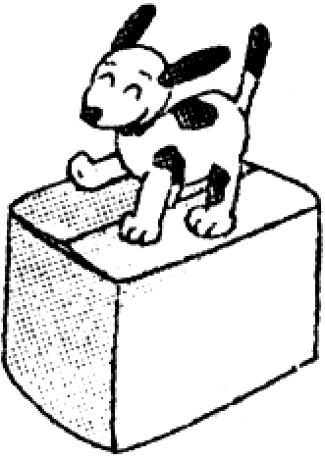
1．方位介词
on，under和in三姐妹都是方位介词。它们都可以用在名词或代词前表示方位。让我们一起来认识它们吧！
(1)我是方位介词on，意为“在……上”，常指某物在另一物的表面上。 另外：树上长出的叶子/果实，也用on。

Slide 3
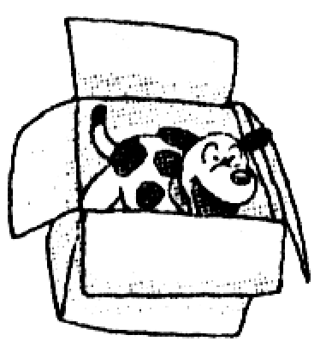
(2)我是方位介词under，表示“在……下方”，指在某物垂直的下方，反义词是on。eg：Her baseball is under the bed.(她的棒球在床底下。)
(3)我是方位介词in，表示方位时，意为“在……里面”，常指某物在某范围或空间内。eg：His CDs are in the bag.他的唱片在包里。
另外：外在的物品在树上用in。eg：Tom's kite is in the tree.Tom的风筝在树上。

Slide 4
2．词组归纳：
tape player 录音机
model plane
飞机模型
English books
英语书
under the radio
在收音机下面

Slide 5
一、用适当的介词填空。
1．My sister is ______her room.
2．This is a photo ________his family.
3．Thanks ______your books.
4．Call Jane ______5473­268.
5．My books are __________the radio.
in
of
for
at
under

Slide 6
二、根据句意及汉语提示写单词。
6．His _________(钟) is white.
7．Jim's _____________(飞机模型) is in his room.
8．Some _______(磁带) are on the bed.
9．Is this Alice's ________(收音机)?
10．This is her __________(播放机)．That is her hat.
clock
model plane
tapes
radio
player

Slide 7
三、单项选择。
11.—Where's my model plane?
—It's ______ the desk.
A．under B．on
C．in D．at
12．Where ______ his books?
A．is B．are
C．/ D．isn't
13．This is ______ English book.
A．my a B．a my
C．my D．me
B
B
C

Slide 8
14．—Where are my keys?
—Sorry，______．
A．I know B．I not know
C．I know not D．I don't know
15．—Are the tapes in the bookcase?
—______
A．Yes，they aren't. B．Yes，it is.
C．Yes，they are. D．No，it isn't.
D
C

Slide 9
四、根据汉语完成句子。
16．我的书包不在床上。
My schoolbag ____________on the bed.
17．我哥哥的钟在椅子下面。
My ________________is _________the chair.
18．录音机在课桌上。
The __________is _______the desk.
is not
brother's clock
under
tape player
on

Slide 10
19．—你的飞机模型在哪里？
—它在沙发底下吗？
—Where's your___________?
—Is it_______________?
20．我不知道他的名字。
I ______________his name.
model plane
under the sofa
don't know

Slide 11
五、完形填空。
Li Yan：Look，Betty！21. __ that under the desk?
Betty：It's 22. __ watch.It's blue.
Li Yan：Is it new?
Betty：Yes.Is it 23. __？
Li Yan：No.Mine is old.Whose is it?
Betty：It looks like 24. __．
Li Yan：Look，he is behind the tree.
Betty：Let's go and ask Mr.Wu.
Li Yan：25. __，Mr.Wu.What's the time?
Mr.Wu：Oh，26. __，I don't know.I can't find my watch.
Betty：Is this your 27. __？
A
B
C
B
B
B
A

Slide 12
Mr.Wu：Let me see.Yes，it is 28. __．
Li Yan：Here you 29. __．You must look after(照看) it.
Mr.Wu：Thank you very much.
Li Yan：30. __
21．A.What's B．Who's
C．How's D．Whose's
22．A.am B．a
C．/ D．the
23．A.you B．your
C．yours D．you's
24．A.Mr.Wu B．Mr.Wu's
C．Mr.Wus D．he
A
C
C

Slide 13
25．A.Hello B．Excuse me
C．Sorry D．How are you
26．A.yes B．sorry
C．no D．thanks
27．A.watch B．desk
C．radio D．floor
28．A.mine B．yours
C．you D．me
29．A.is B．am
C．are D．be
30．A.Nice to meet you. B．Come on!
C．You're welcome. D．It is here.

