Slide 1
Unit 1 Lesson 5
A Basketball Game
WWW.PPT818.COM

Slide 2
Warm-up
Let’s sing

Slide 3
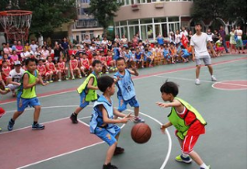
Let’s talk
player
team
player
a basketball game

Slide 4
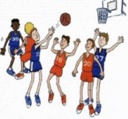
Read and answer
Read the conversation on Page10. Then answer the questions.
What did Jenny and Li Ming do this evening?
They watched Bob play basketball.
Which team Did Bob's team play with?
His team played with the Orange Team.
Who won the game?
Bob's team.

Slide 5
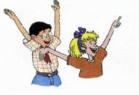
Read and answer
Read the conversation on Page10. Then answer the questions.
Does Bob play basketball every day?
No, he doesn’t.
Is Bob a good player?
Yes, he is.
Did they have fun?
Yes, they did.

Slide 6
Listen to the conversations on Page10 and check the words you hear.
very difficult
game ask
policeman answer

Slide 7
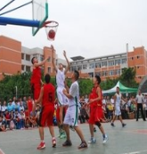
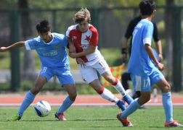
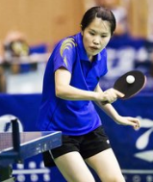
Ask and answer
Talk about a game you played.

Slide 8
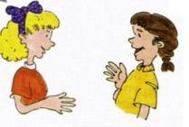
Ask and answer
Work in pairs.
What game did you play? Where did you play the game? When did you play the game? Which team won?
?

Slide 9
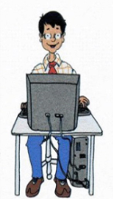
Look and write
Write an email.
Dear Jing,
Today, I
Love, Li Ming

Slide 10
Summary and evaluation
What have you learned in this class?
A excellent B good C adequate D need improvement
内容 | 学生自评 | 小组互评
我能认真听老师讲课，听同学发言
遇到我会回答的问题主动举手了
活动中坚持使用英语来交际
我能积极参与小组讨论活动，能与他人合作。

Slide 11
Homework
1. Read the passage on page10, try to retell it.
2. Finish the e-mail to your friend.

