Slide 1
Water
WWW.PPT818.COM

Slide 2
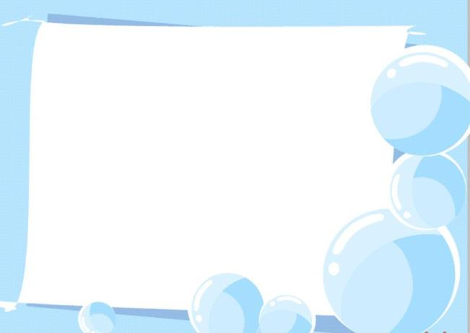
Think and say
What do you know about water?
Does it have any colour?
Does it have any shape?
Does it have any taste?

Slide 3
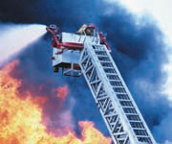
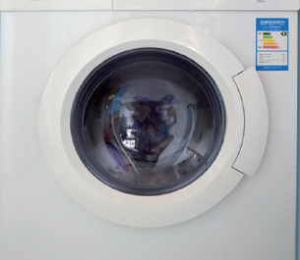
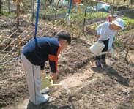
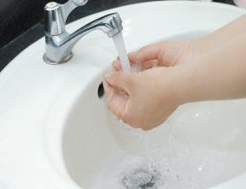
Look and say
How do we use water?

Slide 4
Firemen use water to put out fires.

Slide 5
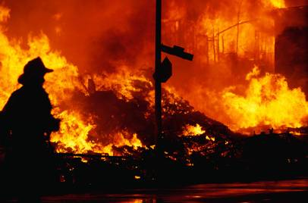
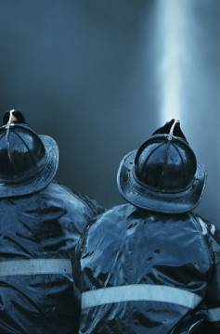
Firemen use water to put out fires.
They are brave!

Slide 6
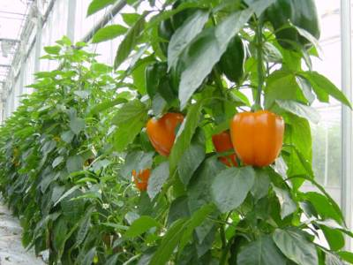
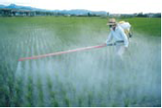
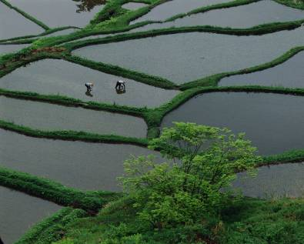
Farmers use water to grow crops.

Slide 7
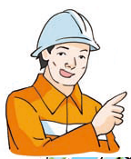
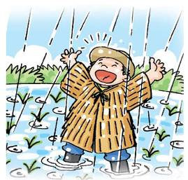
Firemen use water to put out fires.
Farmers use water to grow crops.
？

Slide 8
Firemen use water to put out fires.
Farmers use water to grow crops.
Cooks use water to cook food.
Zookeepers use water to feed animals.

Slide 9
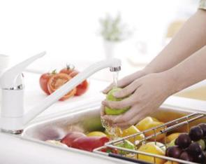
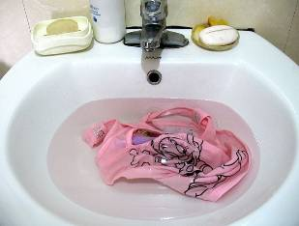
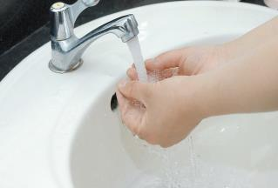
Firemen use water to put out fires.
Farmers use water to grow crops.
How do we use water?

Slide 10
Firemen use water to put out fires.
Farmers use water to grow crops.
How do we use water?
We use water to wash our hands. We use water to wash vegetables and clothes too.

Slide 11
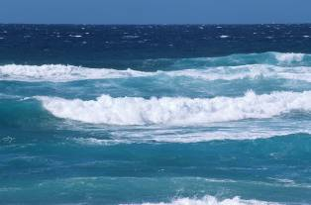
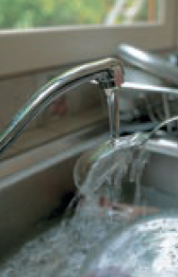
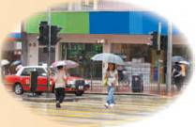
Water is very useful.
Where does water come from?
It comes from the rain.
It comes from the sea.
It comes from the tap.

Slide 12
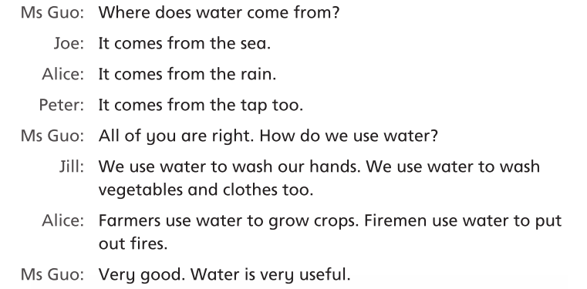
Read aloud

Slide 13
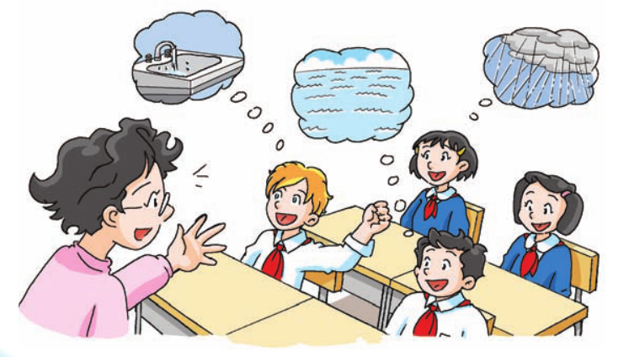
Think and say

Slide 14
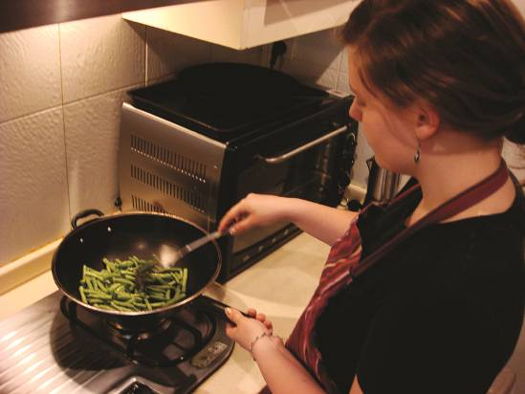
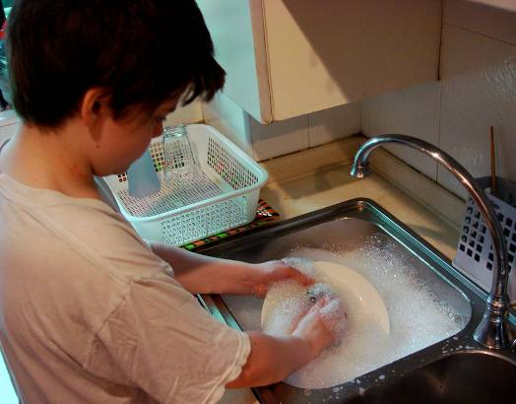
Think and say
Water is very useful. We should save water.

Slide 15
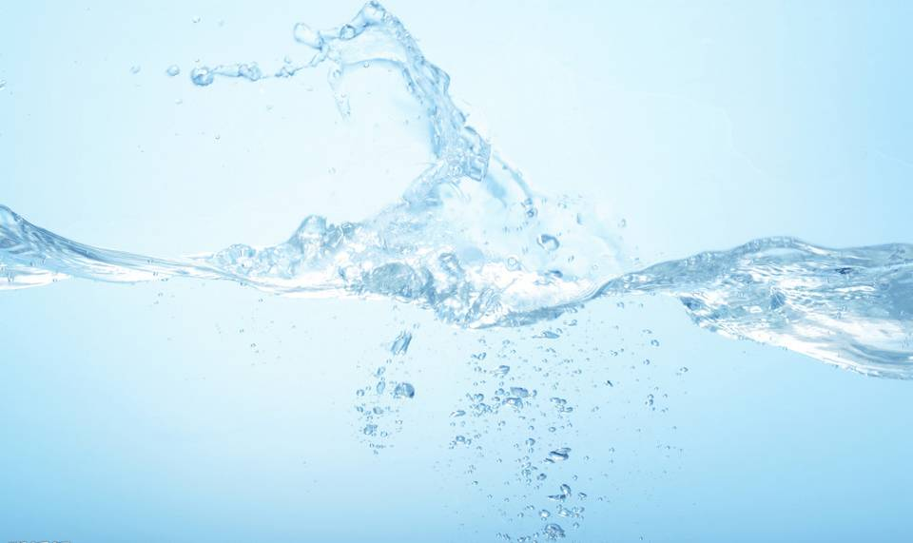
Think and write
Water is very useful. We should save water.
I use water to ______________________.
My father uses water _______________.
My mother ________________________.
Cooks ____________________________.
__________________________________.
__________________________________.

Slide 16
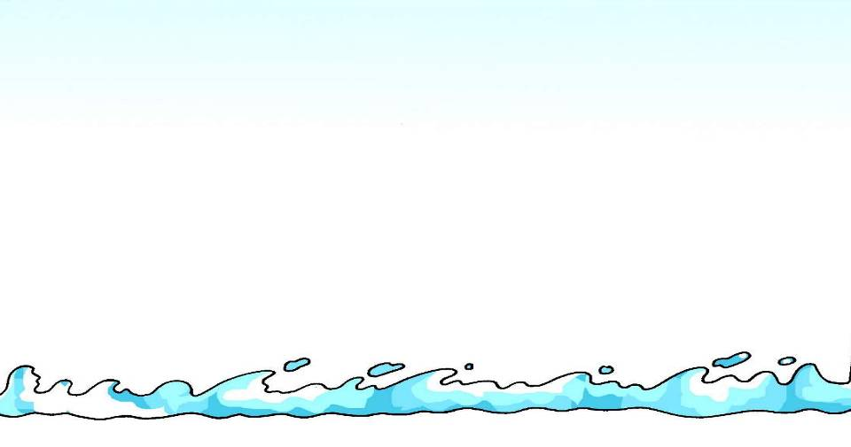
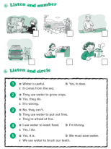
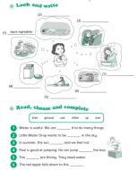
Homework
Listen to and read page 74.
Talk about how you and your family
members use water.
3. Finish Workbook pages 62 and 64.

