Slide 1
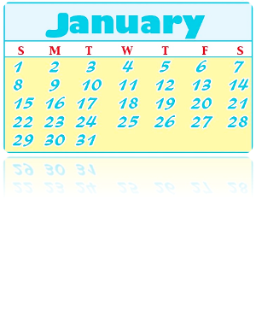
Unit4 January is the first month.
人教精通版六年级上册
WWW.PPT818.COM

Slide 2
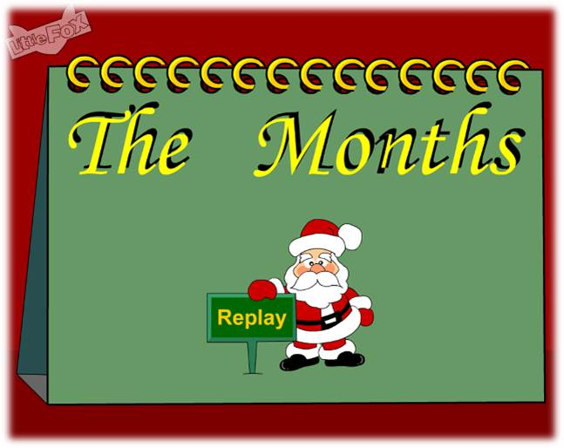
>>Warm-up
Let’s sing

Slide 3
>>Warm-up
Let’s review
What is the first month of a year?
What is the second month of a year?
When is New Year’s Day?
When is Spring Festival ?

Slide 4
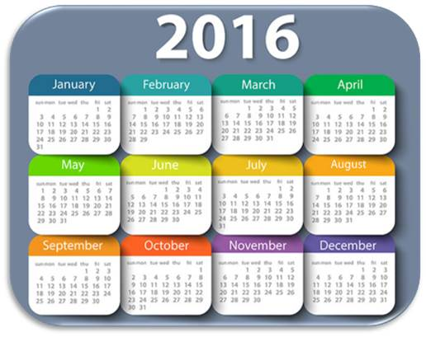
>>Presentation
Let’s learn
What month goes after February?
March
March is the third month of the year.

Slide 5
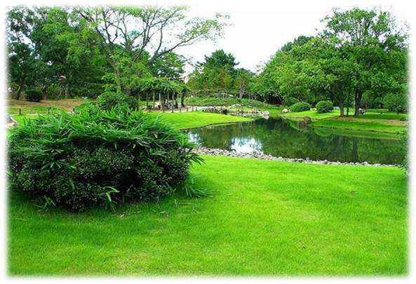
>>Presentation
Let’s learn
tree
grass
In March, people can see green trees and green grass everywhere.

Slide 6
>>Presentation
Look and say
What festival is in March?
Tree Planting Day

Slide 7
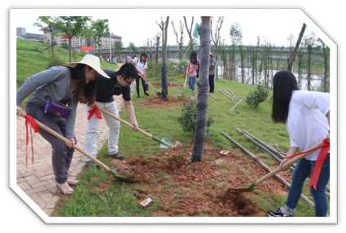
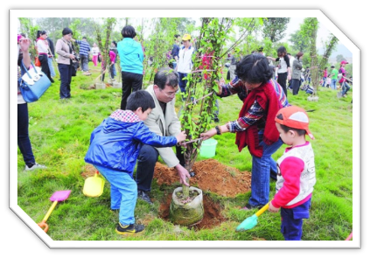
>>Presentation
Look and say
plant trees
People _________ on Tree Planting Day.

Slide 8
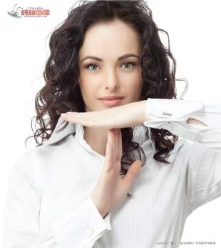
>>Presentation
Let’s learn
stop
____ can stop the sand on windy days and make the air clean.
Trees

Slide 9
>>Presentation
Let’s learn
What’s the fourth month of the year?
April

Slide 10
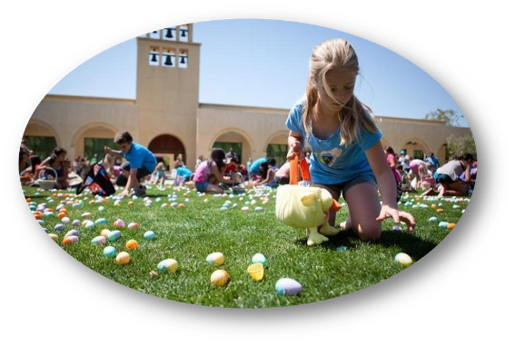
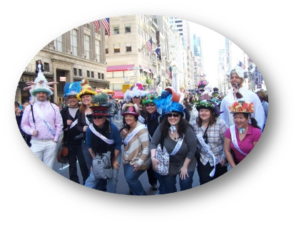
>>Presentation
Let’s learn
Easter
eggs

Slide 11
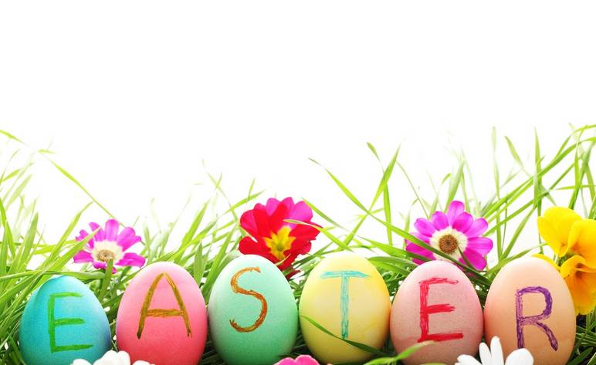
>>Presentation
Let’s learn
按《圣经•马太福音》的说法，耶稣基督在十字架上受刑死后三天复活，因而设立此节。根据西方教会的传统，在春分节（3月21日）当日见到满月或过了春分见到第一个满月之后，遇到的第一个星期日即为复活节。东方教会则规定，如果满月恰好出现在这第一个星期日，则复活节再推迟一周。
因此，节期大致在3月22日至4月25日之间。

Slide 12
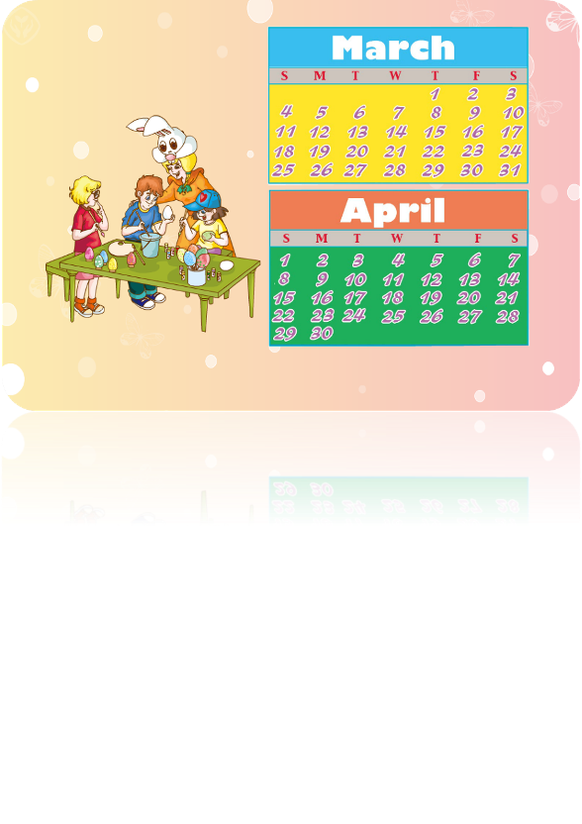
>>Presentation
Look and say
When is Tree Planting Day?
When is Easter?

Slide 13
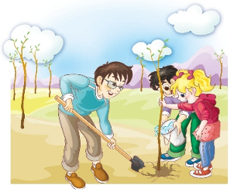
>>Presentation
>>Presentation
Read and say
Why do people plant trees?
They want to stop the sand on windy days and make the air clean. They want to make the country greener.

Slide 14
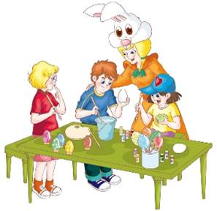
>>Presentation
>>Presentation
Read and say
What do children do during Easter?
During Easter, children get colourful Easter eggs.

Slide 15
>>Presentation
Just read and talk
Listen and imitate
March is the third month of the year.
People can see green trees and green grass everywhere.
In China, Tree Planting Day is on March 12th.
People plant trees on that day.
They want to stop the sand on windy days and make the air clean.
They want to make the country greener.

Slide 16
>>Presentation
Just read and talk
Listen and imitate
April is the fourth month of the year.
Easter is in March or April.
It is always on a Sunday.
For school children in America, the Easter holidays are a week long.
During Easter, children get colourful Easter eggs.

Slide 17
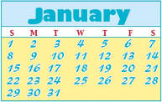
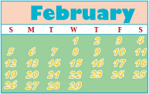
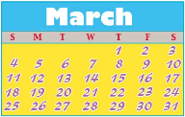
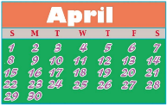
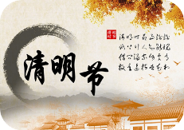
>>Practice
Look and match

Slide 18
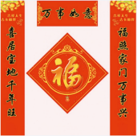
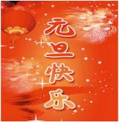
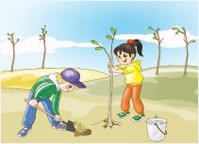
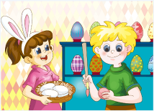
>>Practice
Play a game
Which month or festival is it?
2
1
Quick
response
3
4

Slide 19
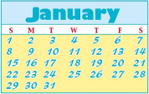
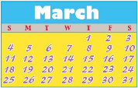
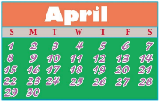
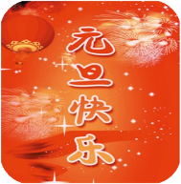
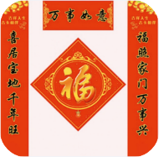
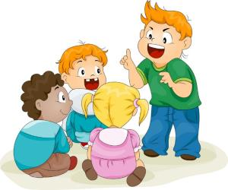
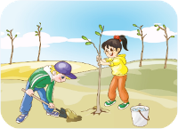
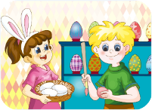
>>Practice
Group work
Which month or festival do you like? Why?

Slide 20
>>Summary
本课学习主要学习的月份和节日有哪些？
March
April
Tree planting Day
Easter

Slide 21
>>Homework
1.跟读课文动画或录音，按照正确的语音、语调朗读课文。 2.查阅资料，了解3、4月份中国以及其他国家的节日，做笔记，下节课与同学们一起交流。
3.预习 Lesson 22。

