Slide 1
Unit 7
What did you do yesterday?
WWW.PPT818.COM

Slide 2
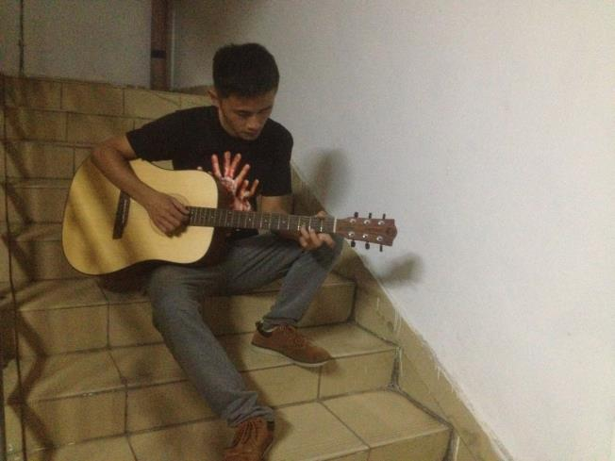
I played the guitar last night.

Slide 3
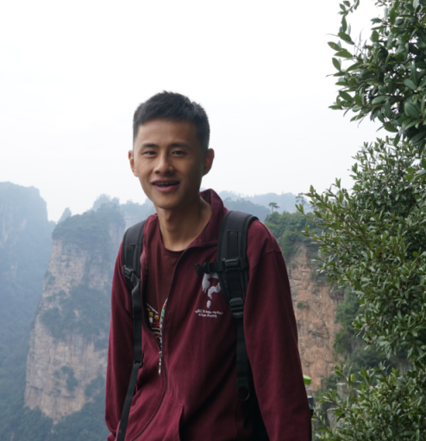
PPT模板：www.1ppt.com/moban/ PPT素材：www.1ppt.com/sucai/
PPT背景：www.1ppt.com/beijing/ PPT图表：www.1ppt.com/tubiao/
PPT下载：www.1ppt.com/xiazai/ PPT教程： www.1ppt.com/powerpoint/
资料下载：www.1ppt.com/ziliao/ 范文下载：www.1ppt.com/fanwen/
试卷下载：www.1ppt.com/shiti/ 教案下载：www.1ppt.com/jiaoan/
PPT论坛：www.1ppt.cn PPT课件：www.1ppt.com/kejian/
语文课件：www.1ppt.com/kejian/yuwen/ 数学课件：www.1ppt.com/kejian/shuxue/
英语课件：www.1ppt.com/kejian/yingyu/ 美术课件：www.1ppt.com/kejian/meishu/
科学课件：www.1ppt.com/kejian/kexue/ 物理课件：www.1ppt.com/kejian/wuli/
化学课件：www.1ppt.com/kejian/huaxue/ 生物课件：www.1ppt.com/kejian/shengwu/
地理课件：www.1ppt.com/kejian/dili/ 历史课件：www.1ppt.com/kejian/lishi/
I climbed mountains last month.

Slide 4
Guessing game
have a party with my friends
had a party with my friends
与朋友聚会

Slide 5
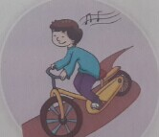
ride my bike
rode my bike
骑自行车

Slide 6
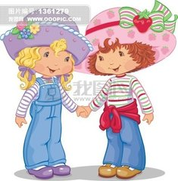
meet my friends
met my friends
会见朋友

Slide 7
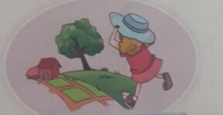
go to the countryside
went to the countryside
去乡下

Slide 8
read a storybook
read a storybook
读故事书

Slide 9
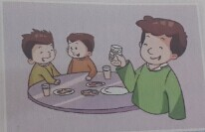
eat at a restaurant
ate at a restaurant
在餐馆吃饭

Slide 10
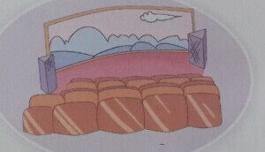
see a film
saw a film
看电影

Slide 11
Task 1
完成研学案的填一填

Slide 12
Flashing Game
went to the countryside
ate at a restaurant
rode my bike
read a storybook
had a party with my friends
met my friends

Slide 13
Task 2
完成研学案的连一连和仿写

Slide 14
Task 3
完成研学案的采访表格

Slide 15
Homework
1 继续完成采访表格。
2 在作业本上抄写短语，每个抄三遍。

Slide 16
1 他摘苹果。 He picks apple.
他正在摘苹果。He is picking apple now.
他昨晚摘了苹果。He picked apple last night.
2 它吃草。 It eats grass.
它正在吃草。It is eating grass now.
它昨晚吃了草。It ate grass last night.

Slide 17
3 他们看电视。 They watch TV.
他们正在看电视。They are watching TV.
他们昨天看了电视。They watched TV yesterday.

Slide 18
He loves playing the guitar.
They like watching TV.
他喂猪。He feeds the pigs.
他正在喂猪。He is feeding pigs.
他昨晚喂了猪。He fed the pigs last night.
meet met

Slide 19
I eat an apple every morning.
2 They often go to the supermarket.

