Slide 1
Unit 14
I remember meeting all of you in Grade 7.
Section A 第2课时
R·九年级下册
WWW.PPT818.COM

Slide 2
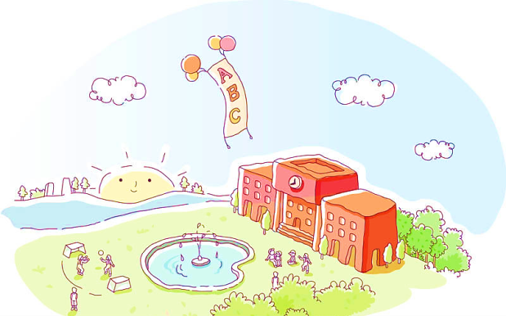
Lead-in
Share your feelings about junior high school,
your teachers or your classmates with your partner.

Slide 3
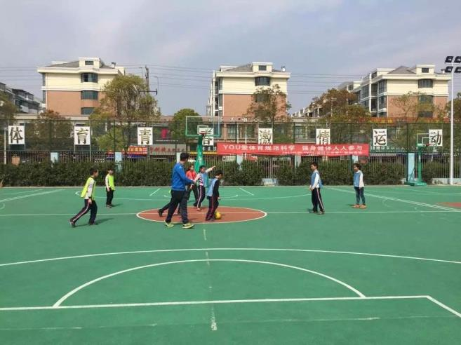
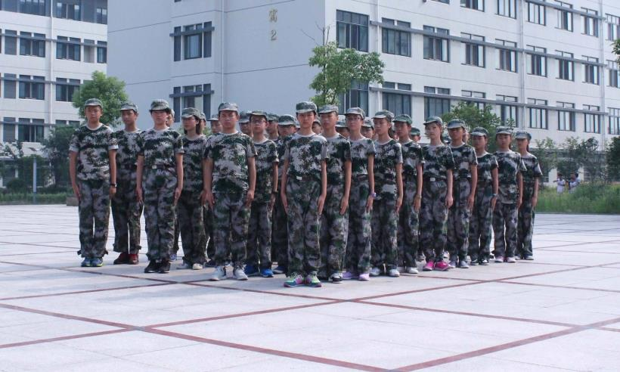
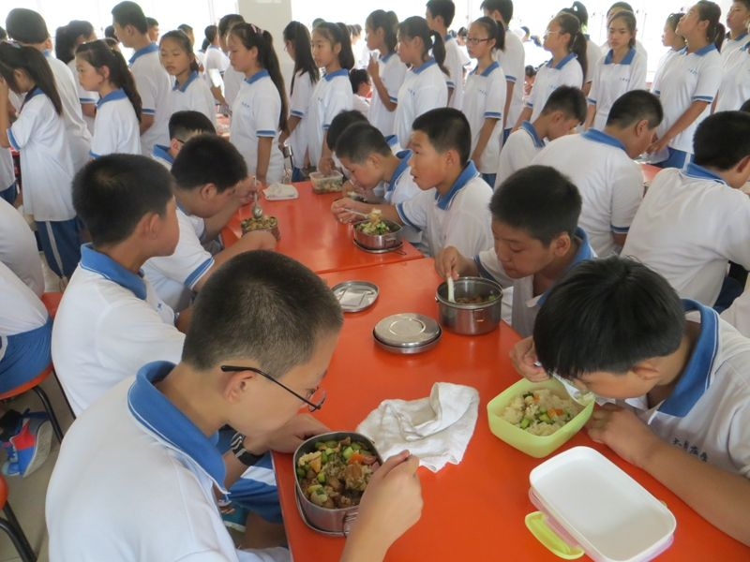
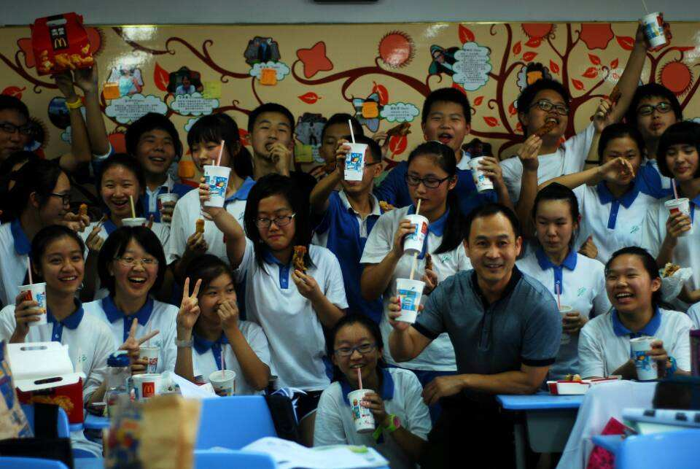
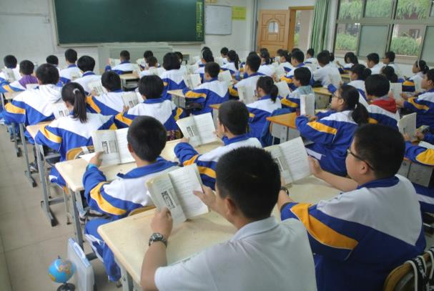
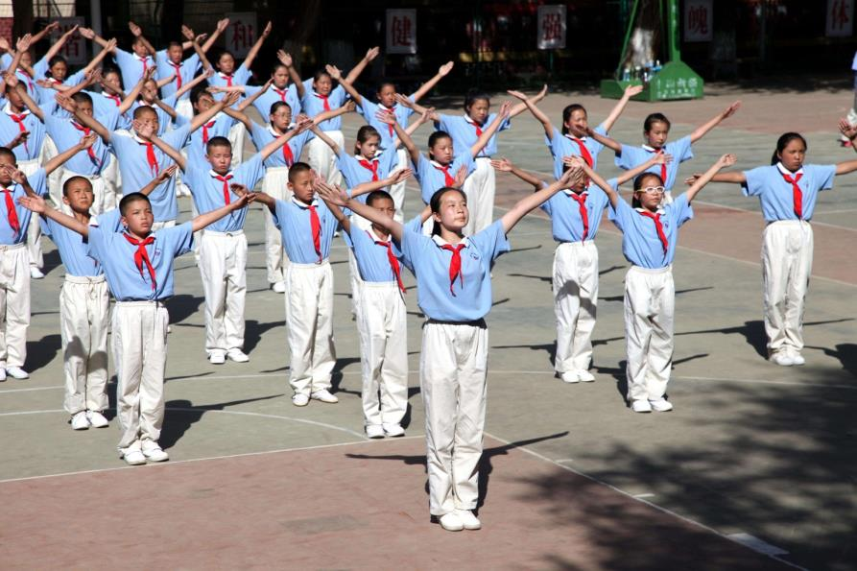
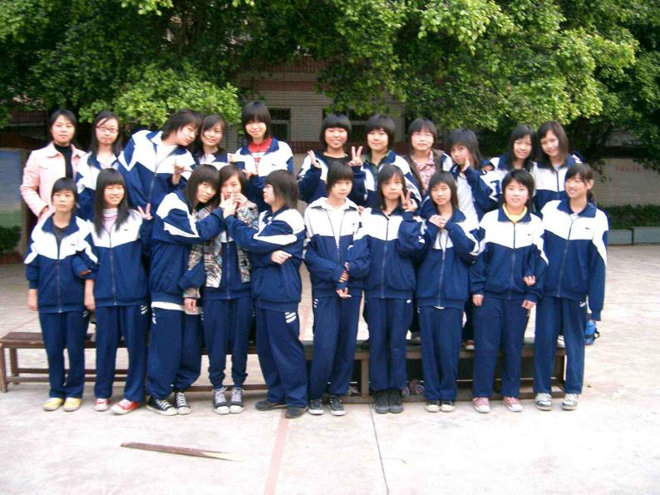
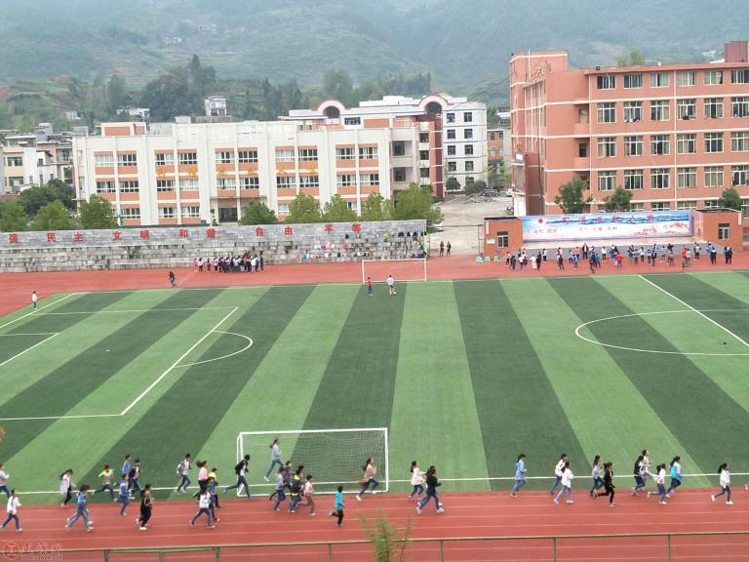
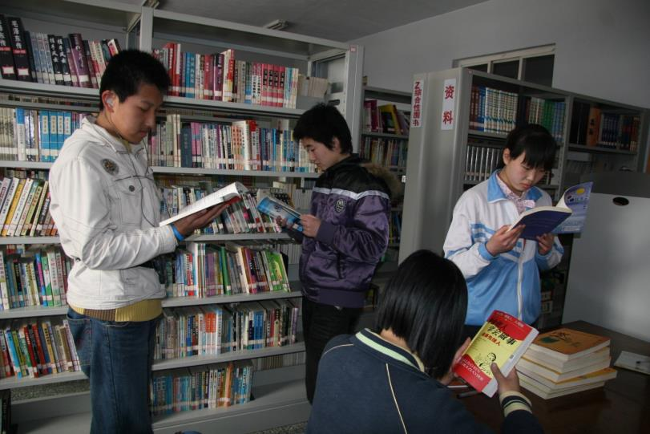
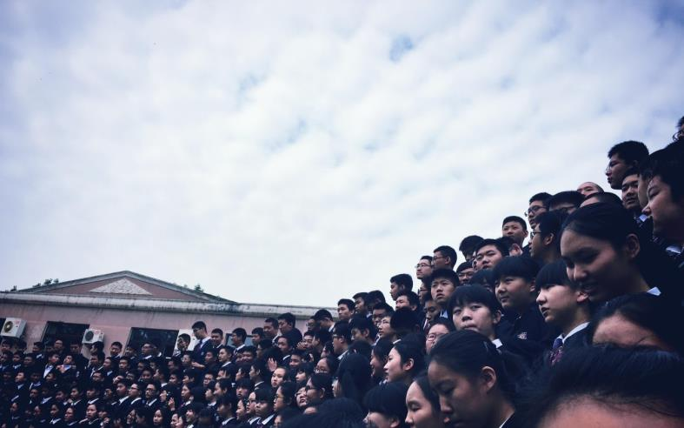
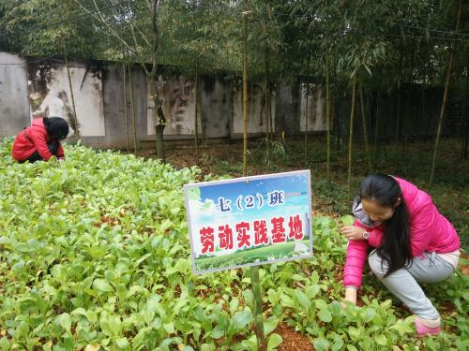
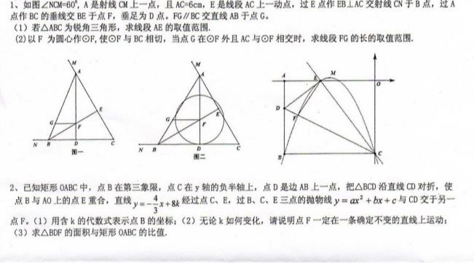
How did you do in junior
high school?
What is your most unforgettable memory in
junior high school?

Slide 4
making friends
helping with
homework
I Remember
Imagine what activities the writer can remember about his or her life in junior high.
morning readings
preparing for
art festivals
kind and caring
teachers
learning
a language
school trees
and flowers

Slide 5
3a
Read the passage and answer the questions.
1. What kind of writing is this?
This is a poem.
2. What is the main subject of this writing?
The main subject is the writer’s memories of school over the last three years.
3. Who do you think the writer is?
The writer is the student who is just about to graduate.

Slide 6
I Remember
Looking back at these past three years
I remember many things
Trying to be on time for morning readings Running when the lunch bell rings
准时做……

Slide 7
I remember the excitement
Of the school sports day each year
The many long hours of training
Pride of overcoming fear
克服恐惧的自豪

Slide 8
I remember starting day one
The shyest in my whole class
Never speaking to anyone
And thinking I would not pass

Slide 9
Then slowly I made some new friends
To remember forever
Helping each other with homework
Getting better together

Slide 10
Preparing for art festivals
And making a great big mess
Having fun at New Year’s parties
Wishing everyone the best
弄得一塌
糊涂

Slide 11
We have learned a different language
That is from a foreign land
English brings many challenges
We work hard to understand

Slide 12
And now it’s time to graduate
We will leave our lovely school
I can’t believe it’s been three years
I’m trying to keep my cool
到该做……的时候

Slide 13
But it’s difficult not to cry
I’ll miss the school trees and flowers
And our kind and caring teachers
Wonderful memories of ours

Slide 14
1. Scan the poem and tell the stanzas that can match the main idea.
Stanzas
Main ideas
Stanzas
1–6
Experiences or memories about the past:
Feelings about having to leave:
7, 8

Slide 15
2. Scan the poem(7-8 stanzas) and answer the following questions.
(1) How does the writer feel about leaving the school?
He/she wants to cry.
(2) What will the writer miss?
The school trees and flowers, and kind and caring teachers.

Slide 16
Read the poem again. Write the words that rhyme with the words below.
3b
things
rings
land
understand
_________
year
fear
school
cool
______
______
class
______
flowers
teachers
pass
________

Slide 17
Have you experienced any of the following things? How did you feel? How does the writer feel about them?
3c
1.trying to be on time for morning readings
2.running to the dining hall when the lunch bell rings
3.training for sports day

Slide 18
4.starting the first day in Grade 7
5.slowly making some new friends
6.helping classmates with homework
7.preparing for art festivals
8.going to New Year’s parties
9.learning English

Slide 19
Check answer
1.It was a struggle to be on time for morning readings.
2.They were hungry so they rushed to the dining
hall when the bell rang.
3.They were excited about training and proud when they overcome their fears.
4.He /She was shy when starting his/her first day in Grade 7.
5.He /She felt a little hard to made friends.

Slide 20
6.He /She was happy to help classmates with homework.
7.They enjoyed preparing for art festivals and making
a great big mess.
8.They had fun at New Year’s parties.
9.There were many challenges and they had to work
hard to understand.

Slide 21
Language points
1. Preparing for art festivals
prepare 为不及物动词，相关短语：
prepare for sth. 意为“为某事做准备”
prepare to do sth. 意为“准备做某事”
例：学生们正忙着准备考试。
The students are busy preparing for the exam.

Slide 22
2. And now it’s time to graduate
(1)it’s time (for sb.) to do sth.
该是（某人）做某事的时候了。
例:该去上学了。
该是你打扫教室的时候了。
It’s time for you to clean the classroom.
It’s time to go to school.

Slide 23
(2)it’s time for sth. 该是(做)……的时候了。
如: 同学们，该上课了。
Boys and girls, it’s time for class.

Slide 24
Grammar Focus
What happened in Grade 7 that was special? | Our team won the school basketball competition.
How have you changed since you started junior high school? | I've become much better at speaking English.
How do you think things will be different in senior high school? | I think that I’ll have to study much harder for exams.

Slide 25
What are your plans for next year? | I'm going to join the school volleyball team.
What do you remember about Grade 8? | I remember being a volunteer.
What did you use to do that you don't do now? | I used to take dance lessons, but I don’t anymore.
What are you looking forward to? | I'm looking forward to going to senior high school.

Slide 26
Language points
一、特殊疑问句
1.概念：由特殊疑问代词或疑问副词引导的疑问句叫特殊疑问句。
疑问代词
who, whom, whose, which, what
疑问副词
when, where, why, how

Slide 27
2.用法：
倒装结构
疑问词+一般疑问句（语序）
陈述语序
疑问词+谓语+其他
例：昨天你去哪儿了？
Where did you go yesterday?
例：谁想帮我？
Who wants to help me?

Slide 28
时态 | 定义
经常、反复发生的动作或行为及现在的某种状况。
一般现在时
表示过去某个时间里发生的动作或存在的状态。
一般过去时
表示将要发生的动作或存在的状态及打算、计划或准备做某事。
一般将来时

Slide 29
时态 | 构成
一般现在时
主语+ 动词原形
主语+was/ were+其他.
主语+实义动词的过去式+其他.
一般过去时
be(is ,am, are) going to do；
will/shall do
一般将来时

Slide 30
时态 | 标志词
always, usually, often, sometimes,
every week (day, year, month...)
一般现在时
一般过去时
yesterday, last week, two months ago, the day before yesterday
tomorrow next day (week, month,
year), the day after tomorrow,
一般将来时

Slide 31
4a
Number the sentences to make a paragraph.
___ When I get to senior high, I will join the school
swim team.
1 My time in junior high school has been enjoyable.
___ In Grade 8, I studied harder but I still got poor
grades in English. I had problems with
pronunciation and reading texts. So the next year,
I worked much harder and got better grades.
6
3

Slide 32
感叹句
_____Next year, I will be in senior high school. I can’t
believe how fast the time went by!
_____This year, with Mr. Trent’s help, my English
level has been improving and I hope to get
good grades at the end of the year.
_____In the first year, I didn’t work very hard in class,
but I joined many different school clubs and had
a lot of fun.
5
4
现在完成进行时
2

Slide 33
Language points
1.I had problems with pronunciation and ...
have problems with sth. 做某事有困难
= have problems (in) doing sth.
例句：他在做家庭作业方面有困难。
He has problems with his homework.
He has problems in doing his homework.

Slide 34
表示“做某事有困难”的句式还有：
have difficulty /trouble with sth.
have difficulty/trouble (in) doing sth.
前面可用some/great/no/little等词修饰，表示有些/很大/没有/没什么困难”。
例： 她做那项任务毫无困难.
She has no trouble with that task.

Slide 35
2. I can’t believe how fast the time went by!
感叹句
感叹句是表达喜、怒、哀、乐以及惊奇、惊讶等强烈感情的句子，感叹句通常由what或how引导。

Slide 36
由what引导的感叹句句式：
(1) What + (a / an) + 形容词 + 名词(+主语+谓语)！
例：那是一部多么有趣的电影啊。
What an interesting film it is!
今天天气多好啊！
What fine weather it is today!

Slide 37
由how引导的感叹句句式：
(1) How + 形容词 / 副词 + 主语+谓语！
例：她是多么细心啊！
How careful she is!
(2) How + 主语 + 谓语！
例：时光飞逝！
How time flies!

Slide 38
4b
Write your own answers to the questions.
1. What do you remember about Grade 7?
2. What happened in Grade 8 that was special?
I remember being friends with Jack in Grade 7.
I learned to play the piano.

Slide 39
3. What did you use to do that you don't do now?
4. How have you changed since you started junior
high school?
5. How do you think things will be different in
senior high school?
I used to fly kites but I don’t do it now.
I become much more outgoing/happy/hard-working...
May be there will be a lot of difficulties...

Slide 40
6. What are your plans for next year?
7. What are you looking forward to?
I will go to Peking ...
I’m looking forward to learning English well.

Slide 41
Exercise
1. It’s time _____ supper.
A. to B. for C. in D. by
B
D
2. I have problems _____ my homework.
A. to B. for C. in D. with
3. — Jane Zhang is going to hold a concert here in July.
— Really? _____ exciting news!
A. How B. What an C. What
B

