Slide 1
NEW YEAR
Synergistically utilize technically sound portals with frictionless chains. Dramatically customize empowered

Slide 2
01
Synergistically utilize technically sound portals , Synergistically
Synergistically utilize technically sound portals , Synergistically
02
03
Synergistically utilize technically sound portals , Synergistically
Synergistically utilize technically sound portals , Synergistically
04
05
Synergistically utilize technically sound portals , Synergistically
Synergistically utilize technically sound portals , Synergistically
06

Slide 3
NEW YEAR
Part one
Synergistically utilize technically sound portals with frictionless chains. Dramatically customize empowered

Slide 4
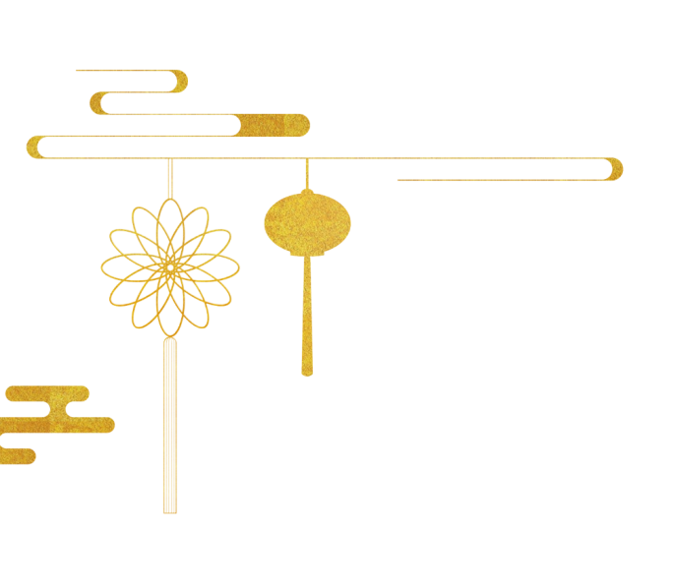
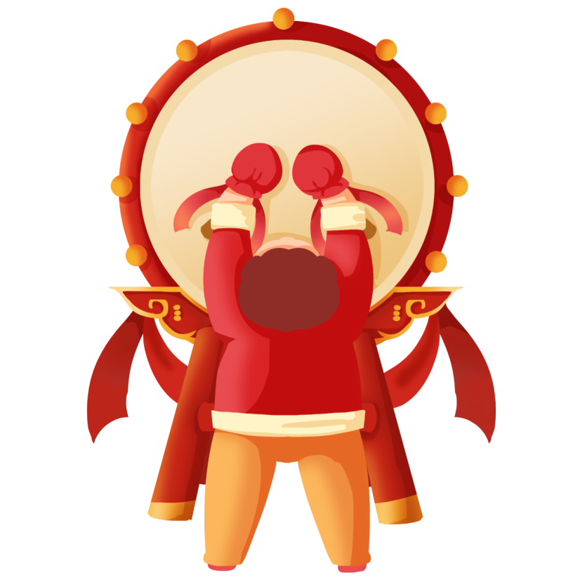
1
Synergistically utilize technically sound portals with frictionless chainsSynergistically，Synergistically utilize，Synergistically utilize technically sound portals with
2
Synergistically utilize technically sound portals with frictionless chainsSynergistically，Synergistically utilize，Synergistically utilize technically sound portals with
3
Synergistically utilize technically sound portals with frictionless chainsSynergistically，Synergistically utilize，Synergistically utilize technically sound portals with
4
Synergistically utilize technically sound portals with frictionless chainsSynergistically，Synergistically utilize，Synergistically utilize technically sound portals with

Slide 5
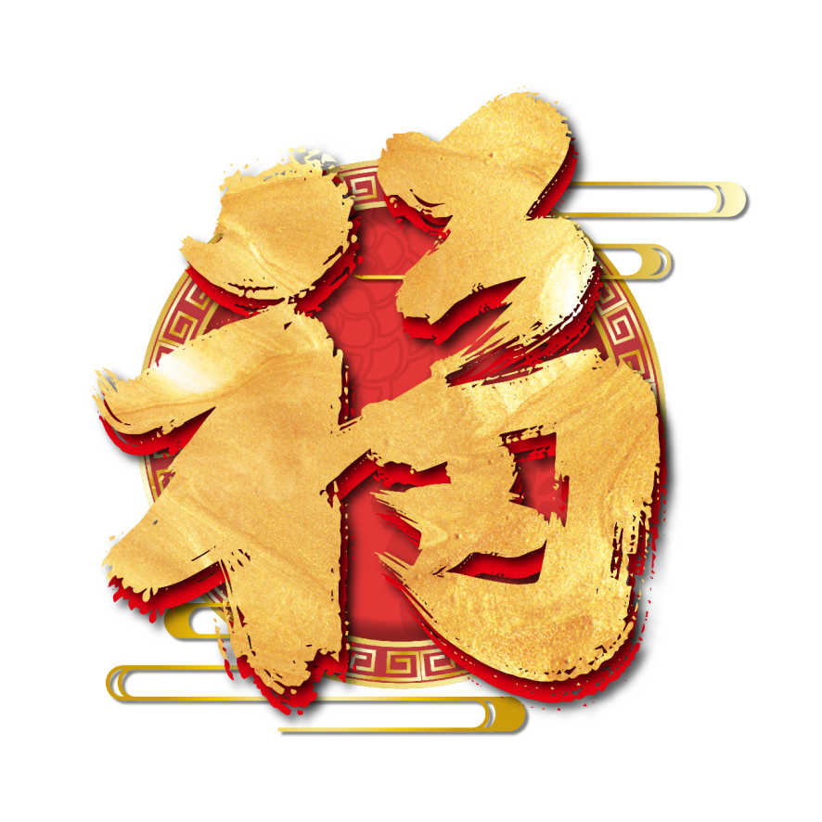
Synergistically utilize technically sound portals with frictionless chainsSynergistically，Synergistically utilize, Synergistically
Synergistically utilize technically sound portals with frictionless chainsSynergistically，Synergistically utilize, Synergistically
Synergistically utilize technically sound portals with frictionless chainsSynergistically，Synergistically utilize, Synergistically
Synergistically utilize technically sound portals with frictionless chainsSynergistically，Synergistically utilize, Synergistically

Slide 6
Synergistically utilize technically sound portals with frictionless chainsSynergistically，Synergistically utilize, Synergistically
Synergistically utilize technically sound portals with frictionless chainsSynergistically，Synergistically utilize, Synergistically
Synergistically utilize technically sound portals with frictionless chainsSynergistically，Synergistically utilize, Synergistically

Slide 7
1
2
3
Synergistically utilize technically sound portals with frictionless chainsSynergistically，Synergistically utilize
Synergistically utilize technically sound portals with frictionless chainsSynergistically，Synergistically utilize
Synergistically utilize technically sound portals with frictionless chainsSynergistically，Synergistically utilize
4
5
6
Synergistically utilize technically sound portals with frictionless chainsSynergistically，Synergistically utilize
Synergistically utilize technically sound portals with frictionless chainsSynergistically，Synergistically utilize
Synergistically utilize technically sound portals with frictionless chainsSynergistically，Synergistically utilize

Slide 8
NEW YEAR
Part two
Synergistically utilize technically sound portals with frictionless chains. Dramatically customize empowered

Slide 9
新年
Synergistically utilize technically sound portals with frictionless chainsSynergistically，Synergistically utilize, Synergistically utilize technically sound
Synergistically utilize technically sound portals with frictionless chainsSynergistically，Synergistically utilize, Synergistically utilize technically sound
Synergistically utilize technically sound portals with frictionless chainsSynergistically，Synergistically utilize, Synergistically utilize technically sound

Slide 10
Synergistically utilize technically sound portals with frictionless chainsSynergistically
Synergistically utilize technically sound portals with frictionless chainsSynergistically
Synergistically utilize technically sound portals with frictionless chainsSynergistically
1PPT.COM
1PPT.COM
1PPT.COM
Synergistically utilize technically sound portals with frictionless chainsSynergistically
Synergistically utilize technically sound portals with frictionless chainsSynergistically
Synergistically utilize technically sound portals with frictionless chainsSynergistically
1PPT.COM
1PPT.COM
1PPT.COM

Slide 11
Synergistically utilize technically sound portals with frictionless chainsSynergistically，Synergistically with
Synergistically utilize technically sound portals with frictionless chainsSynergistically，Synergistically with
Synergistically utilize technically sound portals with frictionless chainsSynergistically，Synergistically with
Synergistically utilize technically sound portals with frictionless chainsSynergistically，Synergistically with

Slide 12
2 0XX
2 0XX
2 0XX
2 0XX
Synergistically utilize technically sound portals with frictionless chainsSynergistically，Synergistically utilize, Synergistically
Synergistically utilize technically sound portals with frictionless chainsSynergistically，Synergistically utilize, Synergistically
Synergistically utilize technically sound portals with frictionless chainsSynergistically，Synergistically utilize, Synergistically
Synergistically utilize technically sound portals with frictionless chainsSynergistically，Synergistically utilize, Synergistically

Slide 13
NEW YEAR
Part three
Synergistically utilize technically sound portals with frictionless chains. Dramatically customize empowered

Slide 14
1PPT.COM
1PPT.COM
Synergistically utilize technically sound portals with frictionless chainsSynergistically，Synergistically utilize, Synergistically utilize technically sound portals with frictionless
Synergistically utilize technically sound portals with frictionless chainsSynergistically，Synergistically utilize, Synergistically utilize technically sound portals with frictionless
Synergistically utilize technically sound portals with frictionless chainsSynergistically，Synergistically utilize, Synergistically utilize technically sound portals with frictionless
Synergistically utilize technically sound portals with frictionless chainsSynergistically，Synergistically utilize, Synergistically utilize technically sound portals with frictionless

Slide 15
Synergistically utilize technically sound portals with frictionless chainsSynergistically，Synergistically utilize, Synergistically utilize technically sound portals with frictionless chainsSynergistically，Synergistically utilize, Synergistically utilize technically
Synergistically utilize technically sound portals with frictionless chainsSynergistically，Synergistically utilize, Synergistically utilize technically sound portals with frictionless chainsSynergistically，Synergistically utilize, Synergistically utilize technically
Synergistically utilize technically sound portals with frictionless chainsSynergistically，Synergistically utilize, Synergistically utilize technically sound portals with frictionless chainsSynergistically，Synergistically utilize, Synergistically utilize technically

Slide 16
NEW YEAR
Part four
Synergistically utilize technically sound portals with frictionless chains. Dramatically customize empowered

Slide 17
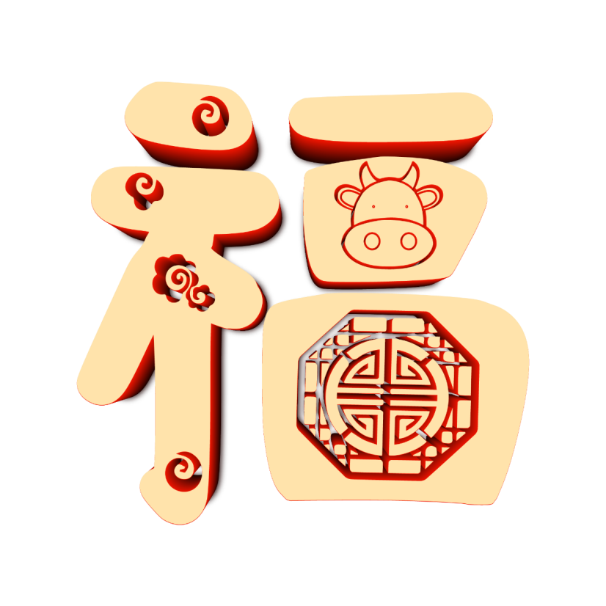
Synergistically utilize technically sound portals with frictionless chainsSynergistically，Synergistically utilize, Synergistically utilize technically sound portals with frictionless chainsSynergistically，Synergistically utilize, Synergistically utilize technically
Synergistically utilize technically sound portals with frictionless chainsSynergistically，Synergistically utilize, Synergistically utilize technically sound portals with frictionless chainsSynergistically，Synergistically utilize, Synergistically utilize technically
Synergistically utilize technically sound portals with frictionless chainsSynergistically，Synergistically utilize, Synergistically utilize technically sound portals with frictionless chainsSynergistically，Synergistically utilize, Synergistically utilize technically

Slide 18
Synergistically utilize technically sound portals with frictionless chainsSynergistically，
Synergistically utilize technically sound portals with frictionless chainsSynergistically，
Synergistically utilize technically sound portals with frictionless chainsSynergistically，
Synergistically utilize technically sound portals with frictionless chainsSynergistically，
Synergistically utilize technically sound portals with frictionless chainsSynergistically，
Synergistically utilize technically sound portals with frictionless chainsSynergistically，

Slide 19
NEW YEAR
Part five
Synergistically utilize technically sound portals with frictionless chains. Dramatically customize empowered

Slide 20
1
Synergistically utilize technically sound portals with frictionless chainsSynergistically，Synergistically utilize，Synergistically utilize technically sound portals with frictionless chainsSynergistically，Synergistically utilize
2
Synergistically utilize technically sound portals with frictionless chainsSynergistically，Synergistically utilize，Synergistically utilize technically sound portals with frictionless chainsSynergistically，Synergistically utilize

Slide 21
Synergistically utilize technically sound portals with frictionless chainsSynergistically，Synergistically utilize
新年好
0 1
Synergistically utilize technically sound portals with frictionless chainsSynergistically，Synergistically utilize, Synergistically utilize
0 2
Synergistically utilize technically sound portals with frictionless chainsSynergistically，Synergistically utilize, Synergistically utilize
0 3
Synergistically utilize technically sound portals with frictionless chainsSynergistically，Synergistically utilize, Synergistically utilize

Slide 22
NEW YEAR
Part six
Synergistically utilize technically sound portals with frictionless chains. Dramatically customize empowered

Slide 23
Synergistically utilize technically sound portals with frictionless chainsSynergistically，Synergistically utilize, Synergistically
Synergistically utilize technically sound portals with frictionless chainsSynergistically，Synergistically utilize, Synergistically
Synergistically utilize technically sound portals with frictionless chainsSynergistically，Synergistically utilize, Synergistically
Synergistically utilize technically sound portals with frictionless chainsSynergistically，Synergistically utilize, Synergistically

Slide 24
Synergistically utilize technically sound portals with frictionless chainsSynergistically，Synergistically with
Synergistically utilize technically sound portals with frictionless chainsSynergistically，Synergistically with
Synergistically utilize technically sound portals with frictionless chainsSynergistically，Synergistically with
Synergistically utilize technically sound portals with frictionless chainsSynergistically，Synergistically with
Synergistically utilize technically sound portals with frictionless chainsSynergistically，Synergistically with

Slide 25
NEW YEAR
Thank you
Synergistically utilize technically sound portals with frictionless chains. Dramatically customize empowered

