Slide 1
Unit3 Is It Snowing?
陕旅版
四年级下册
第二课时
WWW.PPT818.COM

Slide 2
>>Review
Magic fingers
rain snow cloud sky
wind raincoat glasses

Slide 3
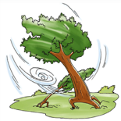
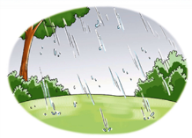
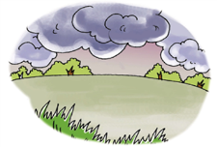
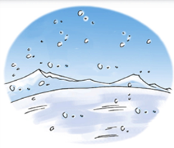
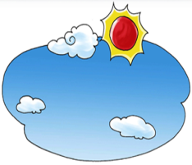
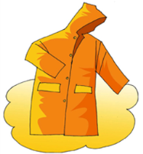
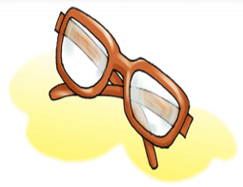
>>Review
What’s missing?

Slide 4
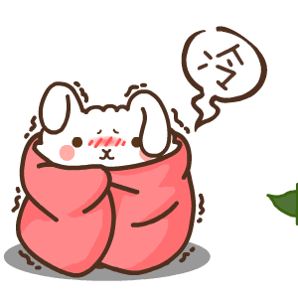
>>Warm-up
Free talk
Oh, I’m very cold.
I need a coat.
Do you have a coat?

Slide 5
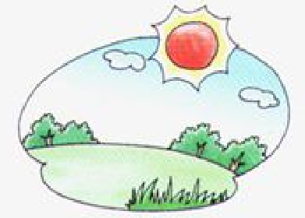
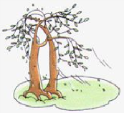
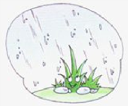
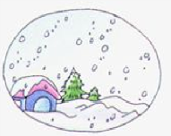
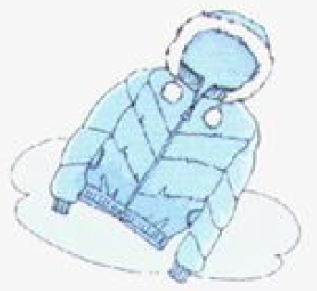
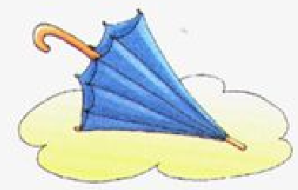
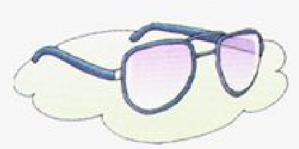
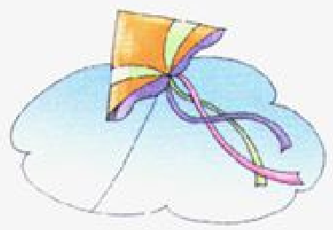
>>Lead-in
Think and match
What do you need?

Slide 6
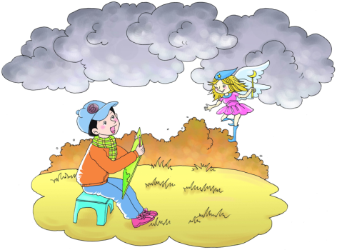
>>Presentation
Ask and answer
Is it snowing?
No, it isn’t. But there are many clouds.

Slide 7
>>Presentation
Look at the clouds in the sky. Let’s go home.
OK.

Slide 8
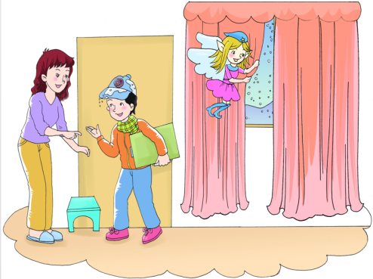
>>Presentation
Ask and answer
Is it snowing now?
Yes, it is.

Slide 9
>>Presentation
Is it snowing, dear?
Look, how beautiful!
Yes, it is.

Slide 10
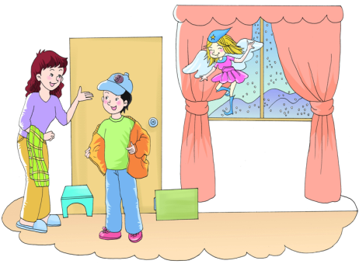
>>Presentation
Ask and answer
Are there any clouds in the sky?
No, there aren’t. There is some snow.

Slide 11
>>Presentation
Is there a wind?
No. It’s snowing. But there’s no wind.

Slide 12
>>Presentation
Let’s talk
Listen and say
Liu: Look at the clouds in the sky.
Let’s go home.
Aggie: OK.
Mom: Is it snowing, dear?
Liu: Yes, it is.
Aggie: Look, how beautiful!
Mom: Is there a wind?
Liu: No. It’s snowing. But there’s no wind.

Slide 13
>>Practice
Show time
小组合作，练习对话并表演，其他同学评价。
 | 模仿录音中的语音语调，有感情地朗读。
 | 可以脱离课本，适当改动其中部分，语音地道。
 | 适当添加内容，意思完整，有创新，表演生动。
good
great
Excellent

Slide 14
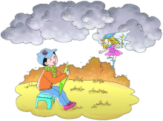
>>Practice
2-3人一组，先朗读再表演课文故事吧。
1
2
3
Read together.
(齐读)
Read in roles.
（分角色读）
Act in roles.
(分角色演）

Slide 15
>>Practice
请将下列句子变成一般疑问句
The dog/It is sleeping.
Is the dog/it sleeping?
The cat/It is eating.
Is the cat/it eating?
变疑问句只需将be动词
提到句首，句尾加问号。

Slide 16
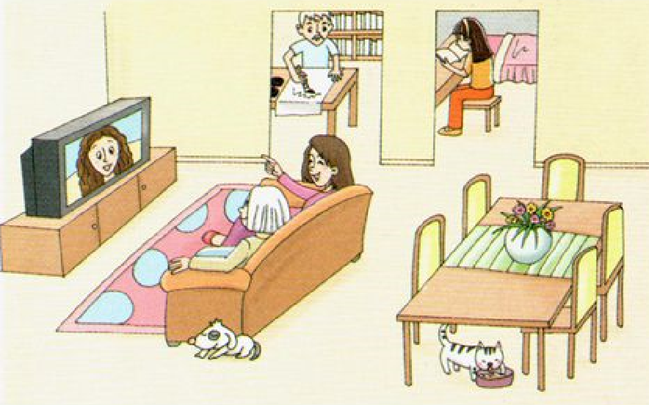
>>Presentation
Look and write
… is/are doing …
Li Shan is reading a book.
Grandpa is writing.
Grandma and Mom are
watching TV.
The dog is sleeping.
The cat is eating.

Slide 17
>>Practice
Look, ask and answer
A: Is he/she ..?
B: Yes, he/she is./
No, he/she isn’t.
A: Are they …?
B:Yes, they are./ No, they aren’t.

Slide 18
>>Practice
请将下列句子变成一般疑问句
Li Shan/She is reading a book.
Is Li Shan/She reading a book?
Grandpa/He is writing.
Is Grandpa/he writing?
Grandma and Mom/They are watching TV.
Are Grandma and Mom/they watching TV?

Slide 19
>>Summary
本课所学现在进行时的一般疑问句？
-Is it raining/snowing?
-Yes, it is./No, it isn’t.
-Is there a wind?
-No. It’s snowing. But there’s
no wind.

Slide 20
>>Homework
1.听课文录音并跟读，按照正确的语音、语调朗读并表演课文对话。 2.用本节课所学的现在进行时句型结构，向自己的家人提问，并操练该句型。
3.预习B Let’s learn more。
close

