Slide 1
精通版英语六年级上册第四单元
《January is the first month》
WWW.PPT818.COM

Slide 2
CONTENTS
导入
知识讲解
课堂练习
小节

Slide 3
Free talk

Slide 4
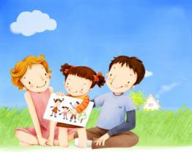
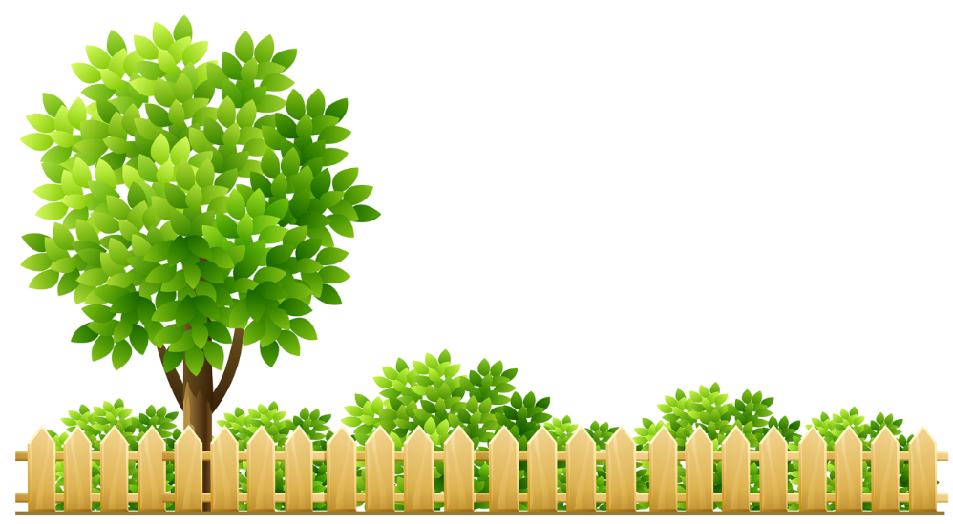
How many days are there in a week?
How many days are there in a year?
How many month names have we learnt?

Slide 5
Look and say
How many months are there in a year?
There are twelve months in a year.

Slide 6
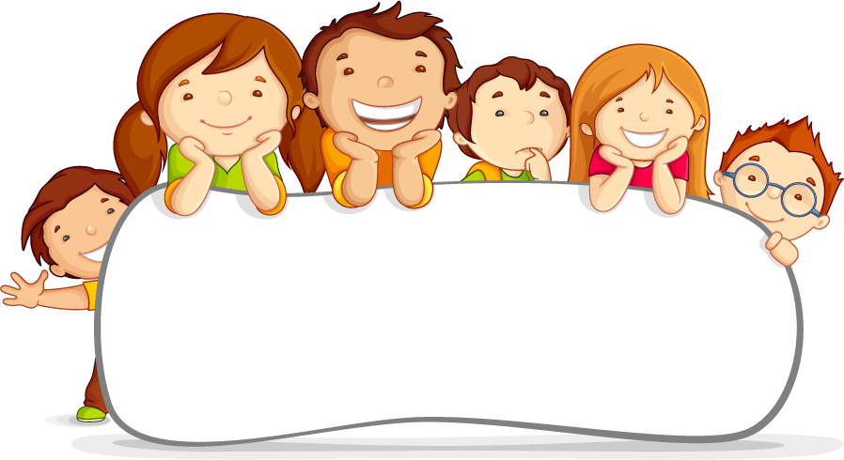
Presentation

Slide 7
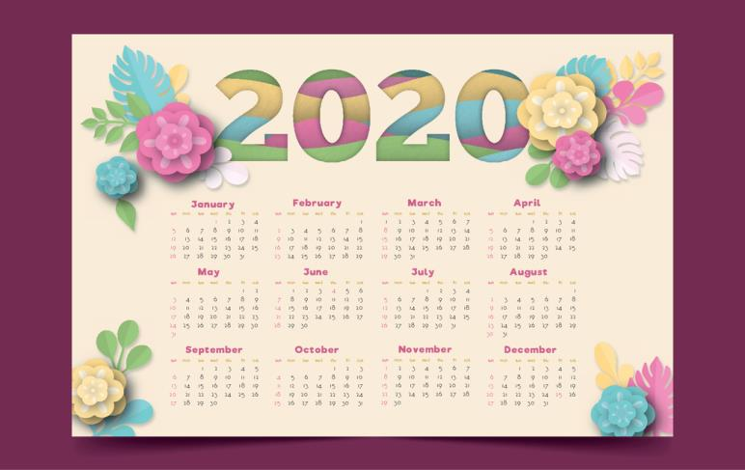
Look and say
January is the first month.
What is the first month of the year?
January

Slide 8
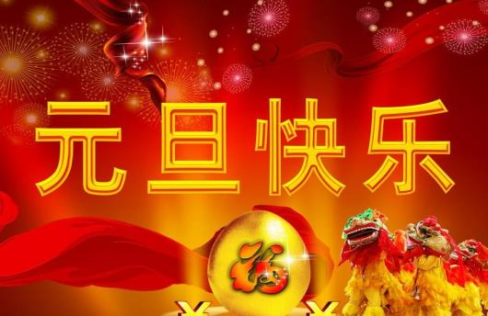
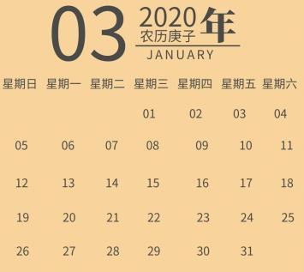
Look and say
The first day,January 1st, is called New Year's Day.
People have a holiday and they celebrate New Year's Day!

Slide 9
Look and say
What is the second month of the year?
February
February is the second month of the year.

Slide 10
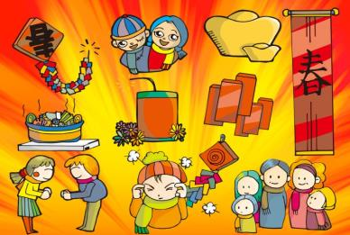
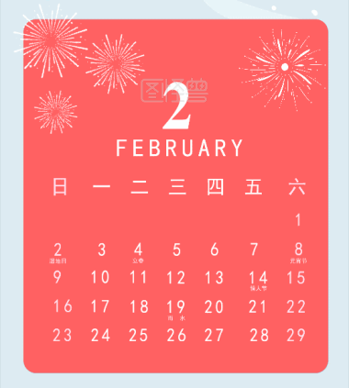
Look and say
In China, Spring Festival is usually in January or February. Now people call it Chinese New Year. For Chinese New Year, all people in China have a holiday. They go back home to celebrate the festival with their families.

Slide 11
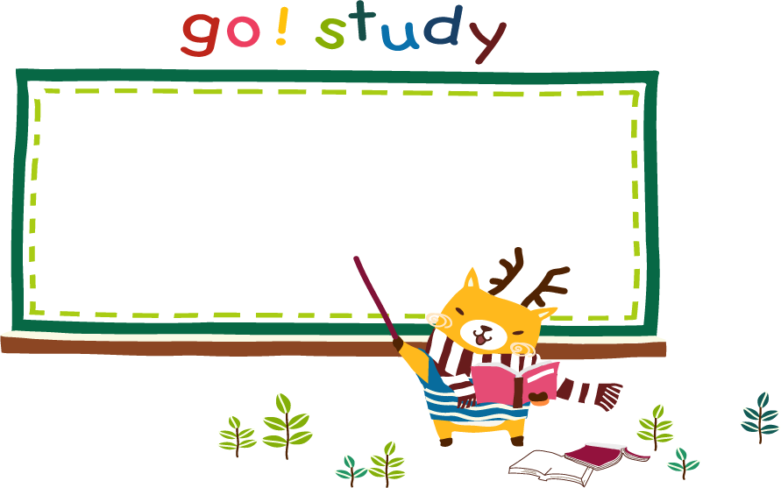
question

Slide 12
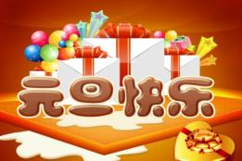
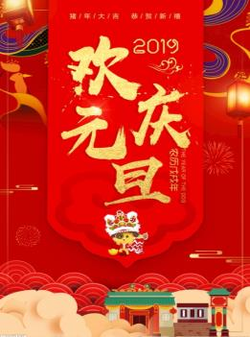
What do people do on New Year's Day?
People have a holiday and they celebrate New Year's Day.

Slide 13
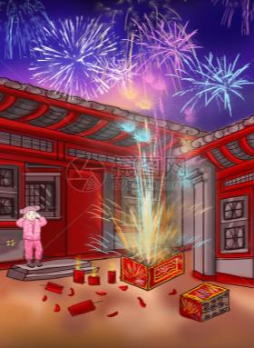
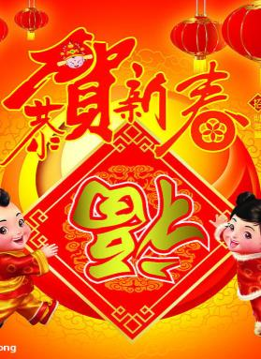
What do people do at Spring Festival?
For Chinese New Year(Spring Festival), all people in China have a holiday. They go back home to celebrate the festival with their families.

Slide 14
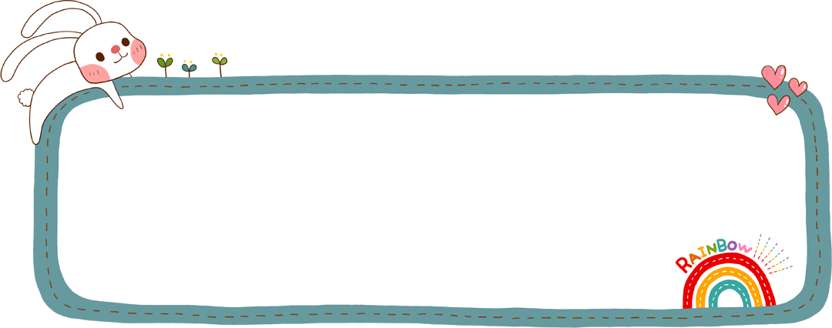
Practice
How many months are there in a year?
What is the first month of the year?
What do people do on New Year' s Day?
What is the second month of the year?
When is Spring Festival?
What do people do at Spring Festival?

Slide 15
summary
How many months are there in a year?
There are twelve months in a year.
What is the first month of the year?January
What is the second month of the year?February
The first day,January 1st, is called New Year's Day.So New Year's Day is on January 1st.People have a holiday and they celebrate New Year's Day!
In China, Spring Festival is usually in January or February. Now people call it Chinese New Year. For Chinese New Year, all people in China have a holiday. They go back home to celebrate the festival with their families.

Slide 16
Homework
1.Look up other months.
2.What are the major holidays in those months? What do people do on these festivals？

Slide 17
Thank you for watching！
Bye！

